Slide 1
Outlook

Slide 2

That’s about it …

Slide 3
The course
Introduction
01_Disciplines / key terminology
03_Sustainability communication as field of research
Course Overview & Introduction (plus: inofficial intro)
4 episodes
4 episodes
05_Communication of Sustainability
06_Communication about Sustainability
07_Communication for Sustainabiity
08_Outlook
4 episodes
4 episodes
4 episodes
9_Dialogue: Employability / research perspectives
02_Theories & perspectives
4 episodes
Dialogues
1 episode (plus: inofficial outro)
04_Dialogue: Social Change
Dialogue

Slide 4
Learning outcomes
Learning outcome 1:
Describe the diverse nature of contemporary practices of sustainability communication on an individual, organizational and societal level, the relationship of strategic communication practices to other public communication practices, the role of stakeholders and publics and the communication practitioners in and outside of organizations (corporate, NGO, political and educational institutions etc.)
Learning outcome 2:
Develop comprehensive and well-founded knowledge in sustainability communication as field of study, an understanding of how other disciplines relate to the field and an international perspective on the field.
Learning outcome 3:
Understand the key elements of communication theories, strategies and tactics, and, thus, the character and operationalization of best practice sustainability communication planning frameworks.
Learning outcome 4:
Advance your understanding of social and civic responsibility and develop an appreciation of the philosophical and social context of sustainability communication. Advance your knowledge and respect of ethics and ethical standards in relation to communication of, about and for sustainability.
Learning outcome 5:
Anticipate and Interpret current issues and challenges of a world in transformation and social change. Develop a deep understanding of and skills to create change, develop advocacy, leadership and authorship in and for sustainability communication.
Notes:
The main idea is .. that you will be able to....

Slide 5
“Sustainability Communication”
Sustainability is a principle of action, a moral compass that guides individual and organizational behavior – with the potential to become a universal value of our society (Weder, 2022)
Notes:
To summarize

Slide 6
“Sustainability Communication”
Sustainability is a principle of action, a moral compass that guides individual and organizational behavior – with the potential to become a universal value of our society (Weder, 2022)
Sustainability is directly connected with communication (Weder et al., 2021; Michelsen 2007: 25; see also Burgess, Harrison et al. 1998; Agyeman 2007; Killingsworth 2007; Plec 2007; Brulle 2010; Monani 2011; Tinnell 2011)
Notes:
To summarize

Slide 7
“Sustainability Communication”
Sustainability is a principle of action, a moral compass that guides individual and organizational behavior – with the potential to become a universal value of our society (Weder, 2022)
Sustainability is directly connected with communication (Weder et al., 2021; Michelsen 2007: 25; see also Burgess, Harrison et al. 1998; Agyeman 2007; Killingsworth 2007; Plec 2007; Brulle 2010; Monani 2011; Tinnell 2011)
Sustainability communication: critically evaluate and introduce an understanding of the human-environment relationship into social discourse (Godemann & Michelsen, 2011, Weder et al., 2021)
Notes:
To summarize

Slide 8
“Sustainability Communication”
Sustainability is a principle of action, a moral compass that guides individual and organizational behavior – with the potential to become a universal value of our society (Weder, 2022)
Sustainability is directly connected with communication (Weder et al., 2021; Michelsen 2007: 25; see also Burgess, Harrison et al. 1998; Agyeman 2007; Killingsworth 2007; Plec 2007; Brulle 2010; Monani 2011; Tinnell 2011)
Sustainability communication: critically evaluate and introduce an understanding of the human-environment relationship into social discourse (Godemann & Michelsen, 2011, Weder et al., 2021)
Sustainability & Communication comprises:
  Communication of sustainability
  Communication about sustainability
  Communication for sustainability
Notes:
To summarize

Slide 9
“Sustainability Communication”
Communication of Sustainability
S. as alternative within capitalism, conservation, compensation, sustainble growth
Communication about Sustainability
S. as revolution, restoration and regenerative practices; new ecological identities, cultural change, innovation
Communication for Sustainability
S. as alterantive to capitalism, abandonment, abstention, degrowth, restrictions
Notes:
Sustainability communication includes all three dimensions – and narratives (vorlesen)
… however, again: not all three narratives are easy to communicate – public / current media society / media culture

Slide 10


D. Discursive construction of a “new norm”
Dissemination
Communication of Sustainability
Findings, information, knowledge
Dialogue
Communication about Sustainability
Use: Questioning, opinion, discussion
Participation
Communication for Sustainability
Communication as defence, promotion, popularization, outreach
Use: Informtion, awareness, learning
Issues, applications, implications, knowledge
Communication as engagement, consultation, interaction
Process, interpretation, (re)construction of knwoledge, meaning-making, value creation
Use: sharing, creating, critique, enjoyment
Communication as deliberation, chat, play, co-creation, film, art, fiction
Purposive, hierarchical, formal
Non-purposive, particpatory, informal, dialectic, co-constructed
Icon made by Raj Dev from www.freeicons.io
Notes:
Communication for Sustainability as social conversation around sustainability

Slide 11
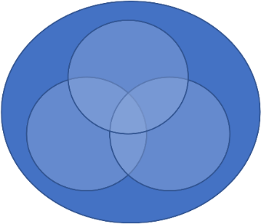
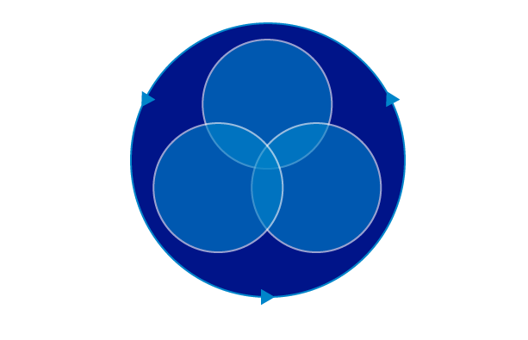
D. Discursive construction of a “new norm”
Questioning
(civil society, universities)
Stabilization
(corporates, pol. institutions, NGOs)
Notes:
There is MUCH more potential to better understand culture as constantly changing process – covering all dimensions of sustainability; it’s change becomes the key concern or paradigm of sustainability, when we INCLUDE the dialectic. The dialectic between the stabilization – and the process of questioning the cultivated patterns, behaviors and “new” norms, the process of acknolweding “normalization” of sustainabilty – but by the same time to put it into question –
which is where
1. new research programs emerge (i.e. … ) and
2. civil society, but as well Universities come into play. …

Slide 12
Potential research topics
Visual Sustainability Communication: How do images of the future look like? How does a sustainable future look like?
Think global, report local: Sustainability communication in local media and community groups
Communicator networks: Who are the key figures in sustainability communication? Why do we need new communicator roles?
Communication spaces: What are conversations spaces where sustainability is problematized, negotiated and – more generally - communicated about?

Slide 13
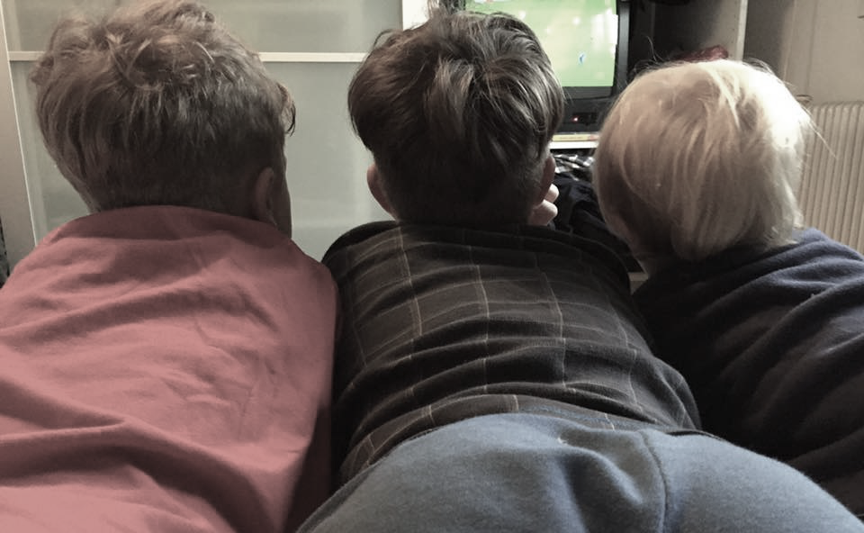
Sustainability in the media
Quelle: http://blog.teamtreehouse.com/wp-content/uploads/2012/08/apps.png
Source: private
Notes:
Conversational spaces?
What role do the media play? Where are these conversational spaces? The communication areans?
Who‘s talking – audiences?

Slide 14
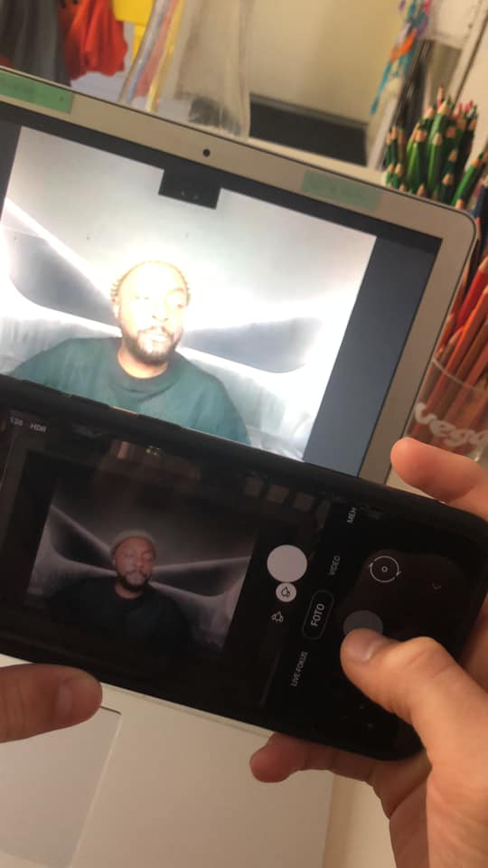
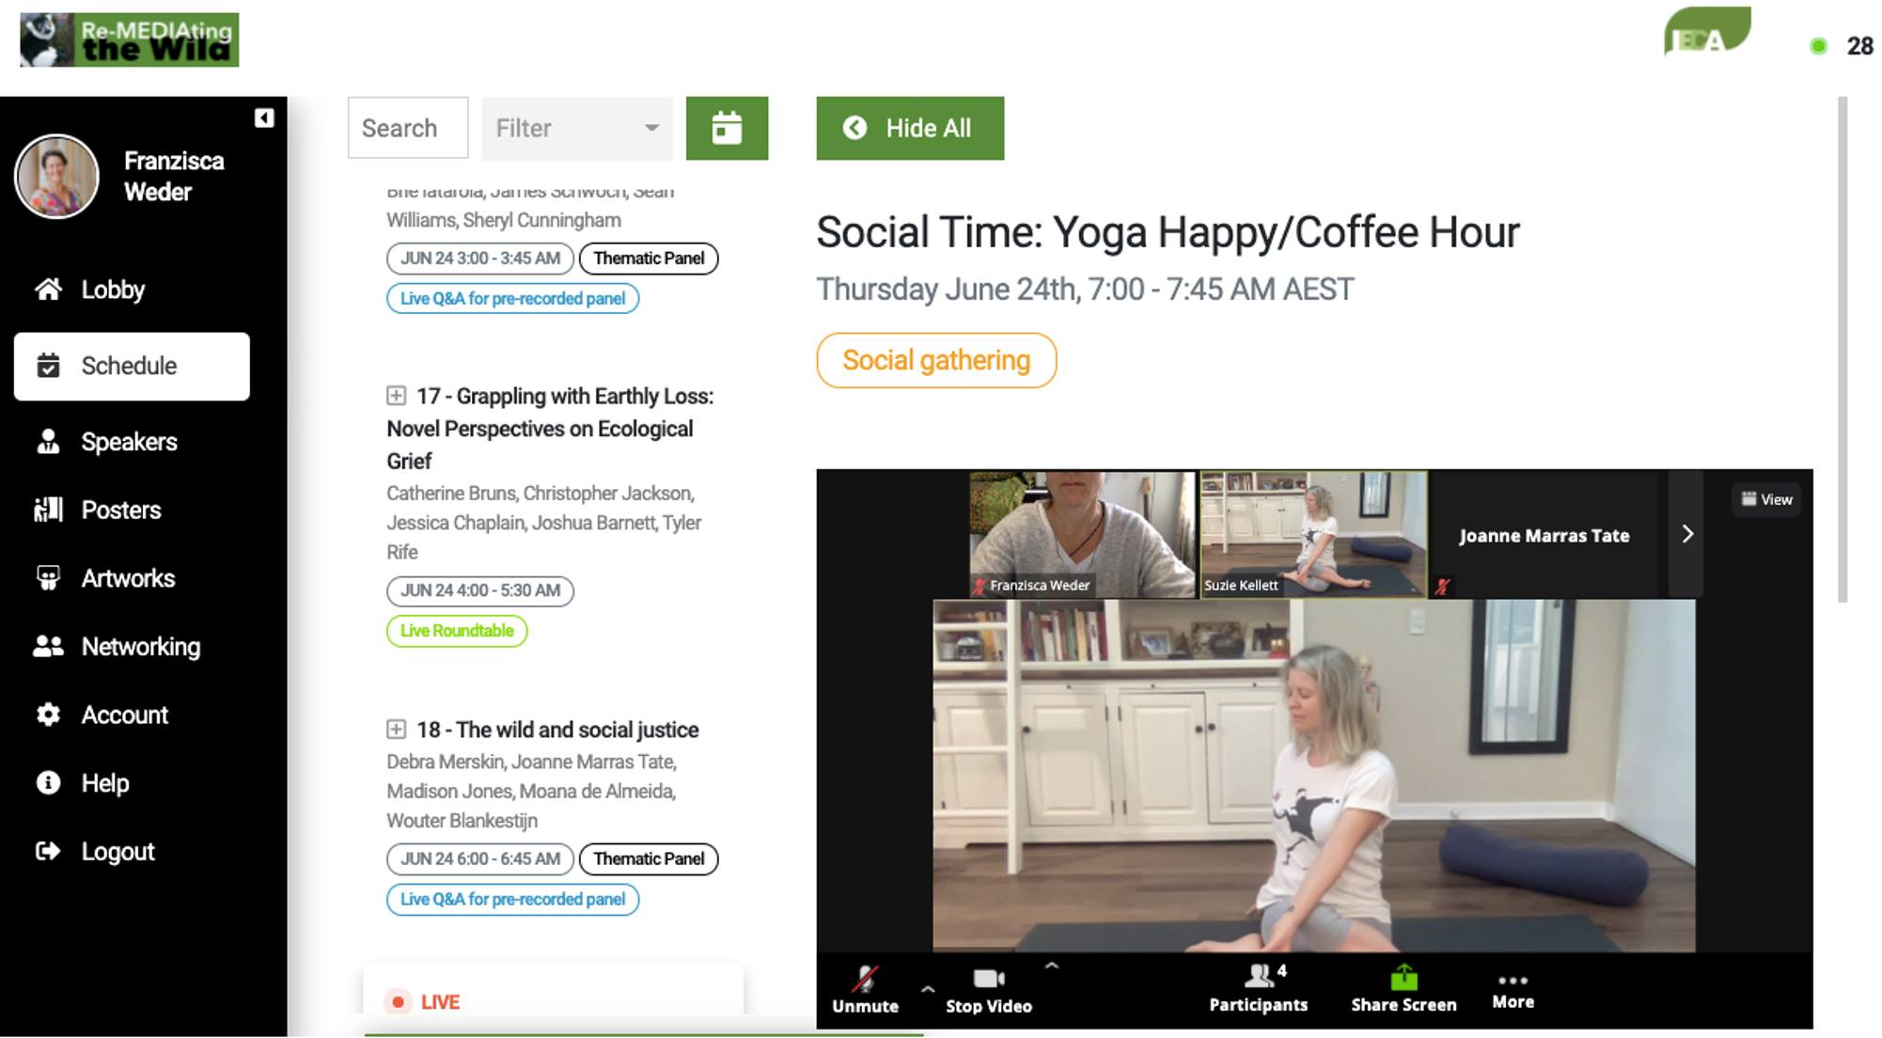
Sustainability in the media
Sense making via social media
… so are you seriously vegan, if you don’t post it on Instagram?
Source: private
Notes:
What about social media?
How can consensus, but also acceptance, for eample for reneable energy be created via social media ?

Slide 15
Sustainability and communication
And further questions like…
communication of an inconvenient truth
contradictions around “green advertisements”
economic interest of corporations and the concept of sustainability – CSR & Sustainability Communication
local, regional and national interests do not always match global phenomena, strategies and solutions needed – what about local business and sustainability?
What about the role of media corporations? What is their responsibility?
What about communicator ethics? Responsibilities of individuals communicating about climate change, crises and sustainability?
Notes:
The challenges are:

Slide 16
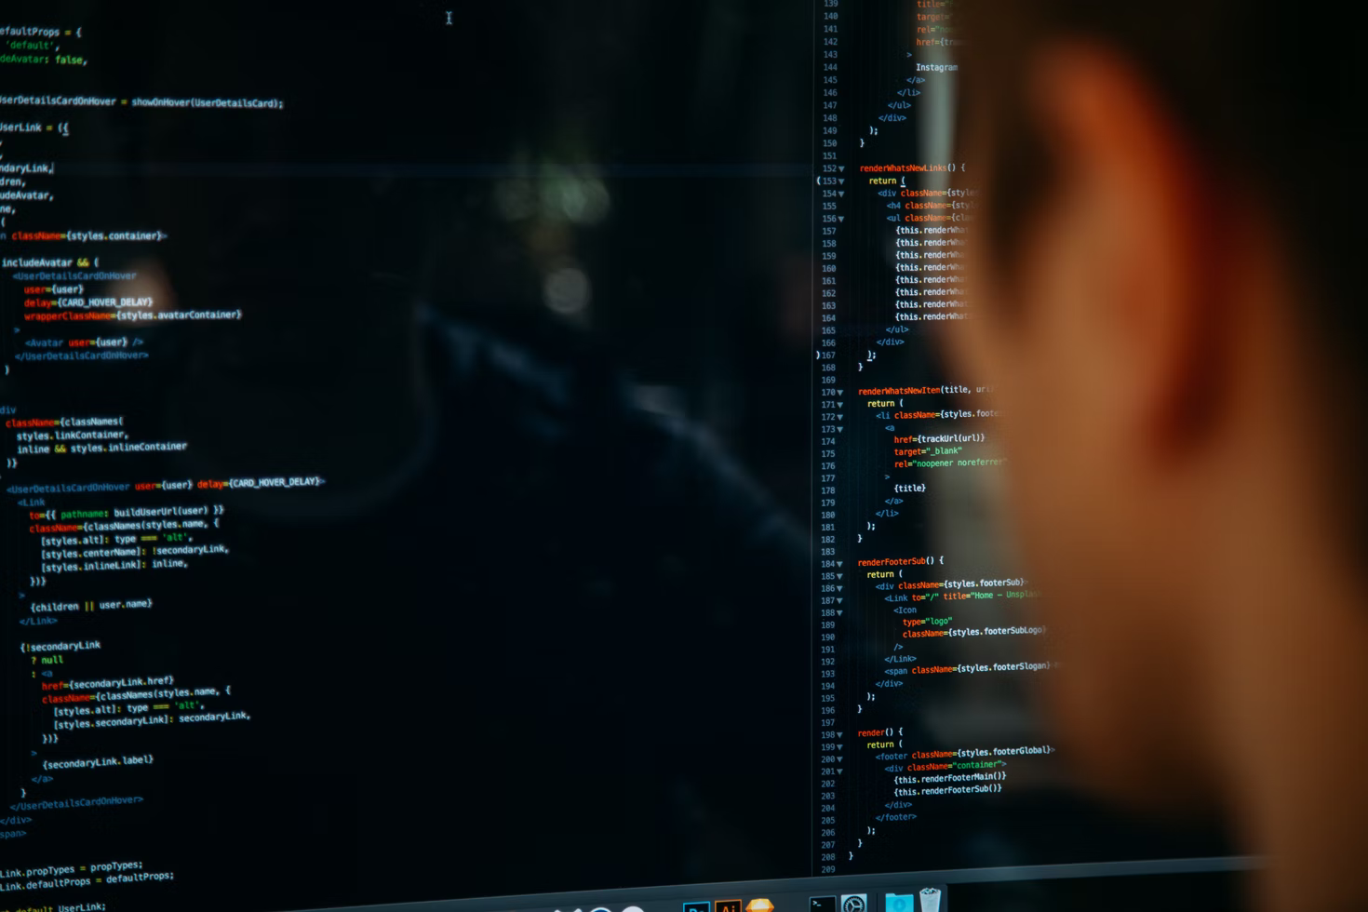
Media technologies & sustainability
Source: Photo by charlesdeluvio on Unsplash
Notes:
And going beyond ...
Digitalization, complex negative socio-ecological effects in production, adaption to it and disposal
However, digitalization brins new possibilities to create more sustainble societies; initiate, stimulate, facilitate and support transformation processes, deep cultural change

Slide 17

Media technologies & sustainability
Source: Photo by Maxim Hopman on Unsplash
Notes:
Digital innovations and education – for a post-growth economy

Slide 18
Media technologies & sustainability
And further questions like…
Acting on social media for sustainability
Production & disposal of new technologies
AI, digitalization, responsibilities and ethics
Participation, social change
Creative writing, drama, storytelling, giving sustainability a face
Learn to take authorship for sustainability stories in various media formats

Slide 19
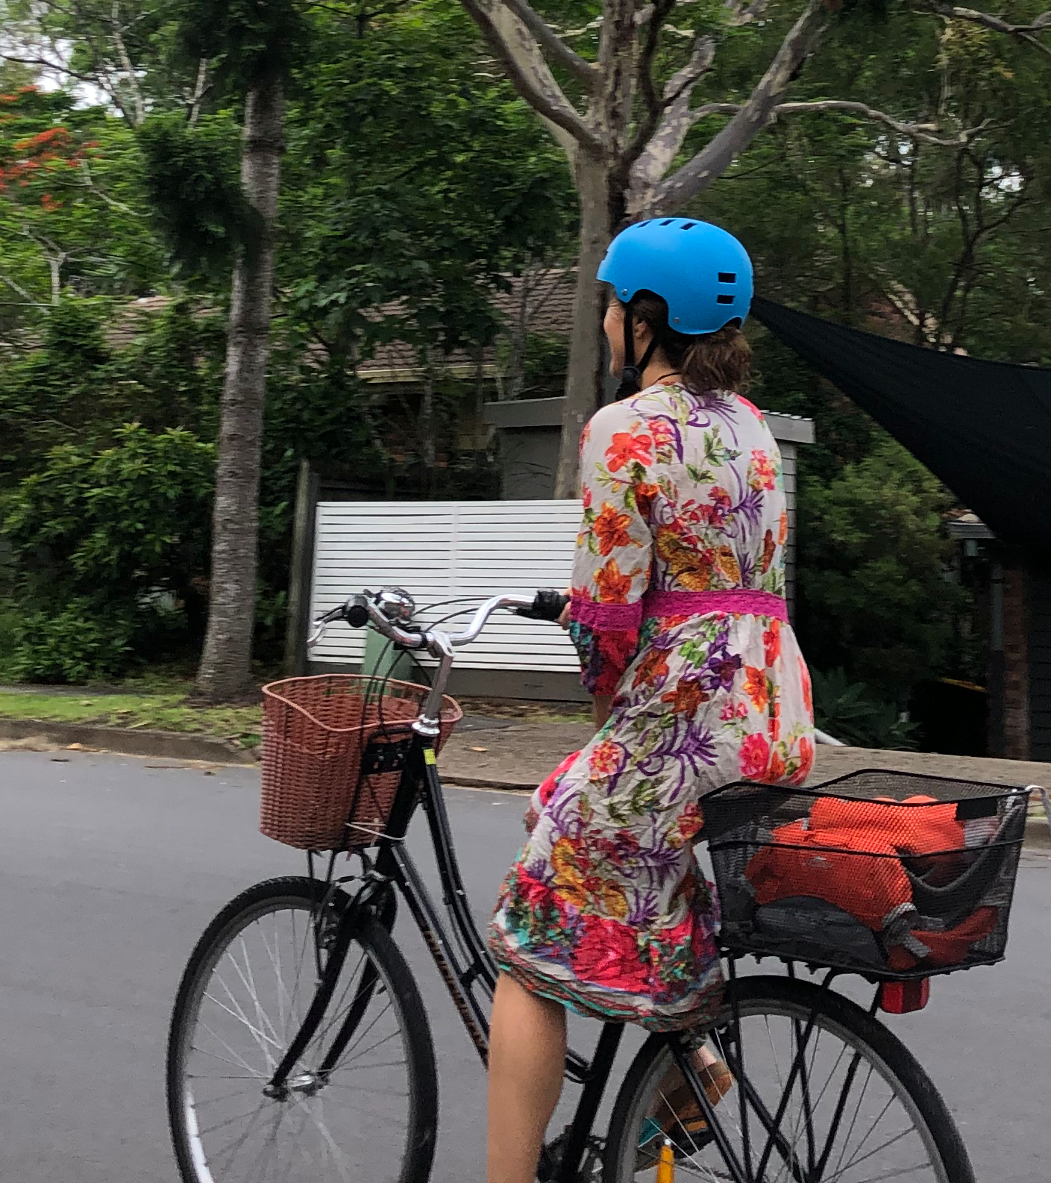
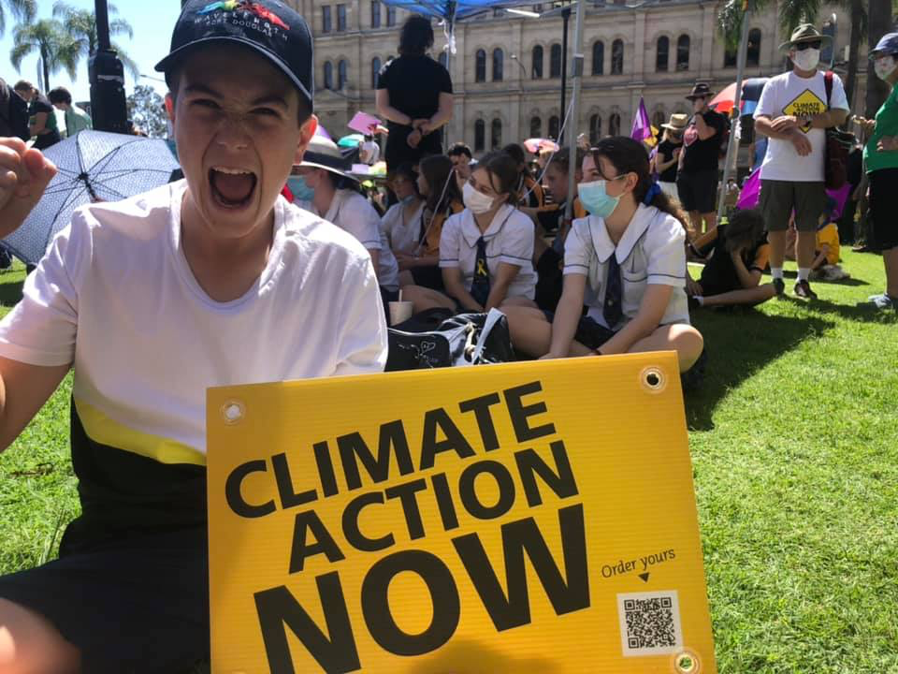
Let’s go…
We need change! … and disruption!
Source: private
Notes:
So let’s go … and answer a few of those questions …
But much more important: let’s get you ready to create change, develop the question, ready to problematize and to take authorship for the change that is needed!

Slide 20
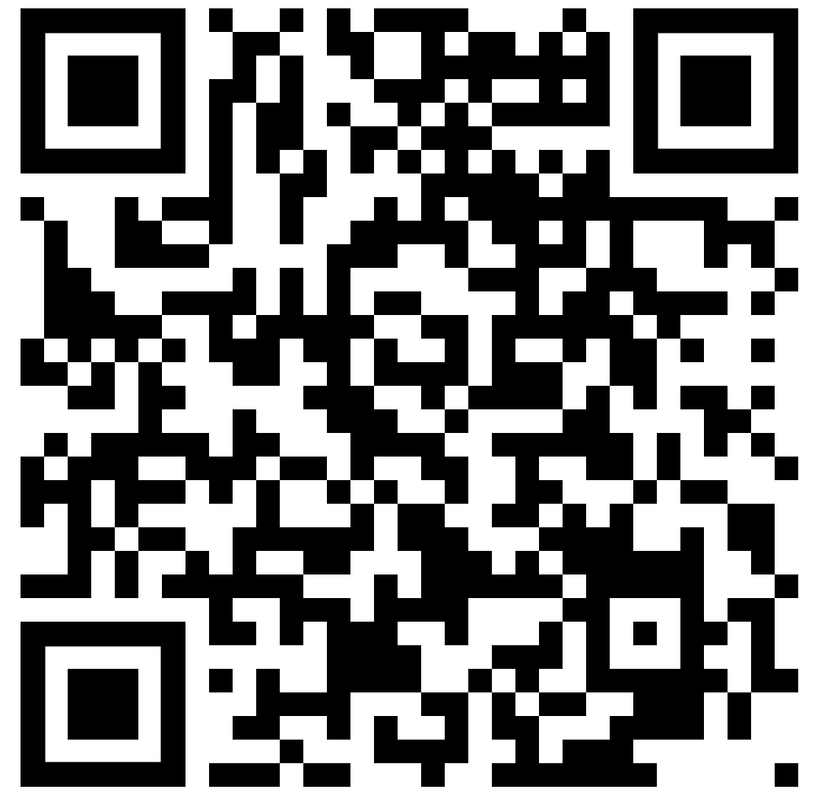
Let‘s stay in touch...
Twitter: Franzisca_Weder
Tiktok: culturesofsustainability
Facebook: become part of the „iSustain“ group and share your examples of sustainability communication!
Spotify: „Sounds like sustainability...“
Or linkedin

