Slide 1
Communication for Sustainability
Lesson 04: Cultures of Sustainability

Slide 2
Where are we?
Episode 1: Key concepts of communication
Episode 2: Framing
Episode 3: Narratives & Storytelling
Episode 4: Cultures of Sustainability

Slide 3
Learning outcomes
Learning outcome 1:
Describe the diverse nature of contemporary practices of sustainability communication on an individual, organizational and societal level, the relationship of strategic communication practices to other public communication practices, the role of stakeholders and publics and the communication practitioners in and outside of organizations (corporate, NGO, political and educational institutions etc.)
Learning outcome 2:
Develop comprehensive and well-founded knowledge in sustainability communication as field of study, an understanding of how other disciplines relate to the field and an international perspective on the field.
Learning outcome 3:
Understand the key elements of communication theories, strategies and tactics, and, thus, the character and operationalization of best practice sustainability communication planning frameworks.
Learning outcome 4:
Advance your understanding of social and civic responsibility and develop an appreciation of the philosophical and social context of sustainability communication. Advance your knowledge and respect of ethics and ethical standards in relation to communication of, about and for sustainability.
Learning outcome 5:
Anticipate and Interpret current issues and challenges of a world in transformation and social change. Develop a deep understanding of and skills to create change, develop advocacy, leadership and authorship in and for sustainability communication.

Slide 4
Overview
Sense- and meaningmaking – recap
Culture – Definition
“Cultivation of Sustainability”?
Discursive construction of a “new norm”

Slide 5
A. Sense- and meaningmaking - recap
Communication for sustainability
Culture oriented
Quality of public discourses, social deliberation
Meeting the uncertainty challenge by producing socially robust knowledge
Meeting the ambivalence challenge by producing shared visions on sustainability
Meeting the implementation challenge by producing better accepeted decisions
Notes:
Ollo in groß, folie in klein

Slide 6
A. Sense- and meaningmaking - recap
Communication for sustainability = Sensemaking
sense making = “enactment of the social world, constituting it through text and verbal descriptions that are communicated to and negotiated with others” (Berger & Luckmann, 1966)
Individual = man in action and practice; “a story-telling animal” (MacIntyre, 1981, p. 201)
Conversation as “sensemaking in action” – sensemaking as “process of narrativization” (narrative-making)

Slide 7
B. Culture - definitions
Artistic definition - refers to the artistic and intellectual creations of a society, especially those which are valued highly. (Kidd, 2002:100)
Social definition - refers to the ‘way of life’ of a social group, including their values, norms, behavioural patterns, customs and rituals and even material objects
The instinctive biological operations of our bodies are not assumed to be cultural (Hall, 1997),
-> but all other activities requiring the transfer, understanding or construction of meaning and value are.

Slide 8
C. Cultivation of Sustainability?
Artistic definition - refers to the artistic and intellectual creations of a society, especially those which are valued highly. (Kidd, 2002:100)
Social definition - refers to the ‘way of life’ of a social group, including their values, norms, behavioural patterns, customs and rituals and even material objects
The instinctive biological operations of our bodies are not assumed to be cultural (Hall, 1997),
-> but all other activities requiring the transfer, understanding or construction of meaning and value are.

Slide 9
C. Cultivation of Sustainability?
Increasing sustainable practices during lockdowns & restrictions
Survey, mixed-methods:
Customized samples, n = 269 (Austria), n = 102 (Australia), 2020
Representative survey, n = 3000 (Australia), 2021
Social practices & representations of sustainability highly depended on situation & cultural context
Online-focus group, duration: 5 days
(website-forum & whatsapp):
Heterogeneous samples, n = 25
Countries: USA, Australia, Indonesia, China, Germany, Austria, Slovenia, Bosnia, Colombia, Chile
Notes:
Don‘t you think that we‘ve been much more sustainable during lockdowns and Covid-related restrictions? Didn‘t we go less shopping, produced less waste and started gardening? Didn‘t we save a lot of CO2 emissions by not flying to conferences to talk about sustainbility strategies for 10 minutes?
Yes – your feeling is correct;
Apparently – from an indiviual perspetcive – sustainbility works as a moral compass and gives us the ideas – and license for specific behavior.
Recent research supports this: ...
But second study, based on student centered research projects, with online focus groups in various cultural settings from south america, Europe, Australasia and China shows, that ... SP & SR of sustainabiloty dependedn on cultural contex – specific social setting, traditions – and the poltical and media system
Apparently it‘s really intersting to learn more about: why do we know that less travelling and recycling is better related to social and environmental change and crises? Who tells us to buy fair trade coffee?

Slide 10

C. Cultivation of Sustainability?
The evolution of the sustainability story in corporate reporting
Increasing institutionalization of CSR / greenwashing
Qual. & quant. content analysis (frames & narratives) of Environmental -> CSR -> Sustainability Reports (2020); published between 1998 – 2019, n = 240
Based on previous studies & framing model (habilitation: Weder 2012, Koinig et al., 2017; Weder et al., 2019)
Notes:
Here mainly corporates and their marketing efforts influence our understanding of more or less sustainable behavior – and they give us the license, the feeling of we’ve done well ☺
…
It’s not only the marketing, the external communication that creates a narrative of sustainability and offers us a lot of labels as social representations of sustainable behavior.
Behind this, frameworks like the SDGS, related Global Reporting Indices, and Management systems are operationalized within Organizations of all kind and shape. This can be beautifully traced back looking at the KLICK “evolution of the sustainability story in corporate reporting, which we did, focusing on …
In this reporting: We can see a lot of greenwashing – but also a high degree of stabilization of sustainability, a high degree of institutionalisation

Slide 11
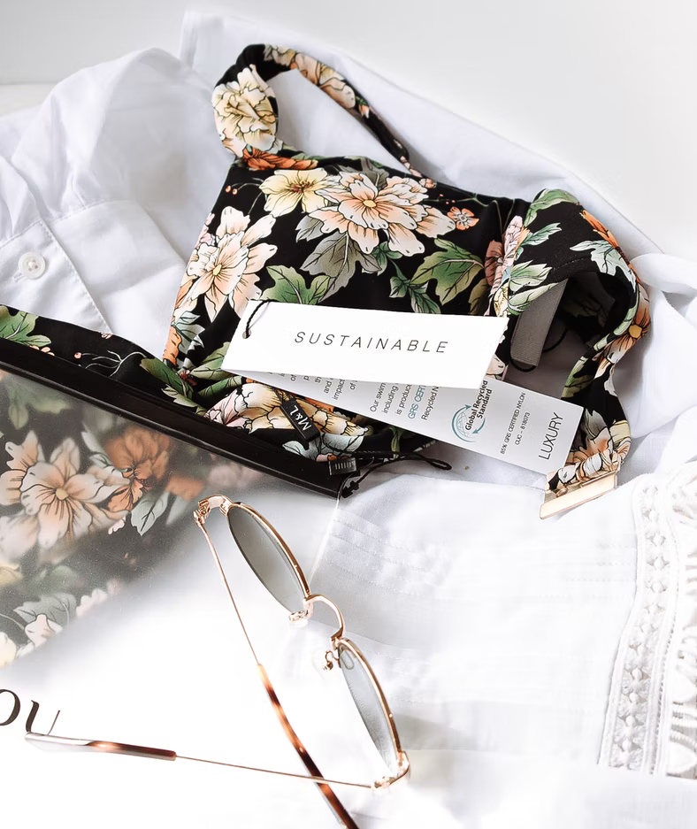
C. Cultivation of Sustainability?
Framing of Sustainable Fashion Concepts on Social Media – a lack of problematization
Discourse analysis of social media content (Instagram, Australia, 2020) (Lee & Weder, 2020)
Narrative Interviews with Journalists, PR Professionals, Influencers, Artists, Scientists, NGO/campaigners, queer communicators (Austria, Germany, New Zealand, Australia, China)
Photo by Harper Sunday on Unsplash
Notes:
So if corporates create their narrative of the future – they still allocate the responsibility for sustainable development, behavior and the future on us, as individuals.
Which is well supported by social media trends where shopping, fashion and food related decisions are increasingly influenced by social media influencersa s we can show with recent data on framing of sustainable fashion in social media.

Slide 12
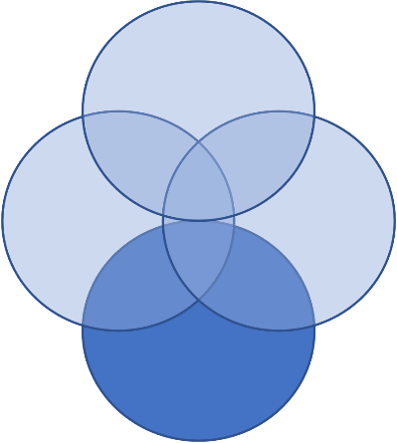
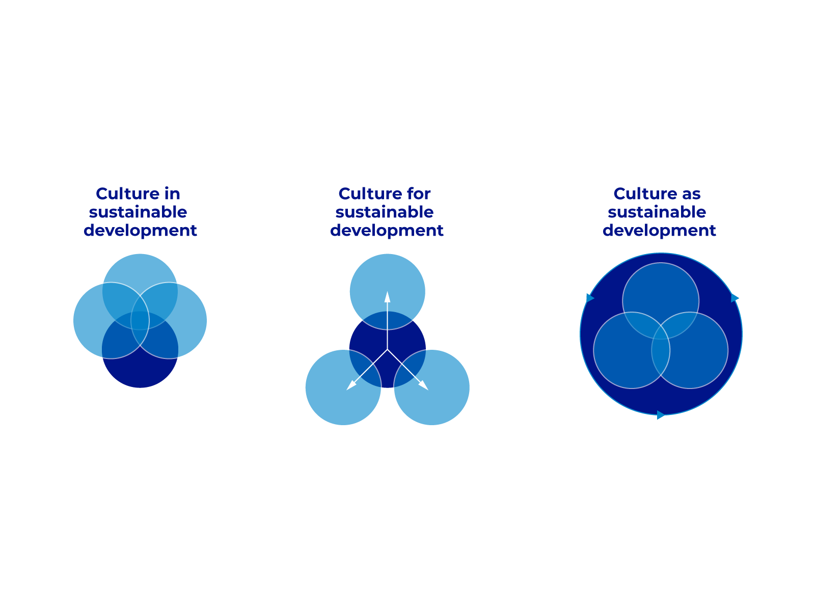
C. Cultivation of Sustainability?
Culture in sustainable development
Culture for sustainable development
3rd way: Culture of sustainability
(Hammond, 2019; Soini & Dessein, 2016; Soini et al., 2015; Godemann & Michelsen, 2011; 2013)
(Spinozzi & Mazzanti, 2019; Skitka et al., 2021; Weder, 2021; Weder et al., 2019)
(Bourdieu, 1987; Giddens, 1984; Mouffe, 2013; Laclau & Mouffe, 2014; Weick, 1995; Batel, 2015; Castro, 2015; Moscovici, 1988)
Notes:
Looking at the literature on culture and sustainbilty, I agree with Soini & Dessein, that there is a lot of literature that conceptualizes culture as 4th pillar, including heritage, art etc. as dimension of Sustainble Development ... Which is good –
KLICK: As well, with an instrumental, pragmatic or even functionalist perspective, culture is conceptualized as supporting econ., ecol., and social change and development.
KLICK: However, what Soini & Dessein conceptualized as Culture as Sustainble Development needs further theoretical development. This 3rd way requires new concepts, and a new way of thinking – less pragmatic, more critical, and constructive, to understand how culture itself is transformed towards sustainbility.
Because a culture OF sustainability means deliberation on what must sustain, what must change – and how this change is to be implemented.
***
Cassirer: dass es ein „Erleben“ außerhalb der strengen Wissenschaften gibt, das sich in der Sprache ebenso ausdrückt, wie in Mythen, der Religion oder der Kunst. Auch Geschichte, Technik, Wissenschaft, Moral oder Politik haben demzufolge eigene Erlebniswelten.

Slide 13
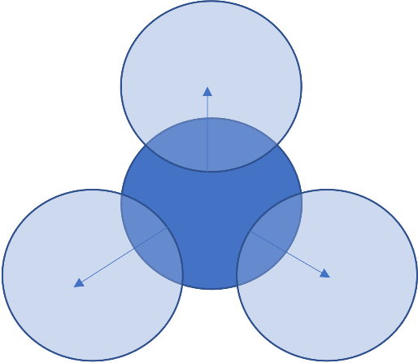
C. Cultivation of Sustainability?
Culture in sustainable development
Culture for sustainable development
3rd way: Culture of sustainability
(Hammond, 2019; Soini & Dessein, 2016; Soini et al., 2015; Godemann & Michelsen, 2011; 2013)
(Spinozzi & Mazzanti, 2019; Skitka et al., 2021; Weder, 2021; Weder et al., 2019)
(Bourdieu, 1987; Giddens, 1984; Mouffe, 2013; Laclau & Mouffe, 2014; Weick, 1995; Batel, 2015; Castro, 2015; Moscovici, 1988)
Notes:
Looking at the literature on culture and sustainbilty, I agree with Soini & Dessein, that there is a lot of literature that conceptualizes culture as 4th pillar, including heritage, art etc. as dimension of Sustainble Development ... Which is good –
KLICK: As well, with an instrumental, pragmatic or even functionalist perspective, culture is conceptualized as supporting econ., ecol., and social change and development.
KLICK: However, what Soini & Dessein conceptualized as Culture as Sustainble Development needs further theoretical development. This 3rd way requires new concepts, and a new way of thinking – less pragmatic, more critical, and constructive, to understand how culture itself is transformed towards sustainbility.
Because a culture OF sustainability means deliberation on what must sustain, what must change – and how this change is to be implemented.
***
Cassirer: dass es ein „Erleben“ außerhalb der strengen Wissenschaften gibt, das sich in der Sprache ebenso ausdrückt, wie in Mythen, der Religion oder der Kunst. Auch Geschichte, Technik, Wissenschaft, Moral oder Politik haben demzufolge eigene Erlebniswelten.

Slide 14
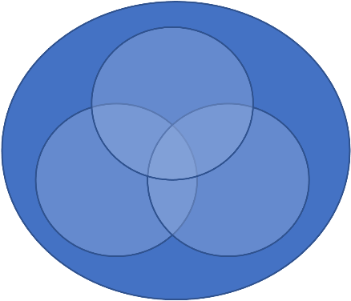
C. Cultivation of Sustainability?
Culture in sustainable development
Culture for sustainable development
3rd way: Culture of sustainability
(Hammond, 2019; Soini & Dessein, 2016; Soini et al., 2015; Godemann & Michelsen, 2011; 2013)
(Spinozzi & Mazzanti, 2019; Skitka et al., 2021; Weder, 2021; Weder et al., 2019)
(Bourdieu, 1987; Giddens, 1984; Mouffe, 2013; Laclau & Mouffe, 2014; Weick, 1995; Batel, 2015; Castro, 2015; Moscovici, 1988)
Notes:
Looking at the literature on culture and sustainbilty, I agree with Soini & Dessein, that there is a lot of literature that conceptualizes culture as 4th pillar, including heritage, art etc. as dimension of Sustainble Development ... Which is good –
KLICK: As well, with an instrumental, pragmatic or even functionalist perspective, culture is conceptualized as supporting econ., ecol., and social change and development.
KLICK: However, what Soini & Dessein conceptualized as Culture as Sustainble Development needs further theoretical development. This 3rd way requires new concepts, and a new way of thinking – less pragmatic, more critical, and constructive, to understand how culture itself is transformed towards sustainbility.
Because a culture OF sustainability means deliberation on what must sustain, what must change – and how this change is to be implemented.
***
Cassirer: dass es ein „Erleben“ außerhalb der strengen Wissenschaften gibt, das sich in der Sprache ebenso ausdrückt, wie in Mythen, der Religion oder der Kunst. Auch Geschichte, Technik, Wissenschaft, Moral oder Politik haben demzufolge eigene Erlebniswelten.

Slide 15
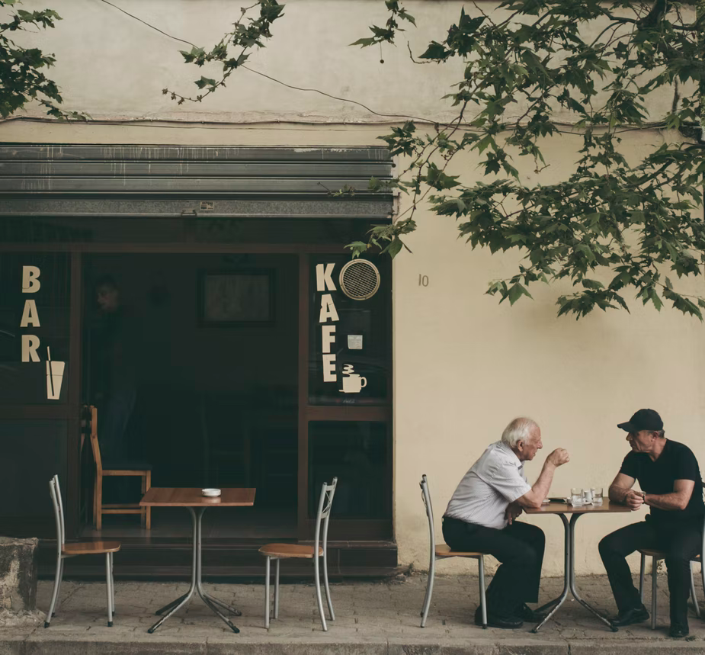
D. Discursive construction of a “new norm”
Communication for sustainability as all communicative activities requiring the transfer, understanding or construction of meaning and value.
Photo by Juri Gianfrancesco on Unsplash
Notes:
Status quo: cultivation on individual, organizational and macro level …
But is there a real “discourse” on the meaning of sustainability happening in organizations and in for example social media channels? Is there a public discourse about and for sustainability?
Are the MEDIA today the “critical deliberative sphere” that would provide the necessary political foundation for social change, for real cultural change?
No, not so much or “not yet”: – a discursive construction of sustainability as a new norm needs innovations:
Theoretical, methodological & pedagogical innovations

Slide 16


D. Discursive construction of a “new norm”
Purposive, hierarchical, formal
Non-purposive, particpatory, informal, dialectic, co-constructed
Icon made by Raj Dev from www.freeicons.io
Notes:
Communication for Sustainability as social conversation around sustainability

Slide 17
D. Discursive construction of a “new norm”
Dissemination
Communication of Sustainability
Findings, information, knowledge
Dialogue
Communication about Sustainability
Use: Questioning, opinion, discussion
Participation
Communication for Sustainability
Communication as defence, promotion, popularization, outreach
Use: Informtion, awareness, learning
Issues, applications, implications, knowledge
Communication as engagement, consultation, interaction
Process, interpretation, (re)construction of knwoledge, meaning-making, value creation
Use: sharing, creating, critique, enjoyment
Communication as deliberation, chat, play, co-creation, film, art, fiction
Purposive, hierarchical, formal
Non-purposive, particpatory, informal, dialectic, co-constructed
Icon made by Raj Dev from www.freeicons.io
Notes:
Communication for Sustainability as social conversation around sustainability

Slide 18
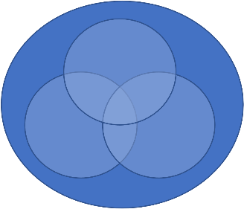
D. Discursive construction of a “new norm”
Questioning
(civil society, universities)
Stabilization
(corporates, pol. institutions, NGOs)
Sustainability, Wellbeing and organizational culture
Narratives, framing & metaphors used in sustainability communication
Eco- and environmental art & science communication
Notes:
There is MUCH more potential to better understand culture as constantly changing process – covering all dimensions of sustainability; it’s change becomes the key concern or paradigm of sustainability, when we INCLUDE the dialectic. The dialectic between the stabilization – and the process of questioning the cultivated patterns, behaviors and “new” norms, the process of acknolweding “normalization” of sustainabilty – but by the same time to put it into question –
which is where
1. new research programs emerge (i.e. … ) and
2. civil society, but as well Universities come into play. …

Slide 19
Links back to …
Inter- / transdisciplinary approach to SD
Communication
Cultural change
SD agenda
Social change
Problem
Solution
Problem
Solution
Problem
Discipline 1
Discipline 2
Discipline 3
Discipline x

Slide 20
Reflection
1. Try to describe Communication for Sustainability from a social constructivist, conversational perspective.
2. Why is it important, to include a cultural perspective in the discussion about sustainability communication?
What are different perspectives on culture & sustainability?
What role does communication play?
3. What are participatory communication modes, where can participatory, transformative communication take place?

