Slide 1
Communication about Sustainability
Lesson 04: Sustainable Consumption

Slide 2
Übersicht zur gesamten Lerneinheit
Episode 1: Key concepts of communication
Episode 2: The „public“ & Public discourses
Episode 3: Sustainability issues & crises
Episode 4: Sustainable Consumption

Slide 3
Learning outcomes
Learning outcome 1:
Describe the diverse nature of contemporary practices of sustainability communication on an individual, organizational and societal level, the relationship of strategic communication practices to other public communication practices, the role of stakeholders and publics and the communication practitioners in and outside of organizations (corporate, NGO, political and educational institutions etc.)
Learning outcome 2:
Develop comprehensive and well-founded knowledge in sustainability communication as field of study, an understanding of how other disciplines relate to the field and an international perspective on the field.
Learning outcome 3:
Understand the key elements of communication theories, strategies and tactics, and, thus, the character and operationalization of best practice sustainability communication planning frameworks.
Learning outcome 4:
Advance your understanding of social and civic responsibility and develop an appreciation of the philosophical and social context of sustainability communication. Advance your knowledge and respect of ethics and ethical standards in relation to communication of, about and for sustainability.
Learning outcome 5:
Anticipate and Interpret current issues and challenges of a world in transformation and social change. Develop a deep understanding of and skills to create change, develop advocacy, leadership and authorship in and for sustainability communication.

Slide 4
Overview
Definitions
Relevance & Responsibilities
Research focus
Policy & Frameworks
Communication perspective

Slide 5
A. Definition
Sustainable consumption
a consumer who takes into account the public consequences of her/his private consumption or who attempts to use her/his purchasing power to bring about social changes
one who purchases products and services perceived to have a positive (or a less negative) influence on the environment or who patronizes businesses that attempt to effect related positive social changes

Slide 6
A. Definition
From an issue perspective…
Sustainable Consumption
AND Sustainable Production

Slide 7
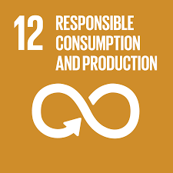
B. Relevance & Responsibilities
One key solution to solve the global sustainability challenges is in changing the ways we consume (Ruby et al., 2020).
Sustainable consumption (SC), “a process of decisions and actions, not limited to the moment of purchase, but considering the whole lifecycle of a product or service” (Sesini, Castiglioni, & Lozza, 2020, p. 2),
UN Sustainable Development Goal 12
Source: www.theglobalgoals.org/resources

Slide 8
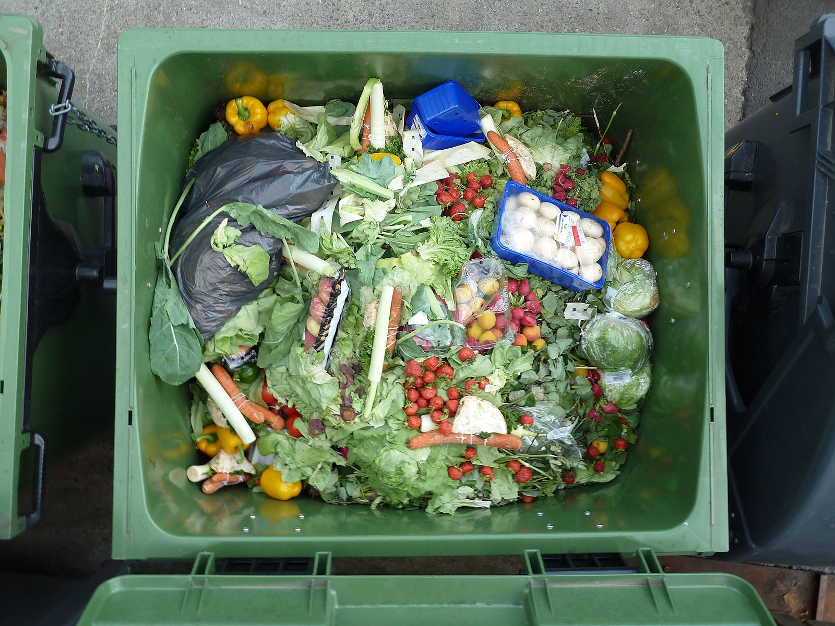
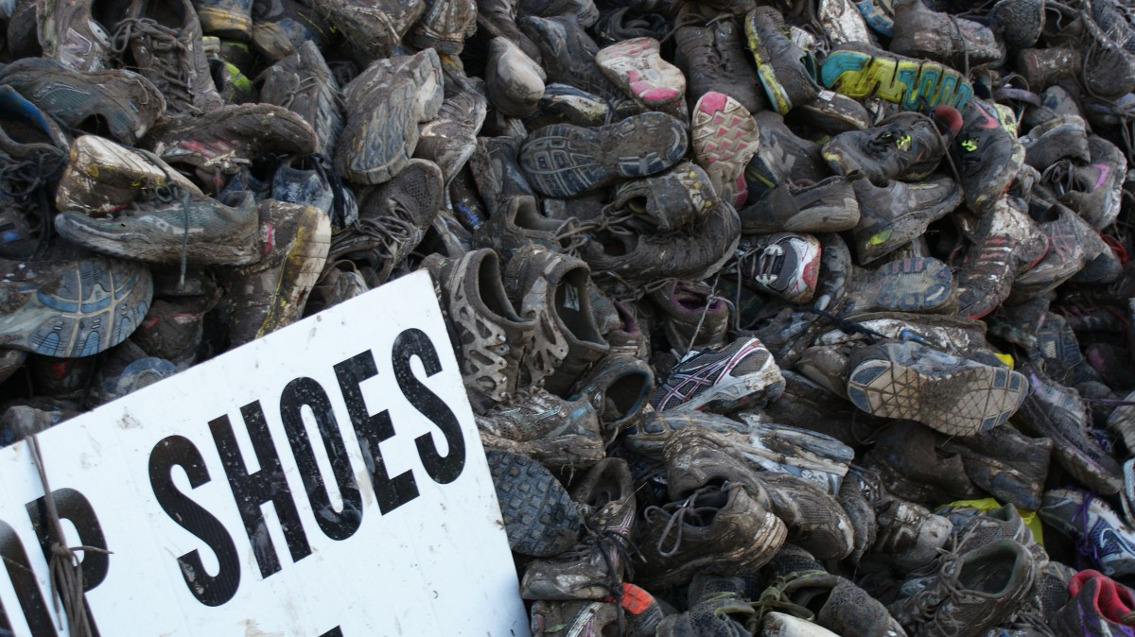
B. Relevance & Responsibilities
Why?
Source: Photo on pxhere.com, Licence: CC-0
Source: Photo on commons.wikimedia.org, Licence: CC-0

Slide 9
B. Relevance & Responsibilities
Lack of understanding, leadership
Comfortable lifestyle
Budget constraints
History, culture of “free tuff”
Tradition
Short term thinking
No obvious rewards
Social inequity

Slide 10
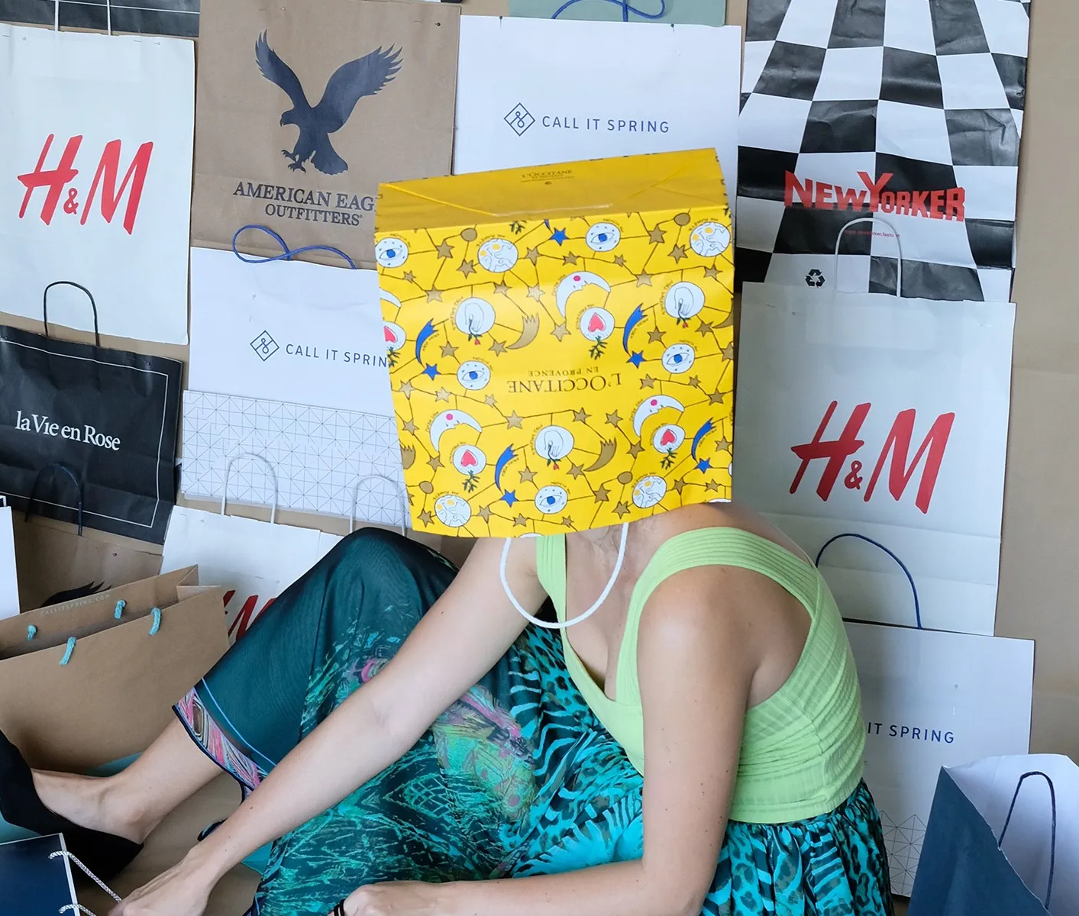
3. Who is responsible?
B. Relevance & Responsibilities
Notes:
The embracement of sustainability as a guiding principle for consumption has put a challenge to consumption activities on a normative level and consumers have been ascribed social responsibility and agency to help solving pressing social and environmental problems (Halkier, 2010 ŠE DODAJ). Subsequently, framing ordinary individual consumers as being co-responsible for sustainable problems has become a political position which strongly influences policies, measures and communication about SC (Belotti & Panzone, 2016).
exploring variables as values, social norm, environmental concern, attitudes, morality and environmental efficacy via the ABC psychological models
approaches to SC based on individualization and social-cognitive reductionism have yet to be proven effective for translating the attitudes into sustainable behaviors and achieving durable and generalizable change (e.g. Davies et al., 2020).

Slide 11
C. Research focus
sustainable practices alongside sustainable food and purchasing are the most frequently studied aspects of SC (Gustavsen & Hegnes, 2020; Sanchez-Sabate & Sabate, 2019; Morone et al., 2017, Vermeir & Verbeke, 2006)
sustainable food / eating behaviour: heavily medialized (Halkier, 2010; Skitka et al., 2021; Weder et al., forthcoming).
consumer behaviour – marketing! (e.g. Belotti & Panzone, 2016; Castro & Lima, 2001; Davis et al., 2020; Lunde, 2018; White, Habib, & Hardisty, 2019)
HOWEVER: taking into the account a social view – different contexts and the many aspects and complexities of daily life and acknowledging that SC is about social rather than just individual change (Hargreaves, 2011).

Slide 12
D. Policy & Frameworks
Consumption
Increase awareness
Change attitudes Create intentions to act
Production
Regulatory
Raise knowledge
Achievement of change in behavior
Economic instruments
Information, communication, education

Slide 13
D. Policy & Frameworks
Regulatory
Product design standards
Economic instruments
Eco taxes (carbon tax, price signals)
Restrictions on products (i.e. pesticides)
Bans (plastic bags, single use plastic etc.)
Labeling (food labels, energy stars, water sense)
Extended producer responsibility (CSR)
Statutor targets (CSR; pollution, emissions etc.)
Producer incentives, innovation funds (for sustainable business operations)
Consumer subsidies (for environmentally friendly products)

Slide 14
D. Policy & Frameworks
Weak
Low regulatory intervention
Strong
Systemic approach
Voluntary action (individual, market)
„Green consumerism“
Efficiency focus/greening existing patterns of consumption
Macro-economic issues
Sufficiency focus: reduce overall consumption!

Slide 15
E. Communication Perspective on Consumption
Environmental Attitudes and Behaviour
Public Awareness
Societal Norms and Values
Sustainable Practices

Slide 16
E. Communication Perspective on Consumption
Social practices

Slide 17
E. Communication Perspective on Consumption
Social representations

Slide 18
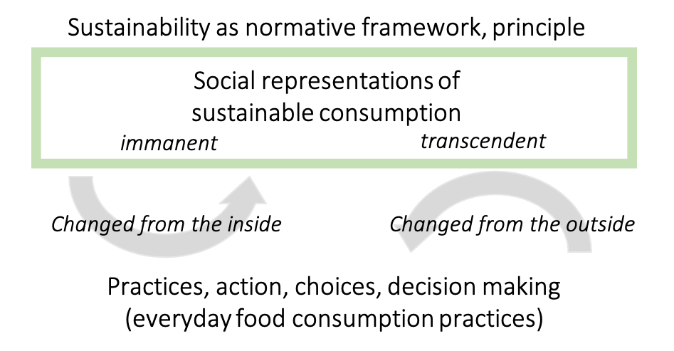
E. Communication Perspective on Consumption

Slide 19
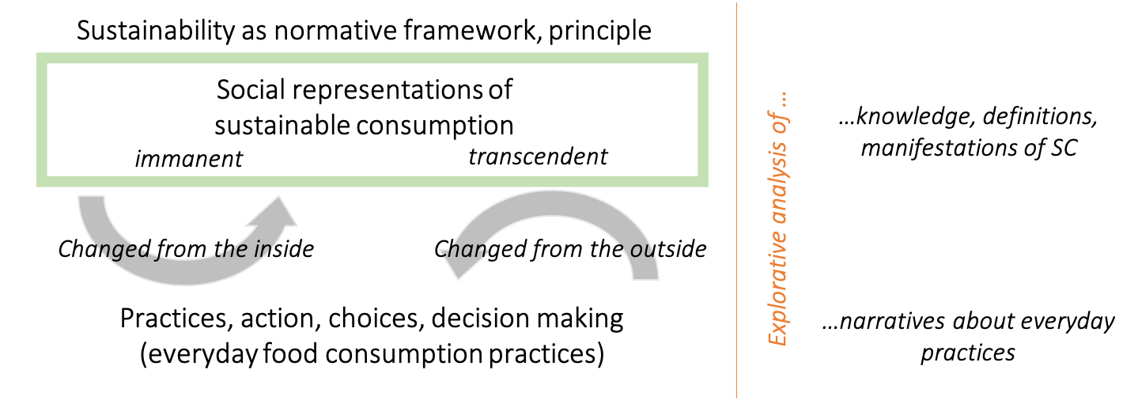
E. Communication Perspective on Consumption

Slide 20
E. Communication Perspective on Consumption
Moralization / Demoralization

Slide 21
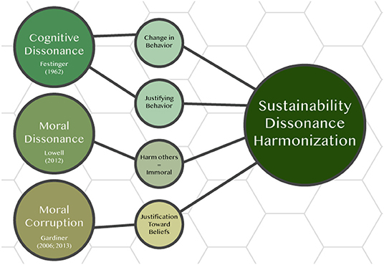
E. Communication Perspective on Consumption
SDH strategy

Slide 22
Reflections
Do you consider yourself as sustainable consumer?
Why?
What would you need to do better?

Slide 23
Reflections
Why is sustainable consumption one of the most dominant issue areas where sustainability is debated?
Who possibly dominates the public discourse on sustainable practices / and sustainable consumption in particular?
What are issues and discourses related to sustainable consumption?
On which levels (interpersonal communication, organizational/strategic communication and media/public communication) is sustainable consumption predominantly discussed? Who are the voices that are not heard? Why?

