Slide 1
Communication about Sustainability
Lesson 03: Sustainability Issues & Crises

Slide 2
Where are we?
Episode 1: Key concepts of communication
Episode 2: The „public“ & Public discourses
Episode 3: Sustainability issues & crises
Episode 4: Sustainable Consumption

Slide 3
Learning outcomes
Learning outcome 1:
Describe the diverse nature of contemporary practices of sustainability communication on an individual, organizational and societal level, the relationship of strategic communication practices to other public communication practices, the role of stakeholders and publics and the communication practitioners in and outside of organizations (corporate, NGO, political and educational institutions etc.)
Learning outcome 2:
Develop comprehensive and well-founded knowledge in sustainability communication as field of study, an understanding of how other disciplines relate to the field and an international perspective on the field.
Learning outcome 3:
Understand the key elements of communication theories, strategies and tactics, and, thus, the character and operationalization of best practice sustainability communication planning frameworks.
Learning outcome 4:
Advance your understanding of social and civic responsibility and develop an appreciation of the philosophical and social context of sustainability communication. Advance your knowledge and respect of ethics and ethical standards in relation to communication of, about and for sustainability.
Learning outcome 5:
Anticipate and Interpret current issues and challenges of a world in transformation and social change. Develop a deep understanding of and skills to create change, develop advocacy, leadership and authorship in and for sustainability communication.

Slide 4
Overview
Issues
Issue Management
Crises & Cracks
Sustainability communication as set of simultaneous or subsequent discursive strategies which gradually introduce and/or perpetuate in public discourse some new patterns of representing social actors, processes and issues – stimulated by crises & cracks!

Slide 5
A. Issue
Definition
a topic of debate, a trend or a recurring theme that moves from the private sphere into the public sphere and onto the media agenda (L’Etang 2008, p.75)
any trend or development – real or perceived – usually at least partly in the public arena, which, if it continues, could have a significant impact on individuals and organizations

Slide 6
A. Issue
Definition
Issues are controversial inconsistencies caused by gaps between the expectations of organisations and those of stakeholders.
These gaps lead to a contestable point of difference, the resolution of which can have important consequences for an organization (Heath, 1997; Wartick & Mahon, 1994).
The role of the „issue‘s management“ process is to investigate and determine the existence and likely impacts of these contestable points of difference (-> communication about sustainability as reaction!).

Slide 7
B. Issue Management
Definition
Issues management is an anticipatory, strategic management process that helps organisations detect and respond appropriately to emerging trends or changes in the socio- political environment
Emerging trends or changes may crystallise into an “issue,” which is a situation that evokes the attention and concern of influential organisational publics and stakeholders
At its best, issues management is stewardship for building, maintaining and repairing relationships with stakeholders and stake-seekers (Heath, 2002)
Organisations engage in issues management to actively look for, anticipate, and respond to shifting stakeholder expectations and perceptions likely to have important consequences for the organisation/industry -> communication about sustainability; production of intersubjective/shared concepts & frames of sustainability and the future.

Slide 8
C. Crisis & Cracks
Climate Change as risk: refers to uncertainty about and severity of the consequences (or outcomes) of an activity with respect to something that humans value (Aven & Renn, 2009): a sudden, calamitous event that seriously disrupts the functioning of a community or society and causes human, material, and economic or environmental losses that exceed the community’s or society’s ability to cope using its own resources. Though often caused by nature, disasters can have human origins.
Typical areas of communication about risks & crises include public health and environment, eg.
food products,
health treatments/procedures, regulations,
environmental damage, natural hazards...

Slide 9
C. Crisis & Cracks
Natural hazards - naturally occurring physical phenomena caused either by rapid or slow onset events:
geophysical (earthquakes, landslides, tsunamis and volcanic activity),
hydrological (avalanches and floods),
climatological (extreme temperatures, drought and wildfires),
meteorological (cyclones and storms/wave surges),
biological (disease epidemics and insect/animal plagues).

Slide 10
C. Crisis & Cracks
Technological or man-made hazards - events caused by humans and occur in or close to human settlements;
complex emergencies/conflicts:
Famine,
displaced populations,
climate change, degradation
unplanned-urbanization,
under-development/poverty,
threat of pandemics,
industrial accidents
Transport accidents;
Environmental pollution,

Slide 11
C. Crisis & Cracks

Slide 12
C. Crisis & Cracks
Important difference:
issue
topic
event

Slide 13
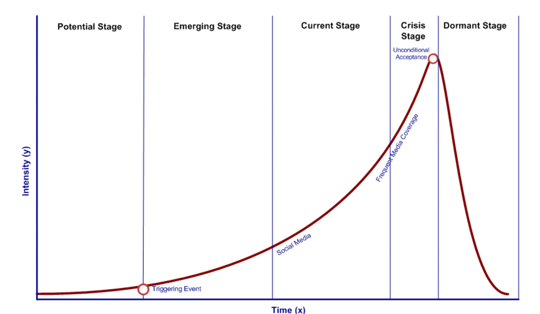
C. Crisis & Cracks
Public Issue Life Cycle

Slide 14
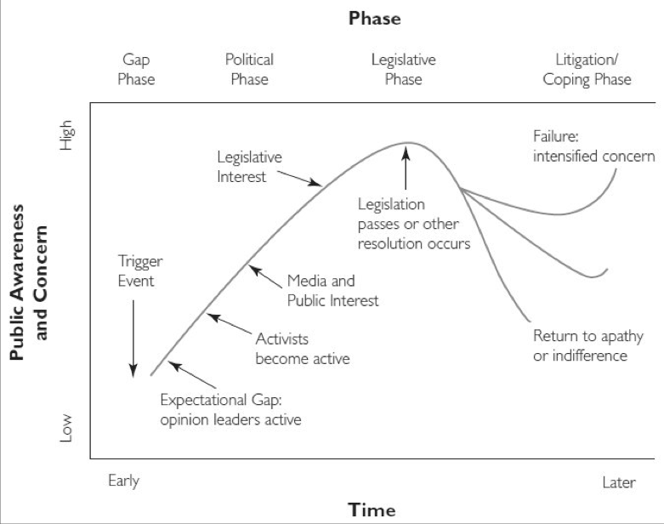
C. Crisis & Cracks
Public Issue Life Cycle
Sources:
A. Downs: https://sciencepolicy.colorado.edu/students/envs_5720/downs_1972.pdf
Mahon, J. F., & Waddock, S. A. (1992). Strategic issues management: An integration of issue life cycle perspectives. Business & Society, 31(1), 19-32.
Benford, R. D., & Snow, D. A. (2000). Framing processes and social movements: An overview and assessment. Annual review of sociology, 611-639.

Slide 15
C. Crisis & Cracks
Public Issue Life Cycle
Critical issue
Interactive issue
Functional issue
Events, occasions,
individual opinions
Increasing number of actors, communicatiors, organizational structures; increasing public-ness
Establishment and ‚use‘ of an issue
Source:
Weder, F. (2012). Die CSR-Debatte in den Printmedien: Anlässe, Themen, Deutungen. Facultas WUV Universitätsverlag.
Definition
Process: construction
Relations
Process: interaction, reflection
Interpretation
Process: evaluation, framing
Allocation of (public) awareness

Slide 16
Reflection
1. Describe the difference between an event and an issue.
2. Think about a crisis.
What different kind of crises exist?
How do they possibly influence organizations?
How do they influence the lifecycle of a public issues?
3. On one of the issue life cycle models: try to identify the “stage” of the issue of Covid-19.
4. What about “sustainability”? Is sustainability an issue per se? or a topic? What are “sustainability issues”? What are dominant “sustainability topics” (like sustainable consumption, energy etc.)

