Slide 1
Communication of Sustainability
Lesson 04: Sustainability Reporting

Slide 2
Where are we?
Episode 1: Communication of Sustainability
Episode 2: Organizations & their Stakeholder
Episode 3: Strategic Communication of Sustainability
Episode 4: Sustainability Reporting

Slide 3
Learning outcomes
Learning outcome 1:
Describe the diverse nature of contemporary practices of sustainability communication on an individual, organizational and societal level, the relationship of strategic communication practices to other public communication practices, the role of stakeholders and publics and the communication practitioners in and outside of organizations (corporate, NGO, political and educational institutions etc.)
Learning outcome 2:
Develop comprehensive and well-founded knowledge in sustainability communication as field of study, an understanding of how other disciplines relate to the field and an international perspective on the field.
Learning outcome 3:
Understand the key elements of communication theories, strategies and tactics, and, thus, the character and operationalization of best practice sustainability communication planning frameworks.
Learning outcome 4:
Advance your understanding of social and civic responsibility and develop an appreciation of the philosophical and social context of sustainability communication. Advance your knowledge and respect of ethics and ethical standards in relation to communication of, about and for sustainability.
Learning outcome 5:
Anticipate and Interpret current issues and challenges of a world in transformation and social change. Develop a deep understanding of and skills to create change, develop advocacy, leadership and authorship in and for sustainability communication.

Slide 4
Overview
Learnings from CSR Communication
Reporting

Slide 5
A. Recap: organizations and communication
Management communication
Public Relations
Organizational communication
Marketing communication
Reputation management
Rhetoric
CSR Communication

Slide 6
B. Learnings from CSR Communication
CSR Communication perspectives
Instrumental approaches (communication of CSR as means to the end of profits) (Friedman 1970; Porter & Kramer 2002; 2006)
Integrative approaches (CSR = integration of social demands) (Sethi1975; Preston & Post, 1975; Mitchell et al., 1997; Carroll, 1979)
Ethical approaches (CSR = ethical values/obligation) (Freeman, 1984; Brundtland Report 1987)
Political approaches (CSR = social duties/rights & participation in a certain social cooperation) (Davis 1960; Donaldson & Dunfee 1994; Andriof & McIntosh 2001; Matten & Crane 2005; Garriga & Melé 2004)
Network communication, participatory and constitutive approaches (Golob et al. 2013; Schultz et al. 2013; Morsing, 2017; Elving et al., 2015)

Slide 7
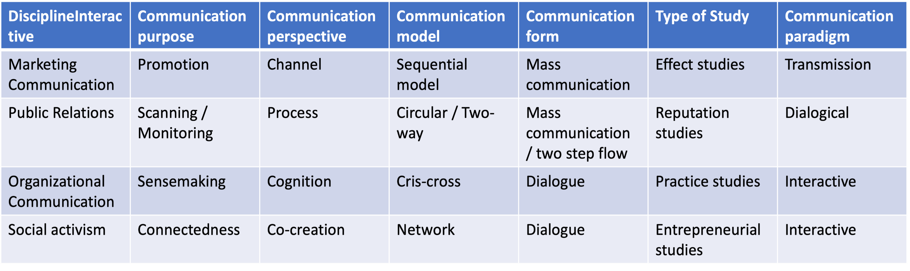


B. Learnings from CSR Communication
CSR Communication perspectives
Icon made by Raj Dev from www.freeicons.io

Slide 8
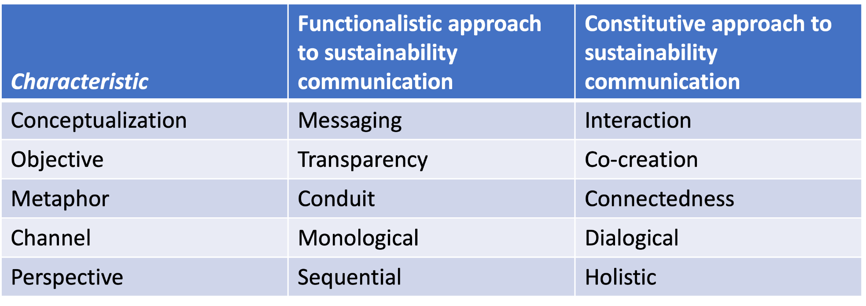
B. Learnings from CSR Communication
CSR Communication perspectives
Information
Response, Involvement
Icon made by Raj Dev from www.freeicons.io
Notes:
Information one-way, inform about CSR actions, no engagement necessary
Response two-way asymmetric, demonstrate integration of CSR, engagement through surveys, polls
Involvement two-way symmetric, proactive, dialogue, stakeholders engaged in defining CSR

Slide 9
B. Learnings from CSR Communication
CSR Communication & Stakeholder Relations
CSR communication: “process of anticipation stakeholder’s expectations, articulation of CSR policy and managing different … tools designed to provide true and transparent information about a company`s or a brand`s integration of its business operations, social and environmental concerns, and interactions with stakeholders” (Podnar, 2008: 85)
Integrative perspective on CSR communication: “harmonization of all CSR-related communication strategies and activities” (Diehl et al., 2017)
Information, response, and involvement as “guides” for communication management (Morsing, 2017; Morsing & Schultz, 2006; Grunig & Hunt, 1984)

Slide 10
C. Reporting
1. Analysis:
Environment, Status Quo (Values/Visison), Stakeholder Analysis, Gaps / SWOT
2. Planning / Strategy:
Relevant areas of action of organization & stakeholder, issues, definition of goals, relation to SDGs, indicators
3. Implementation:
Involvement of internal and external stakeholder, dialogical communication, projects, monitoring
4. Reflection & external communication:
Reporting, evaluation and effect analysis

Slide 11
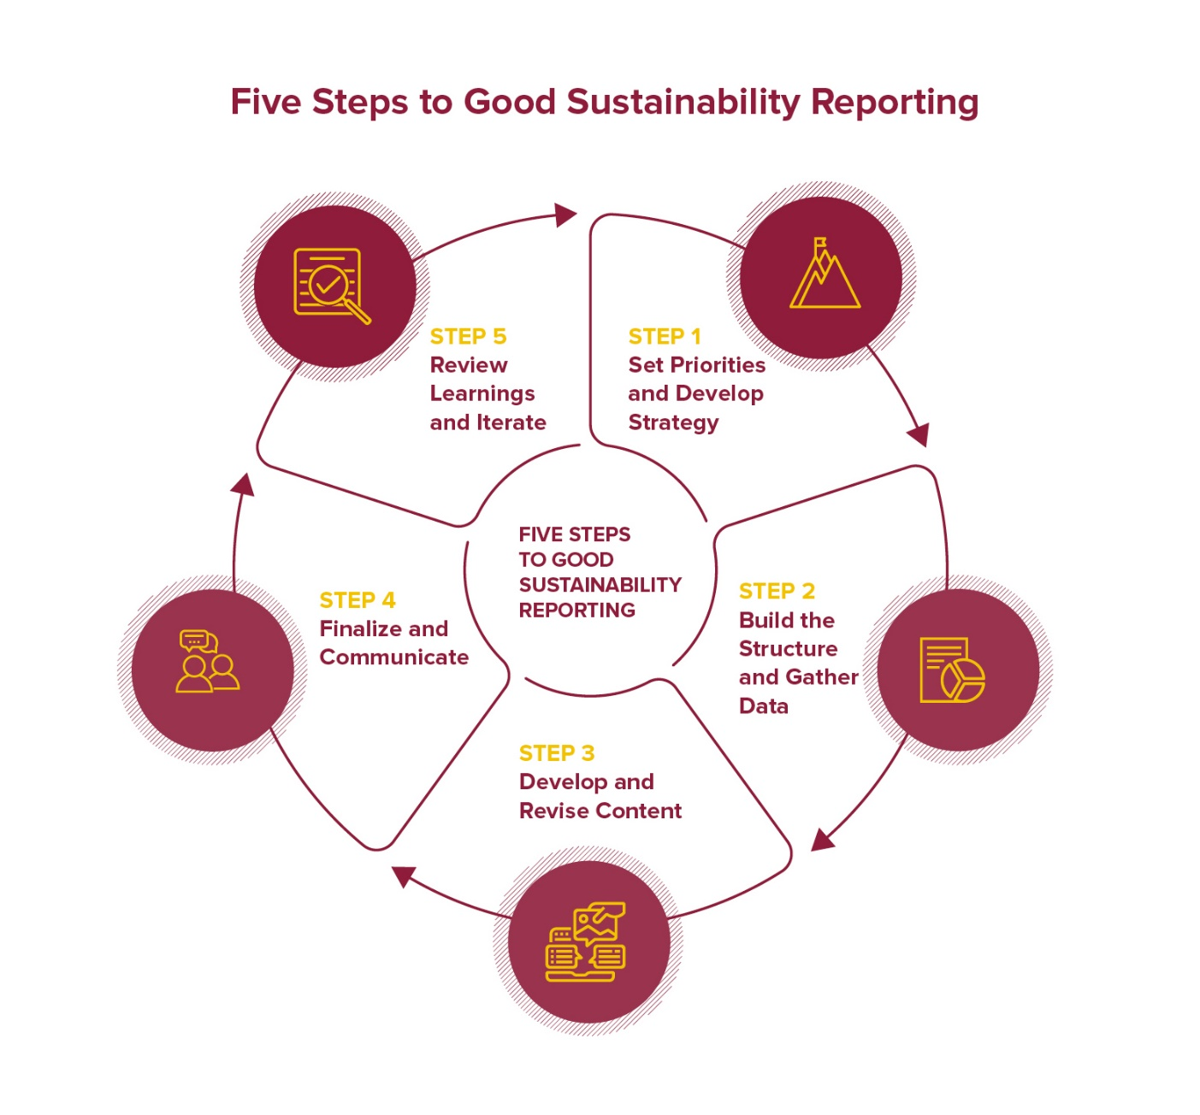
C. Reporting

Slide 12
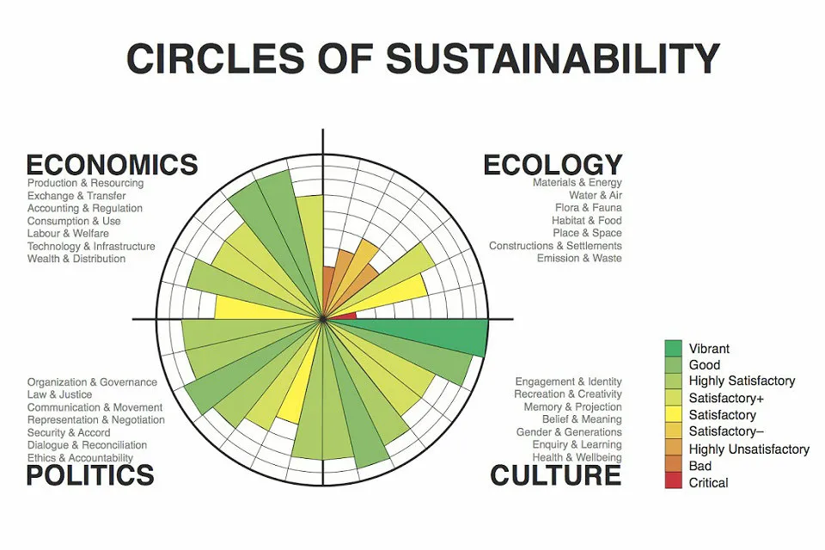
C. Reporting
Examples

Slide 13
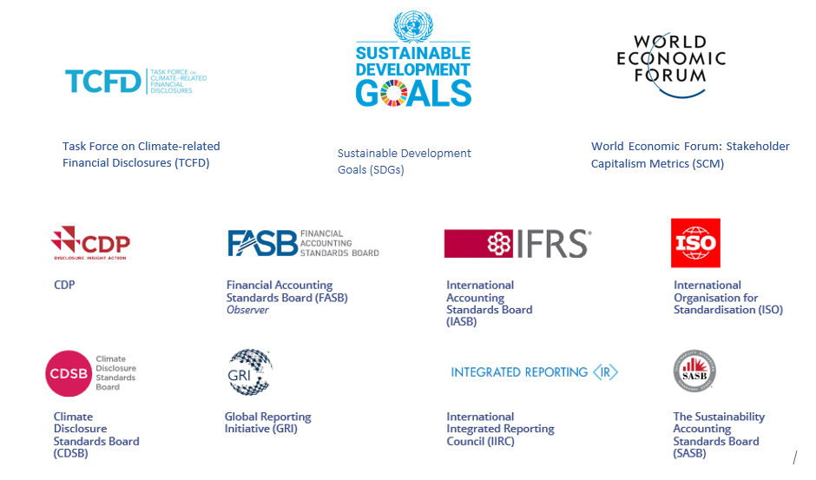
C. Reporting
Indices

Slide 14
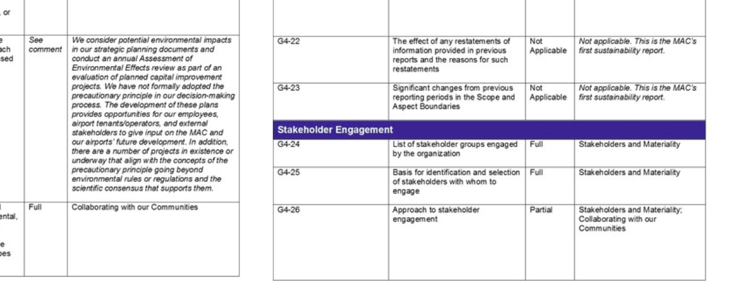
C. Reporting
Indices

Slide 15
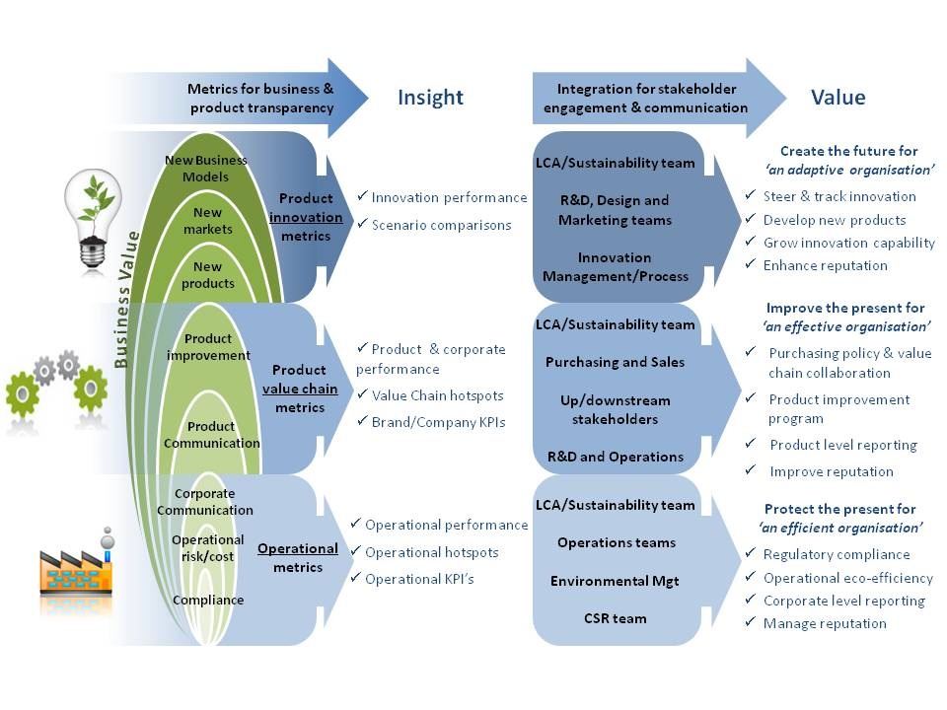
C. Reporting
Source: pre-sustainability.com, 1/2022

Slide 16
Reflection
Have a look at corporate website and check the ”reporting” on their CSR & sustainability related activities:
What are the main issues?
Are there any slogans or “buzz words” that you might find on other websites as well?
Check the sustainability reporting of energy corporates (REWE, Vattenfall, Shell etc.)
What are similarities and differences?
What are visual icons used in communication frequently – why?
Who is the target audiences of the website information available on the website? What about target audiences if the reporting?

