Slide 1
Communication of Sustainability
Lesson 03: Strategic Communication of Sustainability

Slide 2
Where are we?
Episode 1: Communication of Sustainability
Episode 2: Organizations & their Stakeholder
Episode 3: Strategic Communication of Sustainability
Episode 4: Sustainability Reporting

Slide 3
Learning outcomes
Learning outcome 1:
Describe the diverse nature of contemporary practices of sustainability communication on an individual, organizational and societal level, the relationship of strategic communication practices to other public communication practices, the role of stakeholders and publics and the communication practitioners in and outside of organizations (corporate, NGO, political and educational institutions etc.)
Learning outcome 2:
Develop comprehensive and well-founded knowledge in sustainability communication as field of study, an understanding of how other disciplines relate to the field and an international perspective on the field.
Learning outcome 3:
Understand the key elements of communication theories, strategies and tactics, and, thus, the character and operationalization of best practice sustainability communication planning frameworks.
Learning outcome 4:
Advance your understanding of social and civic responsibility and develop an appreciation of the philosophical and social context of sustainability communication. Advance your knowledge and respect of ethics and ethical standards in relation to communication of, about and for sustainability.
Learning outcome 5:
Anticipate and Interpret current issues and challenges of a world in transformation and social change. Develop a deep understanding of and skills to create change, develop advocacy, leadership and authorship in and for sustainability communication.

Slide 4
Overview
Strategic planning of communication
Goals & objectives
Tactics & instruments

Slide 5
A. Strategic planning of communication
Phase 1: Formative Research
Analysing the situation
Analysing the organisation
Analysing Publics
Phase 2: Strategy
Goals and Objectives
Action, response and message strategies
Phase 3: Tactics
Selecting communication tactics
Implementing the strategic plan
Phase 4: Evaluation
Evaluating the plan
Organisational learning

Slide 6
A. Strategic planning of communication
R
Research
What is the problem?
A
Action
What is the best course of action?
C
Communication
How will we communicate this?
E
Evaluation
How will we evaluate this?

Slide 7
A. Strategic planning of communication
How to achieve what the organization wants to achieve
1. Proactive Strategy
An organisation takes the initiative to engage publics
  Engagement, philanthropy and alliances
  Publicity and transparency
2. Reactive Strategy
An organisation responds to influences and opportunities from an organisation’s environment.

Slide 8
A. Strategic planning of communication
Directs ‘how’ you can achieve the objective
  If your objective is to increase awareness, then your strategy should set out how you will do that
Acts as a guiding principle for campaign
Works as your overarching theme
Limits the tactics and channels you use.

Slide 9
B. Goals & Objectives
Objective
WHAT (you would like to achieve?) & WHY
Strategy
How (you will do it, reasoned argument?)
Tactics
actions, to fulfill the strategy and succeed
(Overarching) GOALS
POSITIONING
Notes:
Let’s get back to our flipchart again … cogwheel … if there are new narratives and stories told on the tactical level -> this has an effect on the strategy and the objective!
constitutive approach!!!
Because we cannot underestimate the sense making processes happening in all kind of conversations and discourse, of chats about a corporation etc. … especially in a digitalized, social media world with a very specific media logic

Slide 10
B. Goals & Objectives
Goal
Must be rooted in the organization’s vision or mission statement.
Broad general outcomes you want to see achieved as a result of persuasive efforts. Not quantifiable.
  “Inform customers about the benefits of Bamboo toothbrush.”

Slide 11
B. Goals & Objectives
Objectives
Awareness objectives
  Focus on information
  Deal with dissemination and message exposure
  Impact upon what public knows about the organization, products & services.
Acceptance objectives
  Deals with the affective (feeling part) of message.
  Help to form and reinforce interests & attitudes
Action objectives
  Aim to solicit a behavioral response be it opinion or behavior.
  Can be linked to the bottom line and relationship building.

Slide 12


B. Goals & Objectives
Anatomy of an objective
Sources:
Photo „gas punk“ by Patrick hendry on Unsplash
Photo „earth“ by NASA on flikr
Nature of intended change
Target public
Target Date
By July 1, to increase percentage of home owners from three to 25 percent who know that wildfires destroyed more than 2,500 homes during the past three years.
Amount desired change
Knowledge outcome to be achieved

Slide 13
B. Goals & Objectives
Goal, objectives (goal, vision)
Ideas, vision/mission, goal
(Olivant, 2016; Botan, 2006)
Strategy
Plan, including messages, themes, and products
(Plowman, 2013, Saxton & Waters, 2014)
Tactics („initiatives“)
Operations, practices, content, relationships
(Plowman & Wilson, 2018; Botan, 2006)
Grand strategy
Notes:
when we link our cogwheels to the literature
from a management perspective...
this is what we know now :-)
every organization has ...

Slide 14
C. Tactics & Instruments
Let’s take a minute to think …

Slide 15
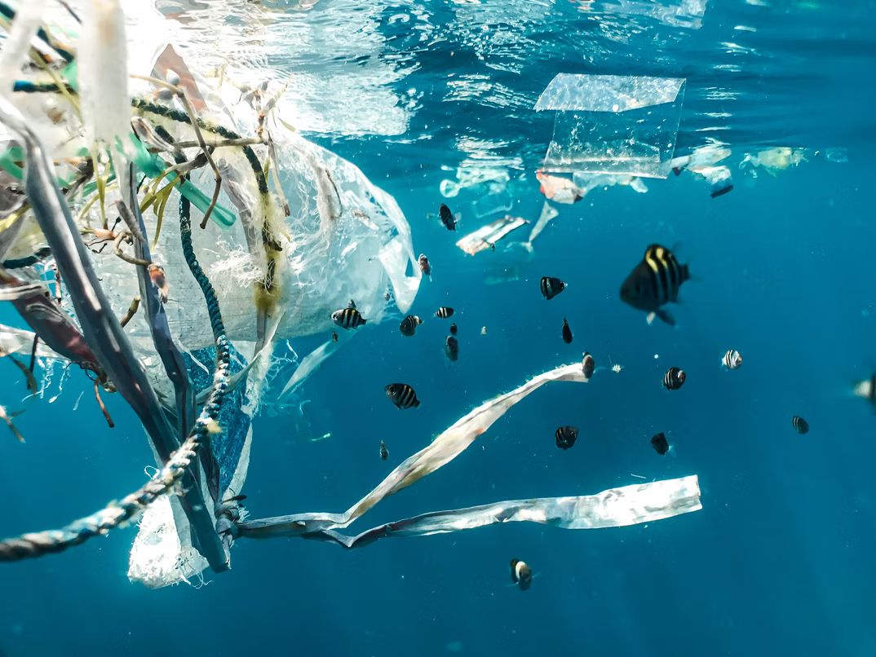
What about you
Photo by Naja Bertolt Jensen on Unsplash
Notes:
You can know officially use your mobile phone … ☺
Look at your phone or think about your apps … ? At least one app related to a sustainable lifestyle (health/wellbeing, sport/activities, food, farmers markets, app to discover microplastic in cosmetics and food
It’s a global trend to a more sustainable lifestyle !!!

Slide 16

Photo by Trent Haaland on Unsplash
Notes:
Without you being an eco warrior and explicitly engaged in a sustainability related topic

Slide 17

Photo by Jacopo Maia on Unsplash
Notes:
You probably try to buy local and organic food …

Slide 18

Photo by Priscilla Du Preez on Unsplash
Notes:
… and use less plastic bags!
And of course - related to your individual behavior - something is happing on the corporate level …

Slide 19
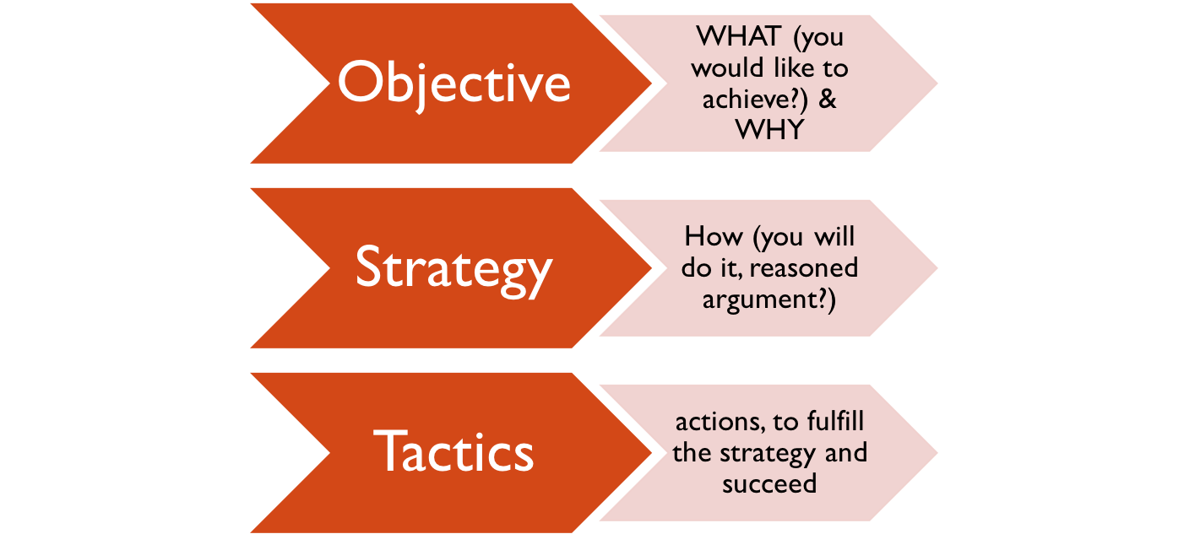
C. Tactics & instruments
Colors old
Mc Donald Logo
Colors new
Mc Donald Logo
Notes:
The objective to go green is popular for all sized business and all kind of organizations – no question –
Why? Because there is a public discourse on climate change related problems, there are the Sustainable Development Goals and there are initiatives and regulations on a national level as well as very engaged consumers ☺ like you …
so even Mc Donalds decided to GO GREEN
That’s the WHAT – but HOW did they do it?

Slide 20
C. Tactics & instruments
REGIONALIZATION
Notes:
For A and CH – developed a strategy – tied to the goal to be more sustainable
The strategy is called: regionalization – klick klick klick
this strategy lead to certain tactics

Slide 21
C. Tactics & instruments
Notes:
For example: Offering bits and pieces of information online

Slide 22
C. Tactics & instruments
Photo: https://adisagroblog.wordpress.com/2009/07/16/enthullt-warum-mcdo-nur-hackfleisch-serviert/
Notes:
And advertising panels like this one in Switzerland.
Yes, from a pragmatic perspective, a regionalization strategy should work in Austria & Switzerland nicely ...
however: it wasn't as successful as it could have been ... mainly because...

Slide 23
https://www.nzz.ch/mc_donalds_wirbt_mit_sterreichischer_kuh_fr_schweizer_fleisch-ld.780819?reduced=true
Notes:
irritation - had it's effects ... _> Discourse started that wasn’t part of McDonalds’s strategy!
This public discourse on greenwashing did definitely not help to reach their goal!
Hmm…. What is the learning from that about strategy and tactics …?!?

Slide 24

C. Tactics & instruments
Objective
WHAT (you would like to achieve?) & WHY
Strategy
How (you will do it, reasoned argument?)
Tactics
actions, to fulfill the strategy and succeed
Pragmatic approach
Icon made by Raj Dev from www.freeicons.io
Notes:
something can go wrong - no question -
the learning from a theoretical perspective is –that the managemnt focus, pragmatic approach in strategic communication seems to be logic – it’s looks like a causal chain: if we want to reach this we have to do tHAT –

Slide 25

C. Tactics & instruments
Objective
WHAT (you would like to achieve?) & WHY
Strategy
How (you will do it, reasoned argument?)
Tactics
actions, to fulfill the strategy and succeed
Pragmatic approach
Constitutive approach
Icon made by Raj Dev from www.freeicons.io
Notes:
Let’s get back to our flipchart again … cogwheel … if there are new narratives and stories told on the tactical level -> this has an effect on the strategy and the objective!
constitutive approach!!!
Because we cannot underestimate the sense making processes happening in all kind of conversations and discourse, of chats about a corporation etc. … especially in a digitalized, social media world with a very specific media logic

Slide 26
Which leads us back to ...
Paradigms
Pragmatic (information, education, instrumental sense of communication, functionalist/structural perspective, description of reality)
Constitutive (symbolic action, social constructivism, sense making, define sth as problem, creates attention, evokes values, orientation, activates/stimulates engagement, exploration)
Icon made by Raj Dev from www.freeicons.io
Notes:
Did you bring your „glasses“?!? What are the persepctives from which we‘re coming analysing wahts going on out there? ...
When we started on our „trip“ to understanding strategic communication we started with various theoretical approaches ... all exploring and explaining organizational communication and communictaio management with a „paradigm“/basic understanding in the background ...

Slide 27
Which leads us back to ...
Strategic communication (structural perspective)
the purposeful use of communication by an organization to fulfill its mission (Hallahaan, 2007, p. 3; Holtzhausen & Zerfass, 2015)
understanding “how a certain set of audience attitudes, behaviors, or perceptions will support those objectives” is what makes communication strategic (Paul, 2011, p. 5).
Communication management (process related, constitutive perspective)
constitutive flows of communication (McPhee & Zaug, 1995, Putnam & Nicotera, 2007; Schoeneborn et al., 2016)
Questions: narratives, discourses, interaction, interrelatedness, power, negotiation processes
Icon made by Raj Dev from www.freeicons.io
Notes:
our general topic!
Two paradigms of communication – the strategic comm. perspective
Linear, transmission, management persepctive – that comes through in strategic comm literature ...
However:
I would like to encourage you as critical communication students to take broader communication management perspective.
Think about how an organization can strategically take part in public discourses and design new narratives of sustainability for example
IF WE DON'T RECOGNIZE THE NARRATIVES AD DISCOURSE - THIS WILL BACKFIRE ON US AS A CORPORATE

Slide 28
Reflection
What is the difference between strategic communication and communication management. Why does it matter?
What are the 4 steps of a strategic communication plan?
Think of an organisation you work for/are embedded in (your work place, your sports club, church or University).
  what could be a sustainability related goal for their communication in the future?
  Would this aim for acceptance, awareness or activation?
  What would be a related obective?
What could be a related strategy – what possible tactics? Why did you choose them? What is there connection to the objectives set?

