Slide 1
Communication of Sustainability
Lesson 02: Organizations & their Stakeholder

Slide 2
Where are we?
Episode 1: Communication of Sustainability
Episode 2: Organizations & their Stakeholder
Episode 3: Strategic Communication of Sustainability
Episode 4: Sustainability Reporting

Slide 3
Learning outcomes
Learning outcome 1:
Describe the diverse nature of contemporary practices of sustainability communication on an individual, organizational and societal level, the relationship of strategic communication practices to other public communication practices, the role of stakeholders and publics and the communication practitioners in and outside of organizations (corporate, NGO, political and educational institutions etc.)
Learning outcome 2:
Develop comprehensive and well-founded knowledge in sustainability communication as field of study, an understanding of how other disciplines relate to the field and an international perspective on the field.
Learning outcome 3:
Understand the key elements of communication theories, strategies and tactics, and, thus, the character and operationalization of best practice sustainability communication planning frameworks.
Learning outcome 4:
Advance your understanding of social and civic responsibility and develop an appreciation of the philosophical and social context of sustainability communication. Advance your knowledge and respect of ethics and ethical standards in relation to communication of, about and for sustainability.
Learning outcome 5:
Anticipate and Interpret current issues and challenges of a world in transformation and social change. Develop a deep understanding of and skills to create change, develop advocacy, leadership and authorship in and for sustainability communication.

Slide 4
Overview
Organizations
Organizations & Communication
Issues & Crises
Stakeholder

Slide 5


A. Organizations
Organisation
Institution
Funktionen
Instrumente
Organisation mit Zielen, Werten, sozialen Aufträgen und Absichten
Organisation und Zusammen-arbeit, Kooperation, Management und Kompetenzen
Organisation mit Strukturen, Abläufen, Regeln, Hilfen, Vorschriften
© Weder
Notes:
Der institutionale Organisationsbegriff: vor allem durch Org.-Soziologie und -psychologie geprägt verstehen darunter ein „zielgerichtetes, offenes, soziales Gebilde mit einer formalen Struktur“
- Ziele, die sich eine Org, steckt, ergeben sich aus den Interessen und Bedürfnissen der Menschen, die sich in ihr organisiere; nEs werden Regeln aufgestellt, die helfen, die gesteckten Ziele zu erreichen
Der funktionale O.-Begriff: - Tätigkeiten, die notwendig sind, die Org. zu gestalten und Regeln zu planen, die organisatorischen Grundanforderungen und Regeln zu planen
- Funktionen des Managements haben zzwei Aufgaben: Aufgaben sind an MAs zu verteilen, Arbeitsprozesse zu segmentieren, Sachmittel einzuteilen = Arbeitsteilung/Differenzierung; die so gebildeten Elmente müssen dann zusammengehalten werden, damit sich alle auf ein übergeordnetes Ziel hin orientieren, und die Zielerreichung sichergestellt ist, Koordination und Integration sind hier die zentralen Aufgaben
Der instrumentale Org.-Begriff: eng verbunden mit der betriebswirtschaftlichen Org.-Lehre Gutenberg: Org ist die Apparatur, die die Aufgabe hat eine durch Planung vorgegeben Ordnung zu realisieren
Ø formale Org.: bewusst und rational gestaltet, gewöhnlich schriftlich fixiert, je nach Formalisierungsgrad sind Tätigkeiten, Ablauf- und Kommunikationswege fixiert; Ausnahmen werden nur akzeptiert, wenn diese schriftlich vorliegen und entsprechend abgesichert sind
Ø informale Org.: bezieht persönliche Aspekte der MA, deren Verhaltensweisen und Ziele mit ein; spontane nicht geplante Beziehungen spielen eine Rolle, informale Machtbeziehungen und Gruppierungen, informale Kommunikationswege und -strukturen sind weitere Kennzeichen; die informelle kann die formelle Org. behindern oder auch unterstützen

Slide 6
A. Organizations
Degree of organization
Organization
Loose structures
market
contracts
Networks
Tight structures
hierarchy

Slide 7
A. Organizations
Influences on organizations
Economic influences
Political, policy influences
Demographic influences
Organization
Physical influences
Socia-cultural influences
Technical influences

Slide 8
B. Organizations and Communication
“it is obvious that without communication there can be no organization”
(Simon 1957)
Simon, H. A. (1952). Comments on the Theory of Organizations. American Political Science Review, 46(4), 1130-1139.

Slide 9
B. Organizations and Communication
Assumptions:
an organization consists of a group of people
… who work together to achieve a common purpose;
an organization is bigger than the individuals and groups that comprise it, but smaller than the society that gives it its context and environment

Slide 10
B. Organizations and Communication
Assumptions:
Organizations are constituted through communication
Organizational communication is “network communication”, including all communication within, out of and about an organization

Slide 11
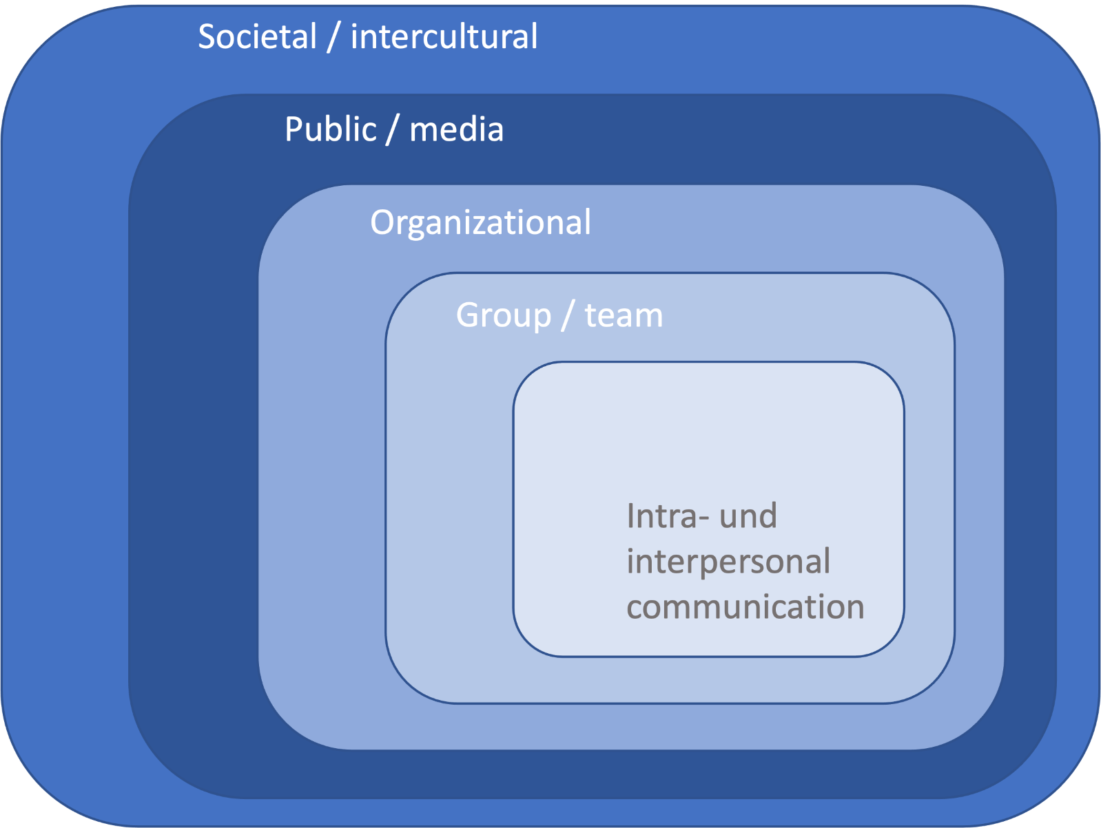
B. Organizations and Communication

Slide 12
B. Organizations and Communication
Organization as “socially constructed verbal systems constituted by multiple, simultaneous and sequential narratives that not only interweave and harmonize but contest and clash” (Brown et al., 2008, p. 1040)
“hidden patterns” in conversations – a pattern is the “organization” of a conversation (Taylor & Van Every, 2011, p. 21)

Slide 13
C. Issues & Crises
Media/Public discourses
Public Relations & Marketing
Organizational communication

Slide 14
C. Issues and Crises
Media/Public discourses
Public Relations & Marketing
Organizational communication
Risk & Crisis
Risk & Crisis
Issues

Slide 15
D. Stakeholder
„Stake“: An interest in an organization, for which a justified and normative demand can be made (Reed, 1999)
„Stakeholder“: „any group or individual who can affect or is affected by the achievement of the organization’s objectives.”(Freeman 1984, S. 46)

Slide 16
D. Stakeholder
Stakeseekers? Those who assert their interests and concerns, seeking acknowledgement and action from an organization

Slide 17
D. Stakeholder
Provide resources, which are important to organizational success e.g. capital, workforce, „licence to operate“, social acceptance
Their well-being is intertwined with the fate of the organization e.g. employment, environmental conditions, products
They have sufficient influence to impact organizational performance e.g. mobilising of social forces, restraining resources

Slide 18
D. Stakeholder
Ways to identify / differentiate stakeholder
General
Internal / external
Primary / secondary
Impact & functionality
Arenas

Slide 19
D. Stakeholder
Stakeholders
Customers
General:
Governments
Employees
Investors
Communities
Suppliers

Slide 20
D. Stakeholder
Internal & External:
„internal“ e.g. boardmembers, key management, employees, legal representatives, shareholders.
„external“ e.g. customers, investors, financial partners (including banks), community leaders, customers, clients, suppliers, vendors, creditors, physical neighbours, special interest groups, environmental groups, competitors, union officials, government agencies, media.

Slide 21
D. Stakeholder
Primary & secondary

Slide 22
D. Stakeholder
Enabling

Slide 23
D. Stakeholder
Enabling
Who has the priority? For day to day operations ...
Enabling and functional – are critical to the daily operation of an organization
Normative – should be kept in mind but are not critical to the operations of an organization (can offer a third-party endorsement)
Diffused – media and community exert influence over public opinion (Rawlins 2006)

Slide 24
D. Stakeholder
Stakeholder arenas
The media move an issue from being just between and organisation and its stakeholders into the public arena
The media play an important role:
  Highlighting an issue
  Creating widespread
  awareness
  Influencing public opinion
  Driving an issue
  Fuelling in a crisis
  Assisting in communication

Slide 25
D. Stakeholder
Strategic stakeholder concept (Freeman, 1984)
Selection of relevant groups based on their power and influence with regard to organizational goal achievement and future
Secure acceptance and cooperation
Ethical stakeholder concept(Ulrich, 2001)
All individuals and groups are stakeholders independent of influence, power, position
Criterium for selection is moral justification of legitimacy of interests
Conflicts of interest are solved on the basis of acceptance and insight

Slide 26
D. Stakeholder
The earliest definition is credited to a memo produced in 1963 by the Stanford Research Institute: “Those groups without whose support the organization would cease to exist”.
Stakeholder theory developed to be inclusive of all groups who affect an organisation (not necessarily supporters, e.g. competitors and opponents).
Suggests if an organisation neglects a stakeholder group, the group has the ability to have a negative impact on the organisation.

Slide 27
D. Stakeholder
Freeman (1984) said it is necessary for an organization to manage its relationships with specific stakeholder groups in an action-oriented way
Demetrious (in J&Z 2009) said it orientates business to include the third sector, and flags an environment ... in which activism, the state and business may interact in less adversarial way.
Because it is impossible that all stakeholders will have the same interests in and demands on the organization, stakeholder management is about managing potentially conflicting interests.
This means we need to be strategic and planned when dealing with stakeholders.

Slide 28
D. Stakeholder
Based on the idea that organizations deal with a range of publics whose activity (or lack of it) is dependant on a given situation.
Allows us to identify which publics (or stakeholders) communicate actively or passively, or not at all, about the organizational decisions that affect them (Grunig 2005)

Slide 29
D. Stakeholder
Non-publics - People who do not face the problem
Latent publics - People who face the problem, but do not recognise it as a problematic
Aware publics - Those who recognise the problem
Active publics (these take priority) - Those who do something about the problem

Slide 30
D. Stakeholder
Three reasons why people become active publics:
1. Problem recognition – the extent to which people detect a problem/issue (see connection between them and a problem)
2.Constraint recognition – the extent to which people identify obstacles to act on the problem/issue
3. Level of Involvement – the extent to which people feel connected to the problem/issue (Grunig 2005)

