Slide 1
Sustainability Communication as Field of Research
Lesson 04: Future Methodologies, Engagement

Slide 2
Overview
Institutionalization (programs, journals, organizations, chairs)
Methodologies, heuristic
Epistemic "core", paradigms

Slide 3
Where are we?
Episode 1: Literature review, status quo
Episode 2: Methodologies used / studies
Episode 3: Issues, topics and degree of institutionalization
Episode 4: Future methodologies, engagement

Slide 4
Learning outcomes
Learning outcome 1:
Describe the diverse nature of contemporary practices of sustainability communication on an individual, organizational and societal level, the relationship of strategic communication practices to other public communication practices, the role of stakeholders and publics and the communication practitioners in and outside of organizations (corporate, NGO, political and educational institutions etc.)
Learning outcome 2:
Develop comprehensive and well-founded knowledge in sustainability communication as field of study, an understanding of how other disciplines relate to the field and an international perspective on the field.
Learning outcome 3:
Understand the key elements of communication theories, strategies and tactics, and, thus, the character and operationalization of best practice sustainability communication planning frameworks.
Learning outcome 4:
Advance your understanding of social and civic responsibility and develop an appreciation of the philosophical and social context of sustainability communication. Advance your knowledge and respect of ethics and ethical standards in relation to communication of, about and for sustainability.
Learning outcome 5:
Anticipate and Interpret current issues and challenges of a world in transformation and social change. Develop a deep understanding of and skills to create change, develop advocacy, leadership and authorship in and for sustainability communication.

Slide 5
Recap
Sustainability communication – new, “critical” methods needed
Empowerment strategies; communication and participation
interactive approaches geared towards shared meaning-making, deliberation, and social learning
Education / BNE, ESD
Communication planning, future workshops, advocacy planning
„The more open and encompassing a scientific community, the more socially robust is the knowledge, it produces“. Openness in this context does not only refer to an institutional or an object-related openness, but also includes a methodological and methodical openness. „In order to fill out the epistemological core, it continuously takes a plurality of scientific traditions“.

Slide 6
Overview
Why do we need new methods?
What could “sustainable methods” be?
Examples
Analysis

Slide 7
A. Why do we need new methods?
A critical approach involves “posing questions, including awkward and unpopular ones…. not merely taking information for granted…but asking how and why these things come to be…”
Downing, Mohammadi, & Sreberny-Mohammadi (1995, p. xx).
Thus, it includes asking ‘what if’?
Notes:
Essential to understanding what might be in the future, and giving us the best chance to plan for it.

Slide 8
A. Why do we need new methods?
UN 2030 Agenda for Sustainable Development
Transformative change
Eco-social policies in line with a reversed normative hierarchy that positions social and environmental priorities above economic ones
Address distributional consequences of climate change policies
Engage affected populations actively in planning and implementation – better results
Promote and provide enabling environment for social innovation (including behavioural change)
Participatory democracy (Dryzek):
Allows for uncertainty and social choice
Society based enquiry
Collective action
Contextually based
Multiple Futures
Todays Knows & Uncertainties
Notes:
Need to understand environmental destruction and climate change as social and political issues.

Slide 9
B. What could “sustainable methods” be?
Gathering Data in Sustainability Studies / Sustainability communication:
Empowerment & Participatory approaches (sustainable communication!)
Design Thinking / Scenario thinking
Creative approaches
Critical pedagogy

Slide 10
C. Examples: Participatory approaches
Gathering data with empowerment & participatory approaches
Goal: help people actively shape the conditions of their own life
involves developing the competence to recognise non-sustainable activities and then apply knowledge about sustainability to remedy them
Core idea: strengthen civil society, promote individual engagement and support political education processes that enable individuals to actively take part in shaping a sustainable society
involves the ability to reflect critically on the uncertainties and risks, different types of rationality as well as the consequences of one's own actions, which are an intrinsic part of such an engagement
Methods: variety of different communicative planning and participation instruments plays a role here, from future workshops to future conferences as well as round tables and mediation or advocacy planning and E-participation.

Slide 11
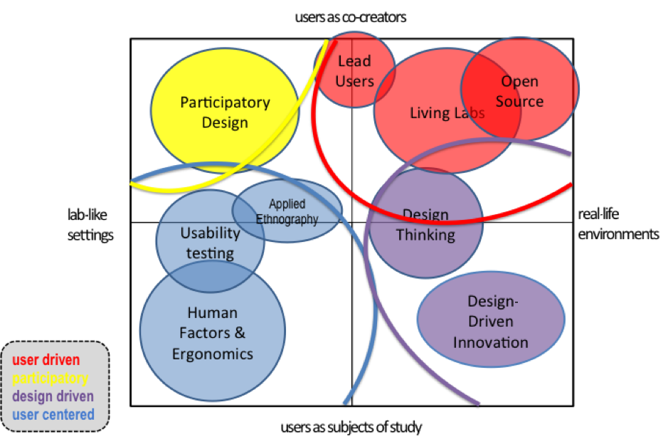
C. Examples: Design & Scenario thinking
Design Thinking & Scenario Thinking
Source: Almirall, E.; Lee, M.; Wareham, J (2012): Mapping Living Labs in the Landscape of Innovation Methodologies, Technology Innovation Management Review, URL: https://timreview.ca/article/603 (11.07.2022)
Notes:
User centered. Users are mostly passive subjects of study. This is the case of usability testing, human factors, and applied ethnography.
Design driven. Designers take the lead. Design-driven methodologies normally work in real-life environments; however, they are led by designers who seek to find novel solutions.
Participatory. Users are considered on equal ground with the rest of the partners in a co-creative process. Participatory design, particularly the Scandinavian tradition, and generative design research belong to this category.
User driven. Where the user is the one who drives the innovation process. Such is the case of open source, lead users and living labs.

Slide 12
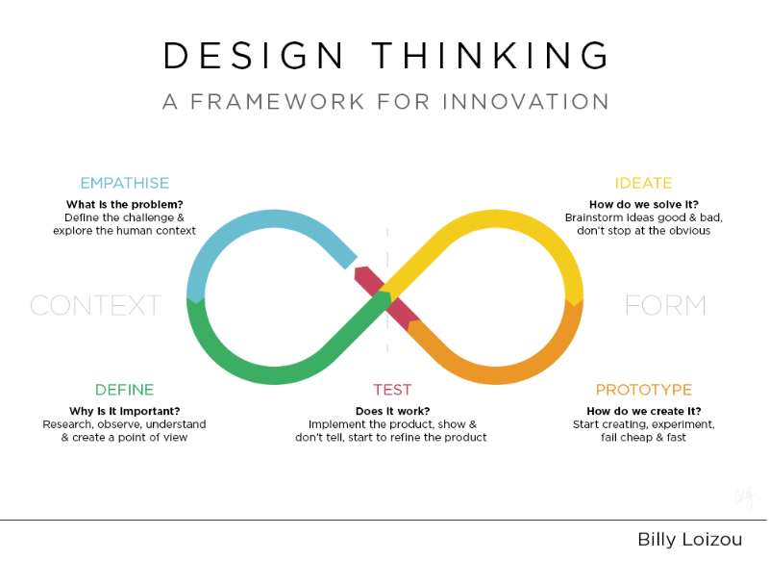
C. Examples: Design & Scenario thinking
Design Thinking & Scenario Thinking
Source: Billy Loizou.com, Original graphic by: Ashish Goel URL: https://medium.com/@ashpodel/good-design-is-making-a-misfit-free-ensemble-2ce5fe25bdb0 (11.07.2022)

Slide 13
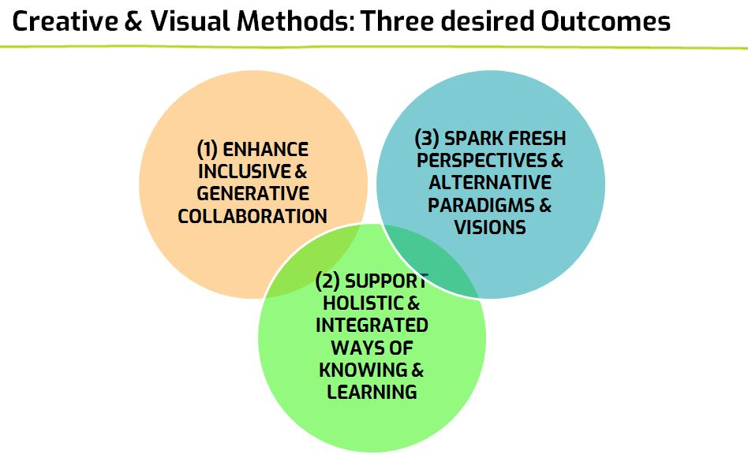
C. Examples: Creative approaches
Creative approaches
Source: Re Imaginary. Cultivating Cuktures of Sustainability: Using Creatrive and Visual Methonds online – a Workshop contributed by Angela Moriggi, URL: https://www.reimaginary.com/resources/using-creative-visual-methods-online-a-workshop (11.07.2022)

Slide 14
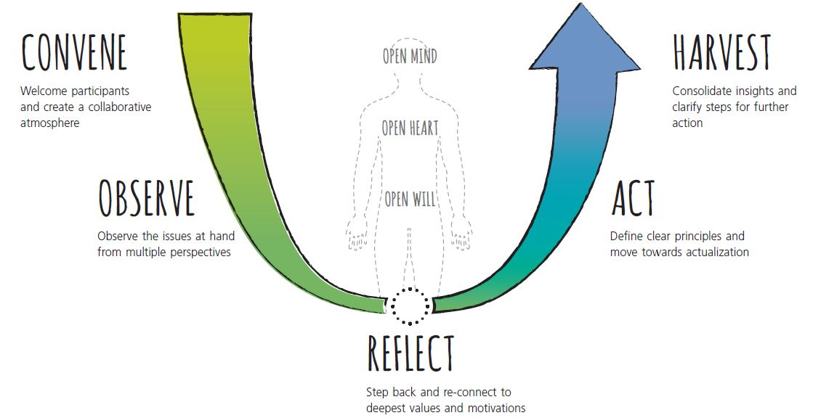
C. Examples: Creative approaches
Creative approaches
Source: Re Imaginary. Cultivating Cultures of Sustainability: Theory U: 5 phases in the workshop structure, URL: https://www.reimaginary.com/resources/theory-u (11.07.2022)

Slide 15
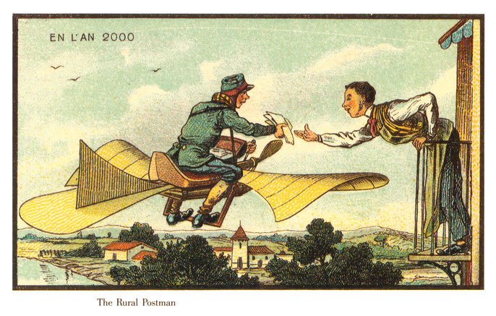
C. Examples: Creative approaches
Creative approaches
Source: Victoria Museum 1/2022
Notes:
Postcards from the future:
Each person writes a postcard to themselves from an imagined relative or relation from a future generation (e.g. great-grandchildren or great-grandchildren of friends).
Participants are asked to imagine that important positive changes have taken place in part due to their efforts, and that the future person wants to thank them.
The postcard describes the way things are in the future, actions that were taken to get there, and extends gratitude to the people from the past (and the writer specifically) for their efforts and caring.
This method stimulates concrete positive visions of the future (which have been shown to help catalyze action), suggests concrete pathways and actions to get there, and incorporates the future generations into one’s current identity (essentially expanding the sense of self through time). Because the exercise is relatively broad and open ended, it often provokes unexpected, spontaneous ideas. The front of the postcard can be designed via drawing or collage. Key themes and images can be collected for data.

Slide 16
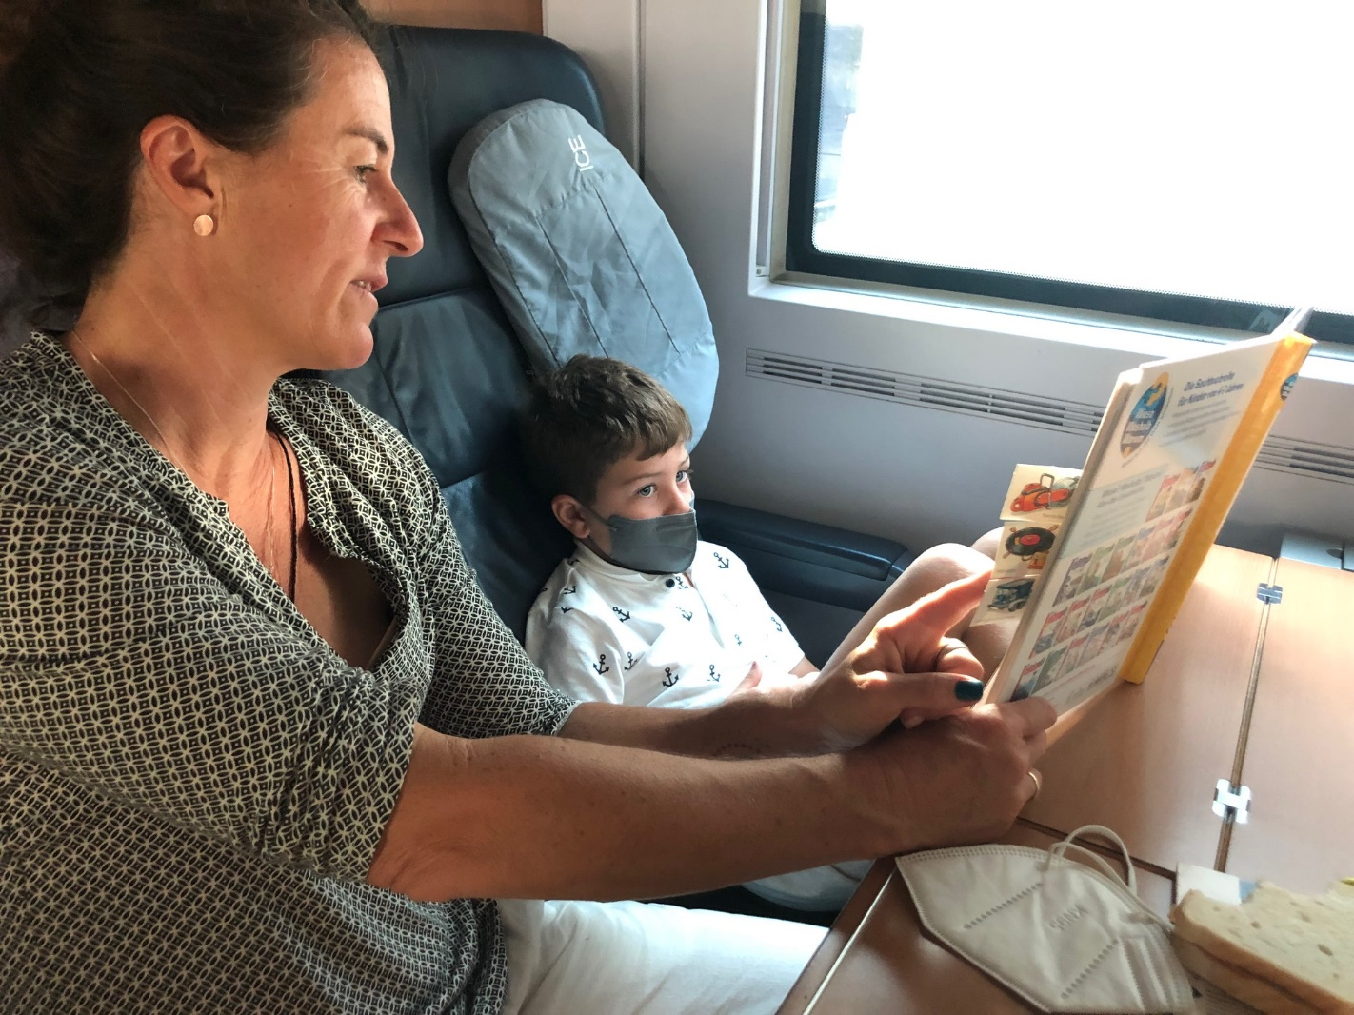
C. Examples: Creative approaches
Creative approaches
We give the world meaning through the stories we tell, thus the ability to craft a narrative that invites empathy and facilitates ‘seeing with fresh eyes’ can be a powerful tool for supporting transformation.
Source: private
Notes:
The stories we tell are never neutral, and the way a case study is described significantly impacts the responses of the audience. For example, it can determine if people feel a personal sense of involvement and care, or if they are left as outside spectators. The metaphors we use, the information we include, and the information we leave out all contribute to conveying both overt and subtle worldviews. With this in mind, it is worth taking the time and attention to carefully craft a narrative that intentionally evokes specific (transformative) mindsets. In the cases presented in our experimental workshops, we focused on stories that evoke more-than-human empathy, on an expanded sense of time, and on the importance of sacred space in a community. ‍
Depending on the context, storytelling can be used in different ways. In this example, we suggest that the participants actively listen to the story using all of their senses (smell, sound, taste, touch, visual images) and note down their intuitive associations and thoughts. Alternatively, various versions can be presented as new “transformative stories” and participants asked to reflect on the differences in their personal responses; or, participants can be asked to craft their own stories. ‍
This method of storytelling can be used in conjunction with Contrasting Tweet & Text and Evoking the Senses.

Slide 17
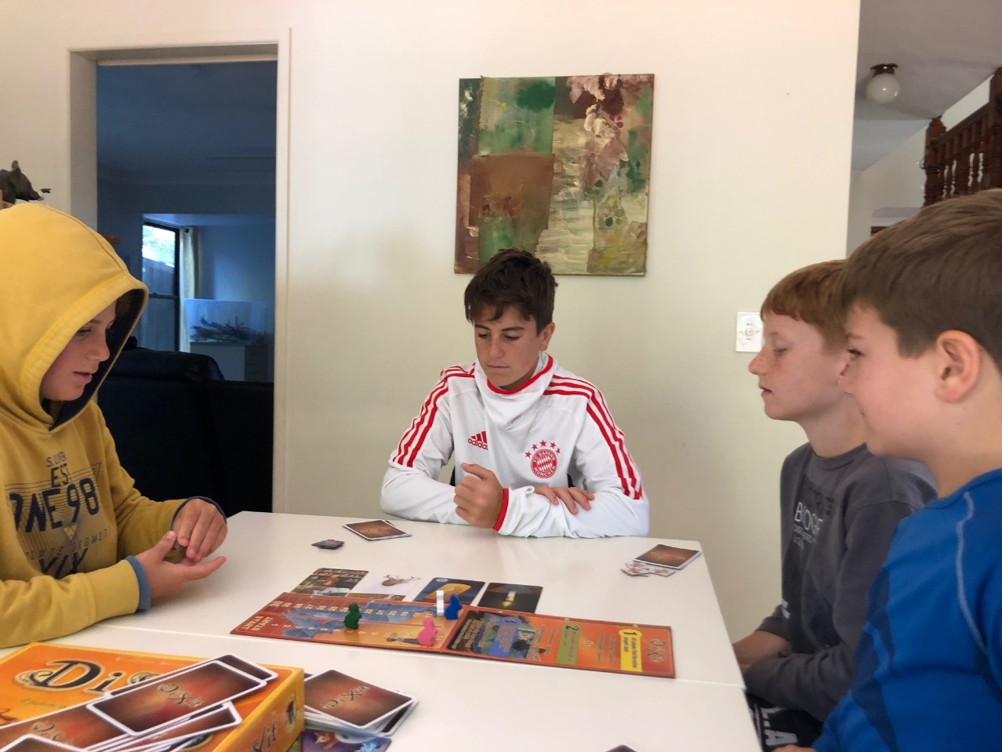
C. Examples: Creative approaches
Creative approaches
Stories We Live By – Eco linguistics
Source: private
Notes:
Visual stimuli
enables people’s creative thinking, as the cards can suggest connections and insights that they were not fully or consciously aware of, encouraging people to break out of formulaic responses

Slide 18

C. Examples: Creative approaches
Creative approaches
Source: Photo by Patrick Perkins on Unsplash
Notes:
This method is for use when exploring a particular case or issue, especially one that is linked to a specific place. Participants are asked to consider the case using their full range of senses (hearing, taste, touch, sight, smell, and emotions or energetic feeling), and to record words, thoughts, and associations that come to mind. They are then invited to share a few of the words or concepts that they found especially illuminating. Consciously designating time and focus to imaginatively engaging all of the senses can lead to new insights and perspectives. Moreover, by capturing and sharing associations, sensations, and emotions, the group becomes more empathetically connected to the case, and to each other.
‍ As a next (optional) step, participants can be asked to group keywords into clusters of related words, or “affinity clusters” (Silent Conversation). This practice highlights both the similarities and the differences in the way that participants perceive the case, and can be a good opening for further dialogue.

Slide 19
C. Examples: Creative approaches
Creative approaches
Gamification
Kahoot! (kahoot.com)
ECO (https://play.eco/)
Notes:
Padelt, miro boards

Slide 20
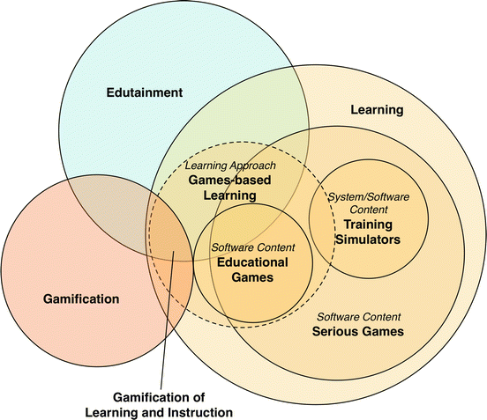
C. Examples: Creative approaches
Creative approaches
Gamification

Slide 21
C. Examples: Critical pedagogy
Critical pedagogy
Goal: assisting learners to acquire the basic knowledge and competencies needed to actively shape a sustainable future for life and work as well as enabling them to participate and empowering them to take action.
„Education for sustainable development“ (ESD): helps to create the conditions for self determined and autonomous action and not just to train changes in behaviour.
Core idea: developing and enhancing the creative potential in the individual, his competencies in communication and cooperative work as well as problem solving and taking action.
Examples for methods (in the formal & informal education sector):

Slide 22
C. Examples: Critical pedagogy
Critical pedagogy
Example: Eco-culture jamming: Eco-culture jamming as art-based intervention (Weintraub, 2012; Lasn, 2000), cracking existing patterns of meaning (Foucault, 1988, O’Sullivan et al., 2002; Sandlin & Milam, 2008, Freire, 1962; Weder & Milstein, 2021; Burns 2015; Michelsen & Fischer, 2015)

Slide 23
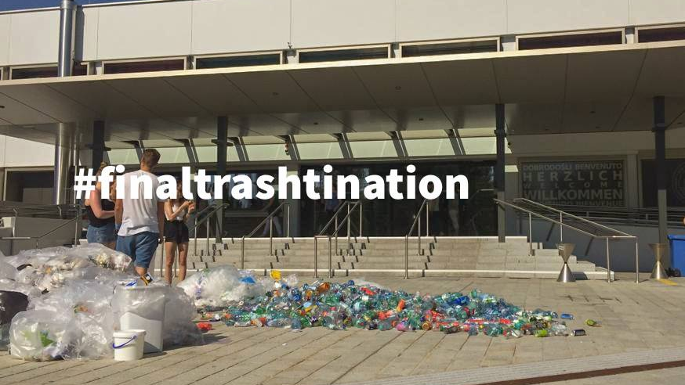
Source: private
Notes:
#finaltrashtination, eco-culture jam/ 1 day activism
_make it visible: waste is not gone just because you put it in the bin
_planned & organized by students (media & comm, 2019, Austria)
_sparking conversations / awareness & cracking hegemonic patterns of meaning

Slide 24
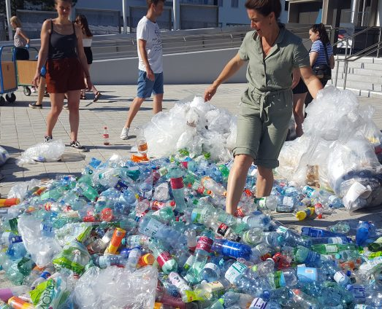
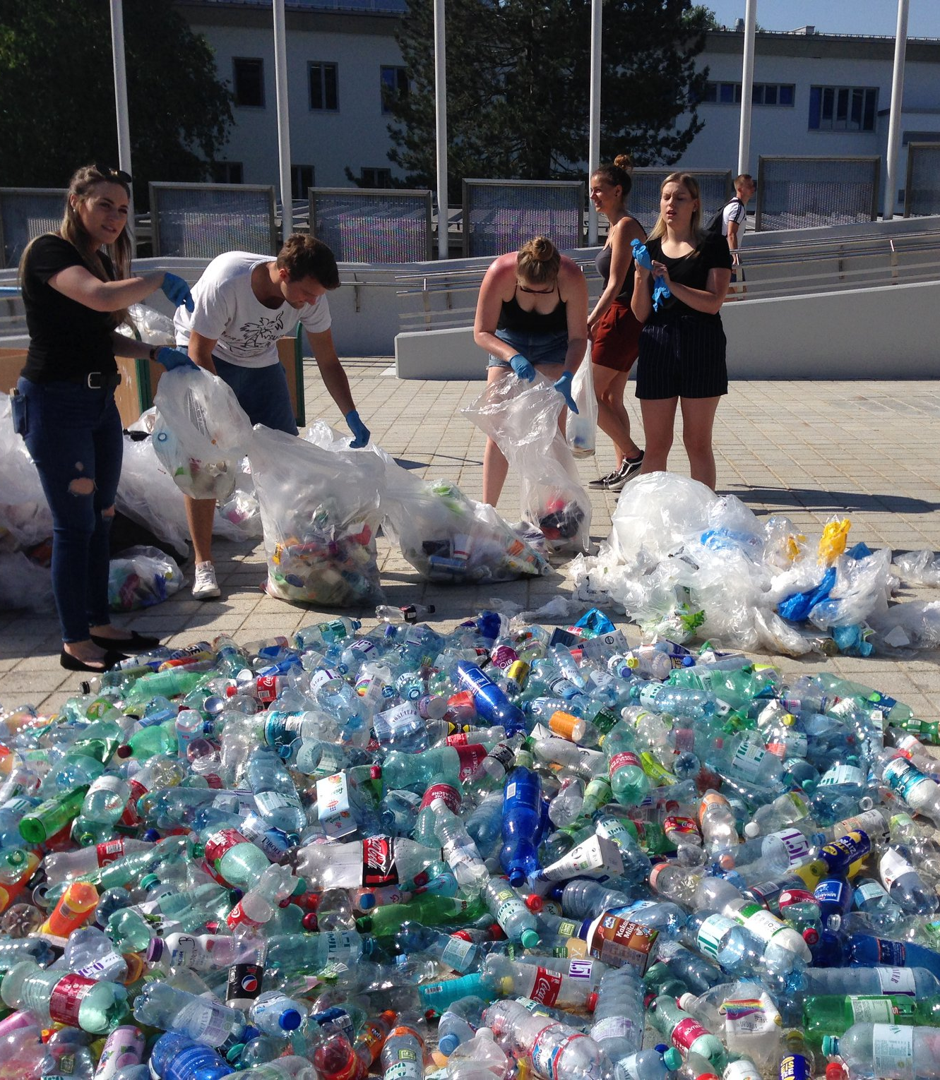
Source: private

Slide 25
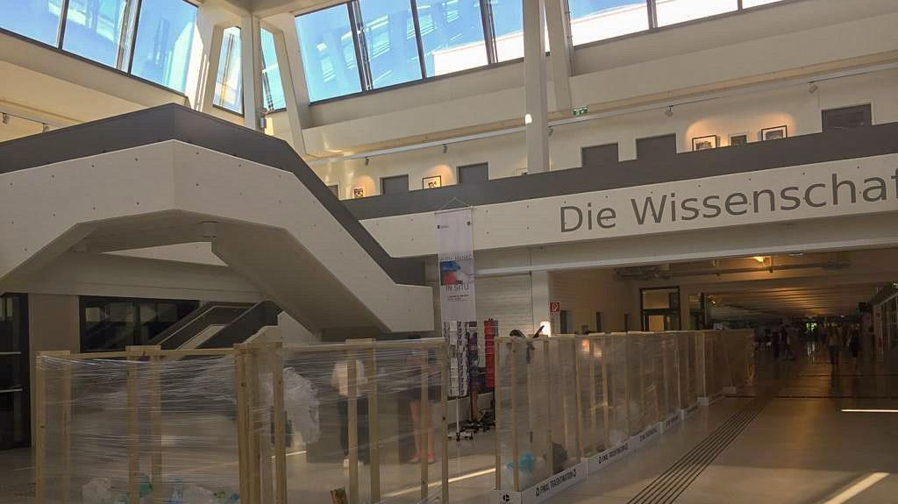
Source: private

Slide 26
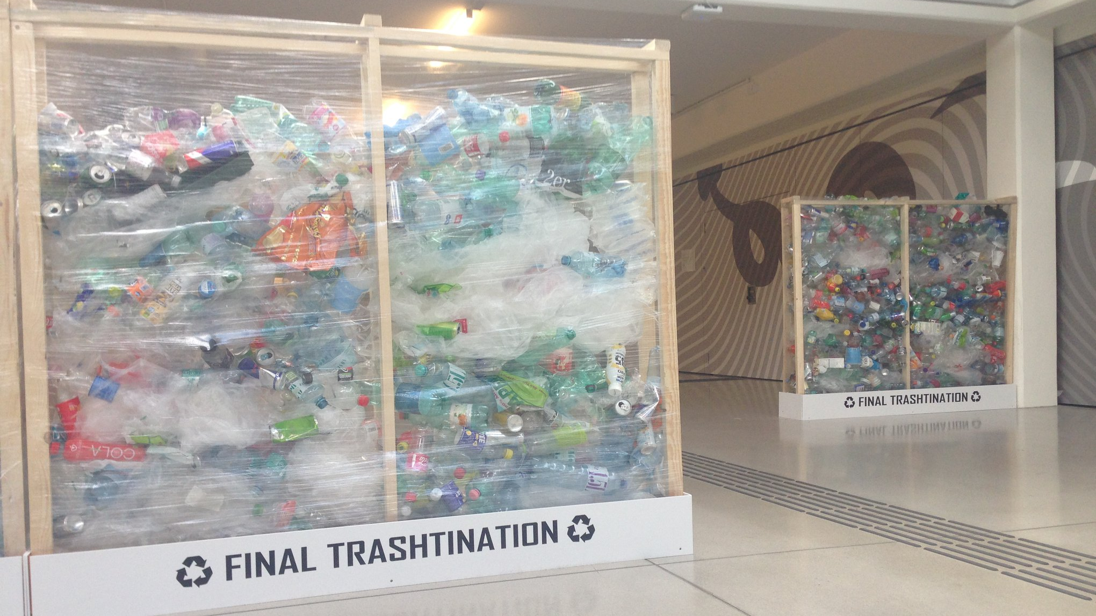
Source: private

Slide 27
Source: Screenshot Facebook Page: Final Trashtination, URL: https://www.facebook.com/finaltrashtination/ (11.07.2022)
Notes:
There was not only a lot of habits and culture of wasting that has been cracked; storytelling and Conversations happened during the action, along the action and conversations on social media

Slide 28
C. Examples: Critical pedagogy
Critical pedagogy
Check it out:
https://www.youtube.com/watch?v=xjQdKJqf6YI&t=3s
https://www.youtube.com/watch?v=0sYv_8O8Ocs

Slide 29
D. Analysis
Analysing data
Research includes the generation & collection of data and the analysis
Possible software:
Nvivo
Qcamap
Categorization / Coding

Slide 30
D. Analysis
Discourse analysis
role of language and meaning in their empirical investigations, both in the study of past transition trajectories and ‘transitions-in-the-making’
discourse analysis is a diverse field that offers heterogeneous theory and methodology for the study of language and meaning
Discourse can refer to nearly its dictionary meaning, but also to diverse concepts, or various theories. It can concern research methodologies, or even a whole discipline.
discourse as social interaction, discourse as power and domination, discourse as communication, discourse as contextually situated, discourse as social semiosis, discourse as natural language use, discourse as complex, layered construct, sequences and hierarchies in discourse, abstract structures versus dynamic strategies in discourse, and types or genres of discourse (Van Dijk, 2011)
three main discourse analytical approaches are first briefly discussed, and then positioned on the two key dimensions in discourse analysis: critical discourse analysis (CDA) (e.g., Fairclough, 1995; Fairclough and Wodak, 1997), discursive psychology (DP) (e.g., Edwards and Potter, 1992; Potter and Wetherell, 1987), and discourse theory (DT) (e.g., Laclau and Mouffe, 1985).
These social constructionist approaches to discourse analysis were chosen for further elaboration because they are in line with key concepts within sustainability transition studies, such as transformative agency and power.
They (1) share certain key premises about how entities such as language and the subject are to be understood, but are yet distinctive from each other, and (2) they carry out critical research, i.e., power relations in society are analysed in order to formulate normative critique on such relations for the possibilities of social change (Jørgensen and Phillips, 2002).
(1a) discourse analysis with a primary focus on language itself, and (1b) discourse analysis focussing on language use (Taylor, 2001).
Notes:
The contemporary emergence of discourse analysis must be sought in remarkably parallel developments in the humanities and social sciences between the mid-1960s and the mid- 1970s. Discourse analysis developed from the mother-disciplines anthropology, linguistics, literary studies, sociology, cognitive and social psychology, communication studies, and political sciences; respectively and roughly in this order (Van Dijk, 2011). Van Dijk (2011) argues that Discourse Studies developed into a discipline in its own right since the end of the 1990s.

Slide 31
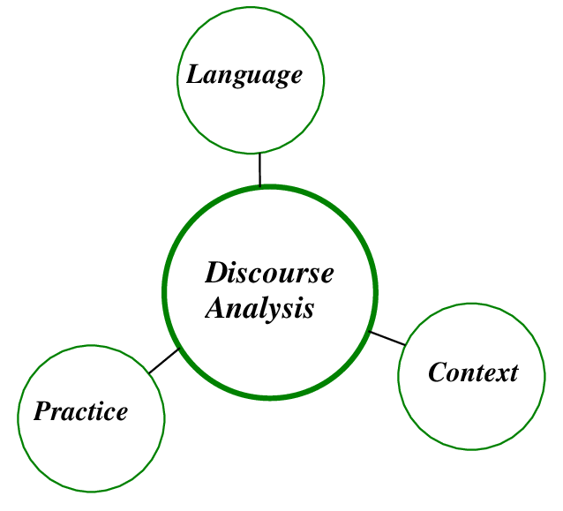
D. Analysis

Slide 32
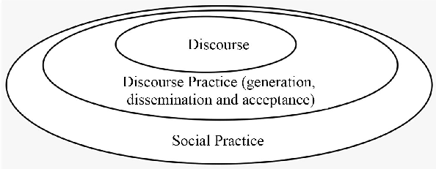
D. Analysis

Slide 33
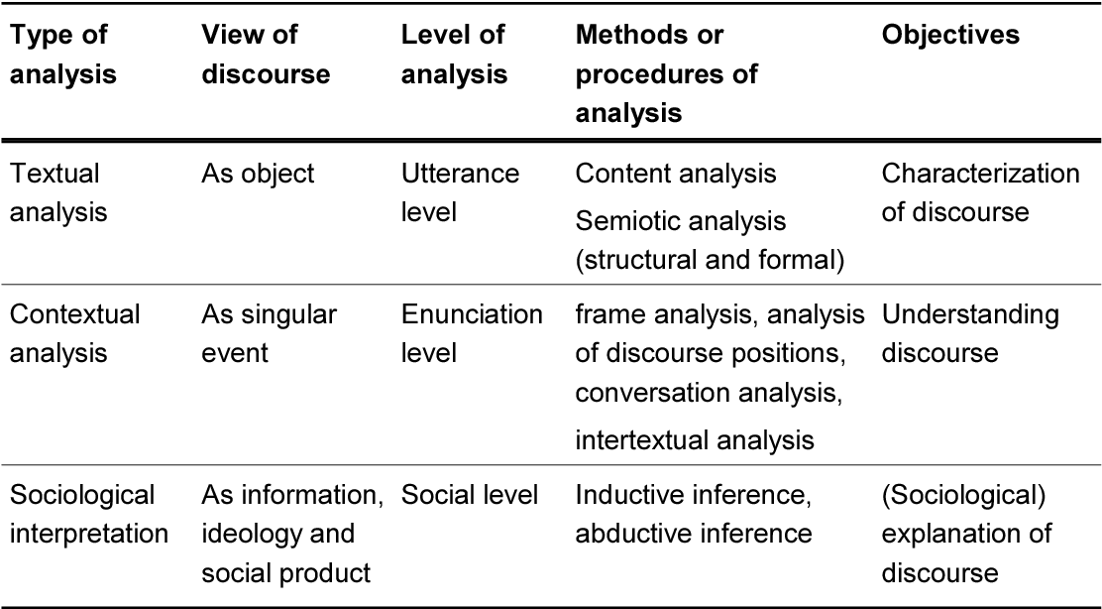
D. Analysis
Discourse analysis
Source: Ruiz, J. R. (2009, May). Sociological discourse analysis: Methods and logic. In Forum qualitative sozialforschung/Forum: Qualitative social research (Vol. 10, No. 2).

Slide 34
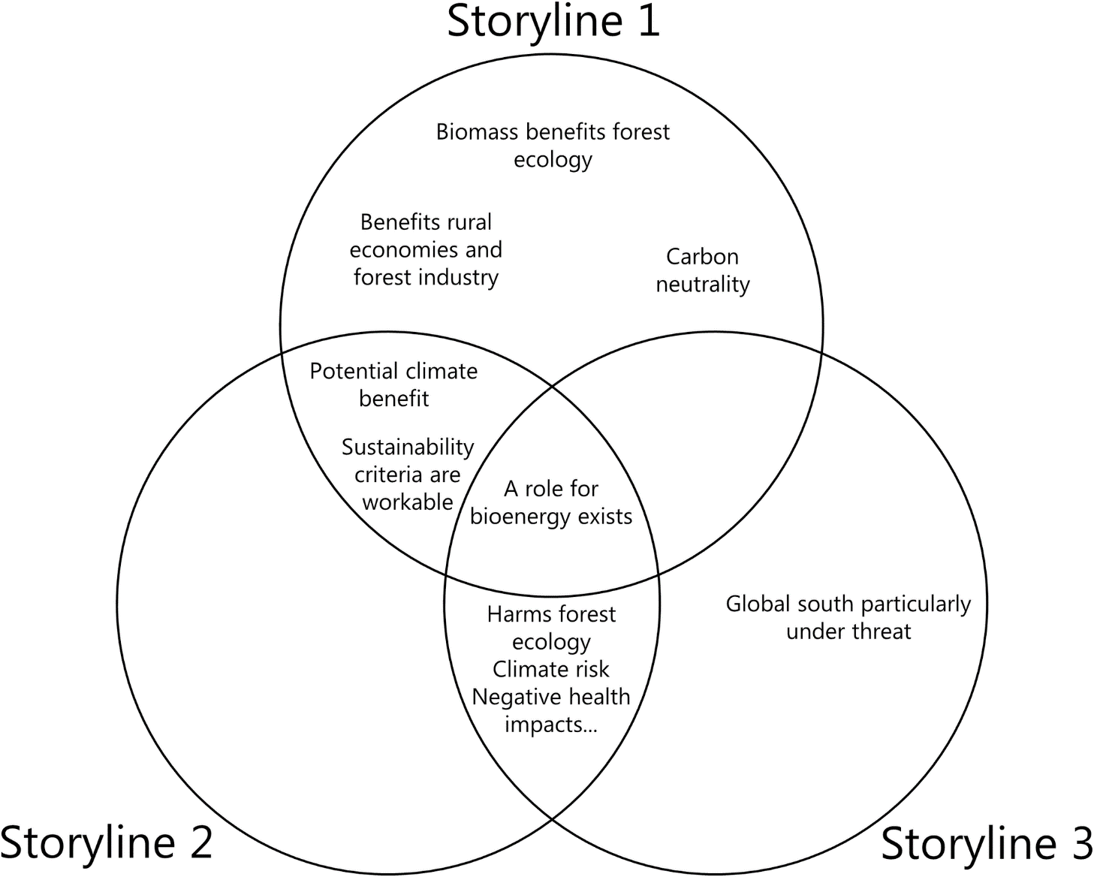
D. Analysis
Discourse analysis
Example: Biomass–energy in Europe
Source: Mather-Gratton ZJ, Larsen S, Bentsen NS (2021) Understanding the sustainability debate on forest biomass for energy in Europe: A discourse analysis. PLoS ONE 16(2): e0246873. https://doi.org/10.1371/journal.pone.0246873

Slide 35
Reflection
1. Play around with the future:
List the key unknown variables that could affect your future
Choose two strong but different variables
Plot one against the other as a matrix of x and y axes
2. Think about creative approaches in research; what could be used?
Whatsapp / focus groups
Padlet / miro boards
Games / gamification
3. Which can be used for workshops, generating ideas etc.? And which for generating knowledge (as research method), and why?
4. What are your experiences and what is your expertise when it come to the analysis of the generated data?

