Slide 1
Theories & Perspectives
Lesson 04: Communication on a societal Level, Communication as Culture

Slide 2
Where are we?
Episode 1: Social & Cultural Sciences & Paradigms
Episode 2: Communication on an individual level
Episode 3: Communication on an organizational level
Episode 4: Communiation on a social level, communication as culture

Slide 3
Learning outcomes
Learning outcome 1:
Describe the diverse nature of contemporary practices of sustainability communication on an individual, organizational and societal level, the relationship of strategic communication practices to other public communication practices, the role of stakeholders and publics and the communication practitioners in and outside of organizations (corporate, NGO, political and educational institutions etc.)
Learning outcome 2:
Develop comprehensive and well-founded knowledge in sustainability communication as field of study, an understanding of how other disciplines relate to the field and an international perspective on the field.
Learning outcome 3:
Understand the key elements of communication theories, strategies and tactics, and, thus, the character and operationalization of best practice sustainability communication planning frameworks.
Learning outcome 4:
Advance your understanding of social and civic responsibility and develop an appreciation of the philosophical and social context of sustainability communication. Advance your knowledge and respect of ethics and ethical standards in relation to communication of, about and for sustainability.
Learning outcome 5:
Anticipate and Interpret current issues and challenges of a world in transformation and social change. Develop a deep understanding of and skills to create change, develop advocacy, leadership and authorship in and for sustainability communication.

Slide 4
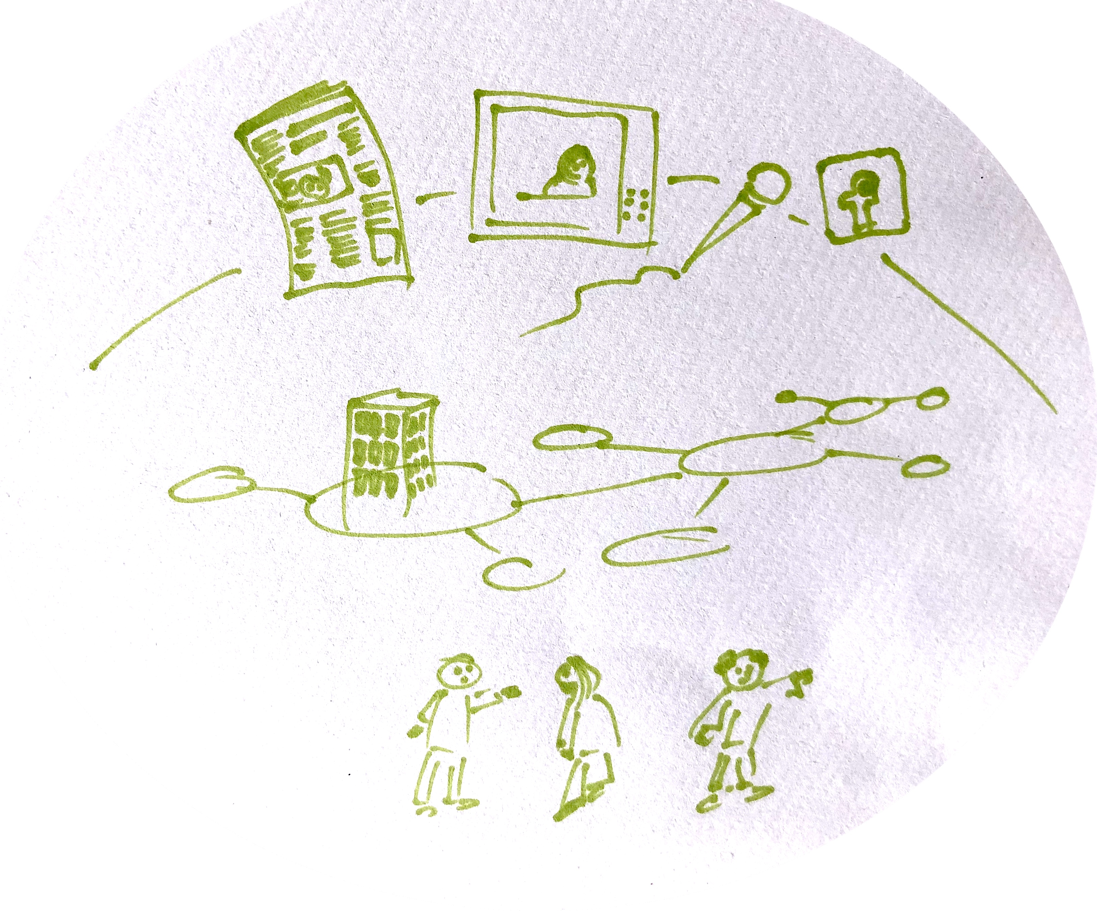
Recap
_MACRO: social system, cultural context, public discourses/public sphere
Communication
_MESO: organizations, institutions, stakeholder/audiences
_MICRO: intra-/interpersonal communication
Notes:
Communication as structure & process
We can look at communication as structure and process on three different levels!…

Slide 5
Overview
Mediatization & Digitalization
Media
Social media
Strategic perspective on media

Slide 6
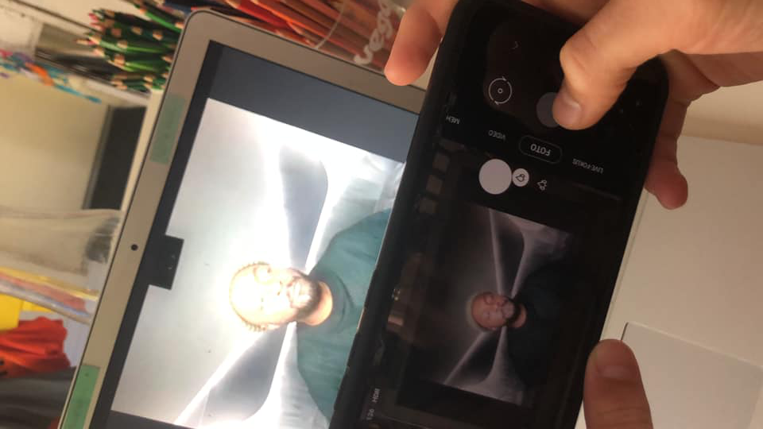
A. Mediatization / Digitalization
Source: private
Source: https://www.datenschutz-notizen.de/sound-an-handy-aus-4315244/,
Notes:
we all know and write about Digitalization (readership down, online up), developments convergence and cross-media ownerships (fairfax/channel9, früher nie möglich/cross-meia owenership laws), concentration, digital online only (guardian, buzzfeed, NY times) – lead to a new media logic, new logic of production, produsage ...
Buzzwords – and related phenomena - like „big data“, „artificial intelligence“ and related questions of regulation & ethics
challenge for communication practitioners – as well as us, media, language, communication and journalism researchers and social sciences in general...
These devlopments rock our field!

Slide 7
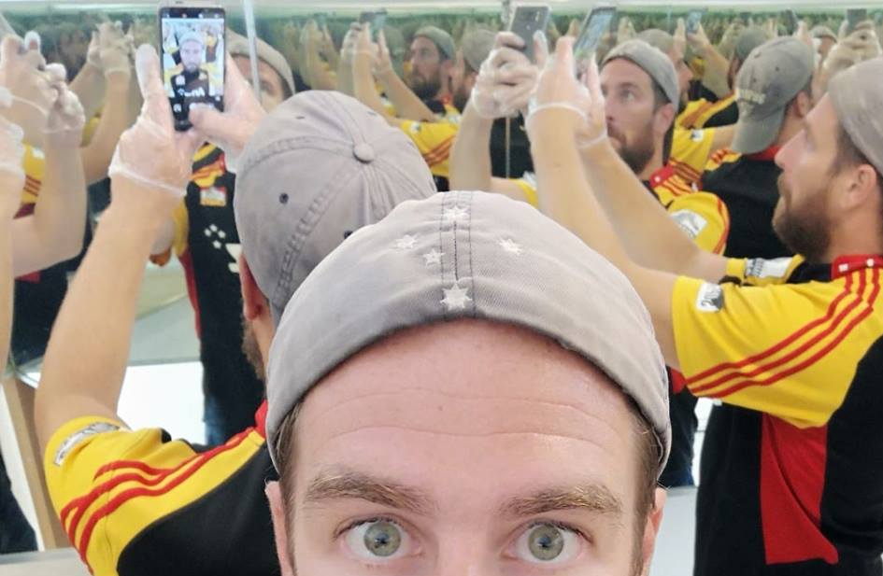
A. Mediatization / Digitalization
Source: private
Notes:
Here is how I see the discipline:
we mirror/reflect on:
Crisis of legacy media
Rise of online & social media and the use of search engines – in other words: technical skills that are required
Economic & time pressure/changed working conditions
Increasing volume and pluarlity of public communication
Media and issue manifold
Fragmentation of the public sphere
But as well new roles and potential of citizen journalism („uber-ization“ of journalism (Jeffrey Dvorkin, US-/Can journalist)), community or alternative media, user-generated content and audience involvement
In general: biggest challenge for j r as a discipline: we have to manoever through the life and deth metaphors used to describe the future of journalism;
as critical journalism researchers: we don't do the death metaphor!:-)
we refer to George Brock from City Univ. London, stating that „journalism is going to adapt an flourish“, has to reinvent, reconstruct itself (in „the conversation“)..

Slide 8
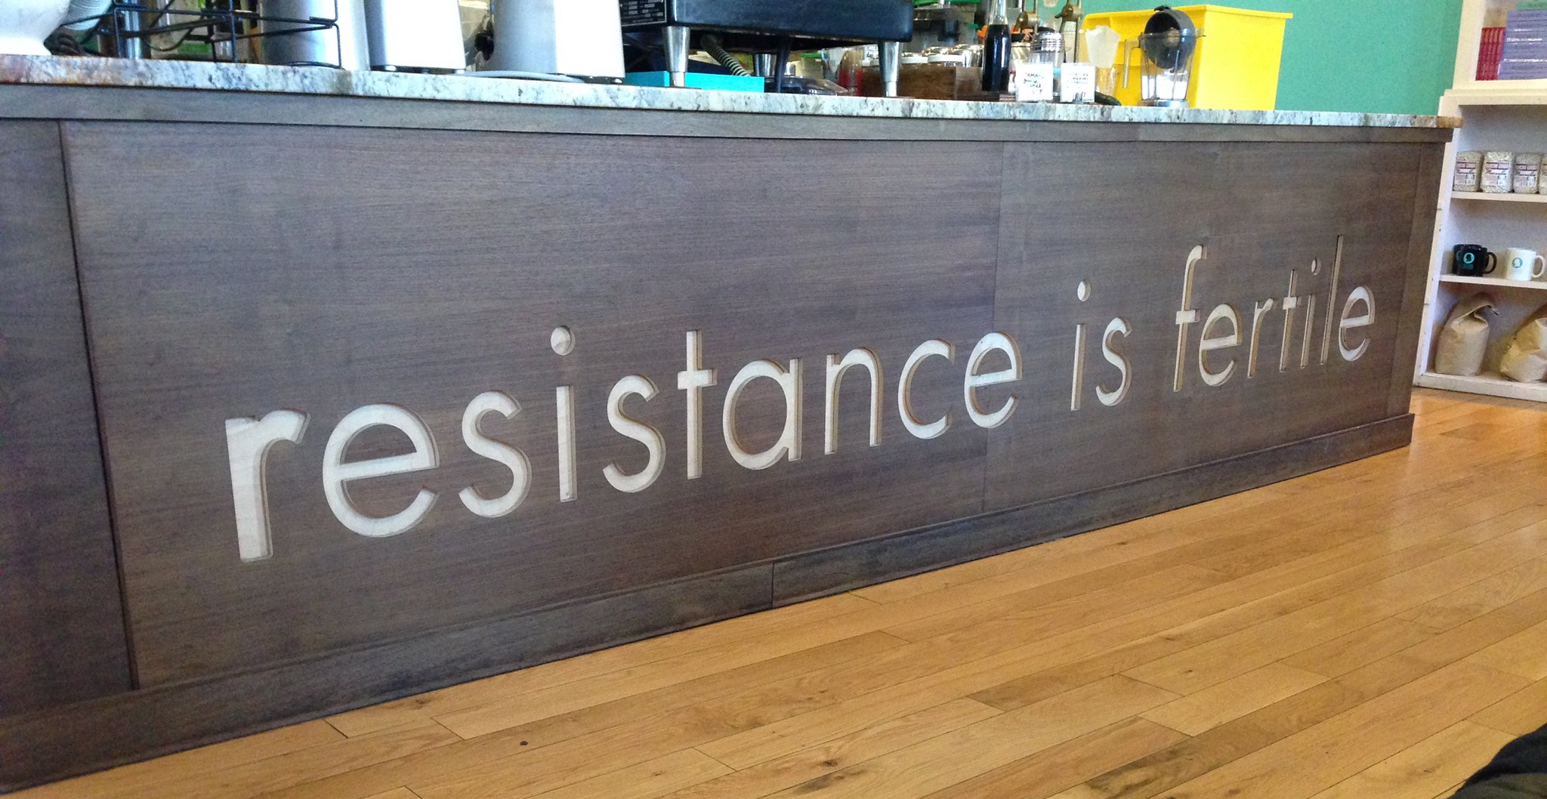
A. Mediatization / Digitalization
Source: private
Notes:
but how - how can we reconceptualize jouranlism - particularly in a "risk society" referring to Beck -
where
1. climate crisis is not only about global changes and ecological decline but also about our political and communicative capacity of the society to respond (Hackett et al., 2017, p. 2).
and
2. with new coordinates like sustainability as normative framework, journalism “is being turned upside down. It is on a roller-coaster ride that can be exhilarating but rather scary” (Beckett, 2008, p. 9).

Slide 9
B. Media
Media are …
means for communication / or structures of communication
related to CONTENT (duplicate, replicate, disseminate, make it accessible)

Slide 10
B. Media
Media are …
text-based
audio-visual
eye-to-eye

Slide 11
B. Media
TEXT
newspaper
magazine
whitepaper
(e)book
magazine
email
newsletter
advertorial
reference stories
user-genereted content
COMPUTER, INTERNET
office
email
learning program
platform
search engines
AUDIO / VISUAL
(info)graphics
photos
video
webinar
podcast
online-product-presentation
games
software / applications
virtual conference
cinema
art
activism (culture jam)
SOCIAL MEDIA
networks
chat
messenger
bookmarking
podcast
microblogging
weblogs
forum
community
wikis
ratings
EYE TO EYE
  fair
  workshop/worldcafe
  product presentation
  speech,
  lecture
  inhouse event
  conference

Slide 12
B. Media
Media can be differentiated …
socially
timewise
space-related
ethically

Slide 13
B. Media
 | Strength | Weaknesses
Websites, blogs, microblogs | Accessible, interactive, diverse, immediate, inexpensive | Prone to inaccuracies, biased, opinionated
Newspapers, magazines, books | Accurate, comprehensive, appeal to general public | Limited to text, pictures, slow delivery
TV, radio | Strong audio & visual appeal, current, local, friendly | Highly commercialized, highly persuasive, may be biased

Slide 14
B. Media
Media can be differentiated …
… related to their function

Slide 15




political function
economic function
cultural & social functions
creation of "public sphere"
articulation of opinion
control & critique
seismographic function
participation, activation
consumption information
product circulation
work, job market
media as sector
orientation & help
integration
education
cultural creativity
recreation
Sources: Images from Flaticon.com

Slide 16
C. Social media
social media users are content creators
social media is instant communication
people can easily share and post news content on their networks
foster a sense of interconnectedness and community

Slide 17
D. Strategic perspective on media
paid
owned
earned
traditional advertisement
own webiste, brand, social media page
comments, shares, reviews

Slide 18
Reflection
Which media do you use – for which purpose?
How often do you use those media?
How would you describe the difference between information you get from a newspaper, compared to twitter etc.

Slide 19
Outlook
Sustainability issues: high levels of complexity and uncertainty
-> call for new modes of science involving increased communication, dialogue, and the involvement of stakeholders to broaden the information basis, but also to include broader societal values.
Sustainability goals: ambivalent, involving conflicts of interests as well as of values;
-> communication is essential in order to reach a common understanding about societal values on sustainability and concrete goals that need to be pursued.
Capacities to govern sustainable development: multileveled; multiple levels of decision-making, making implementation of measures to achieve goals more difficult;
-> network-like forms of coordination that enable effective arguing, bargaining, and social learning needed, facing distributed action capacity.
Notes:
Newig text

