Slide 1
Theories & Perspectives
Lesson 03: Communication on an Organizational Level

Slide 2
Where are we?
Episode 1: Social & Cultural Sciences & Paradigms
Episode 2: Communication on an individual level
Episode 3: Communication on an organizational level
Episode 4: Communiation on a social level, communication as culture

Slide 3
Learning outcomes
Learning outcome 1:
Describe the diverse nature of contemporary practices of sustainability communication on an individual, organizational and societal level, the relationship of strategic communication practices to other public communication practices, the role of stakeholders and publics and the communication practitioners in and outside of organizations (corporate, NGO, political and educational institutions etc.)
Learning outcome 2:
Develop comprehensive and well-founded knowledge in sustainability communication as field of study, an understanding of how other disciplines relate to the field and an international perspective on the field.
Learning outcome 3:
Understand the key elements of communication theories, strategies and tactics, and, thus, the character and operationalization of best practice sustainability communication planning frameworks.
Learning outcome 4:
Advance your understanding of social and civic responsibility and develop an appreciation of the philosophical and social context of sustainability communication. Advance your knowledge and respect of ethics and ethical standards in relation to communication of, about and for sustainability.
Learning outcome 5:
Anticipate and Interpret current issues and challenges of a world in transformation and social change. Develop a deep understanding of and skills to create change, develop advocacy, leadership and authorship in and for sustainability communication.

Slide 4
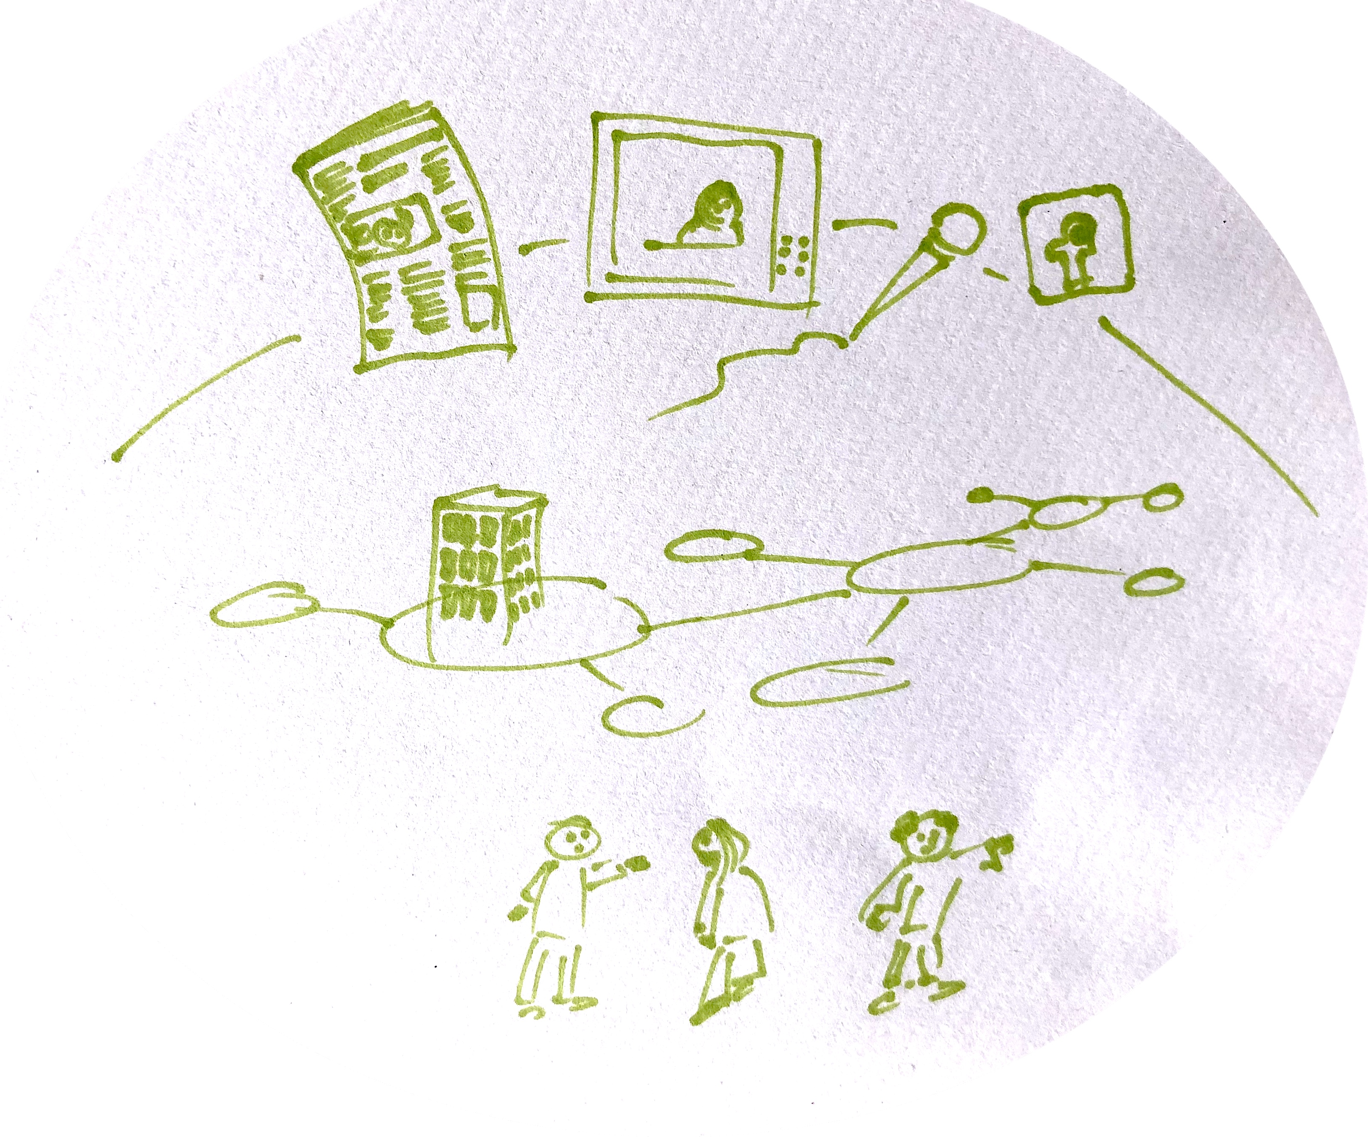
Recap
_MACRO: social system, cultural context, public discourses/public sphere
Communication
_MESO: organizations, institutions, stakeholder/audiences
_MICRO: intra-/interpersonal communication
Notes:
Communication as structure & process
We can look at communication as structure and process on three different levels!…

Slide 5
Overview
Organizations
Communication & Organization
Strategic Communication
Notes:
Science Theory
Why do we need „theories“?
What are the main paradigms we need to understand Sustainability Communication phenomena?

Slide 6
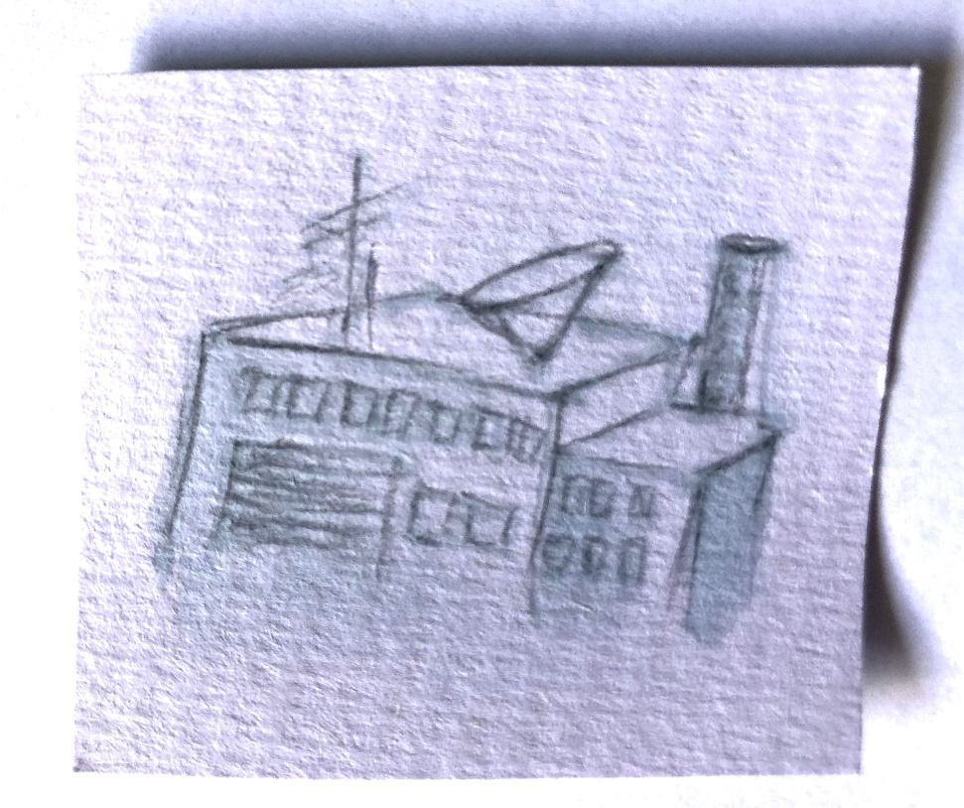
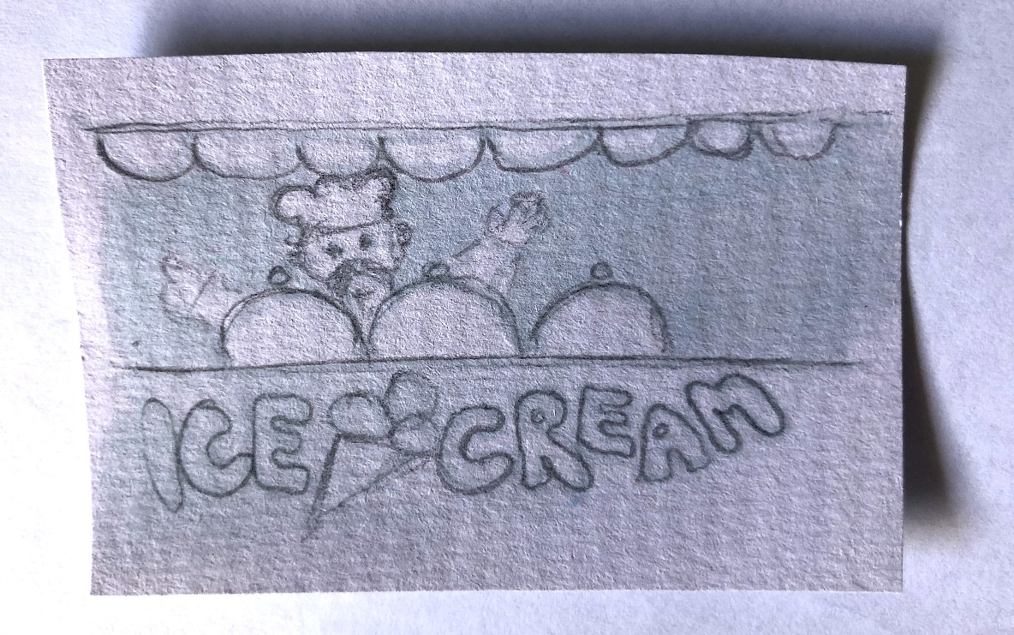
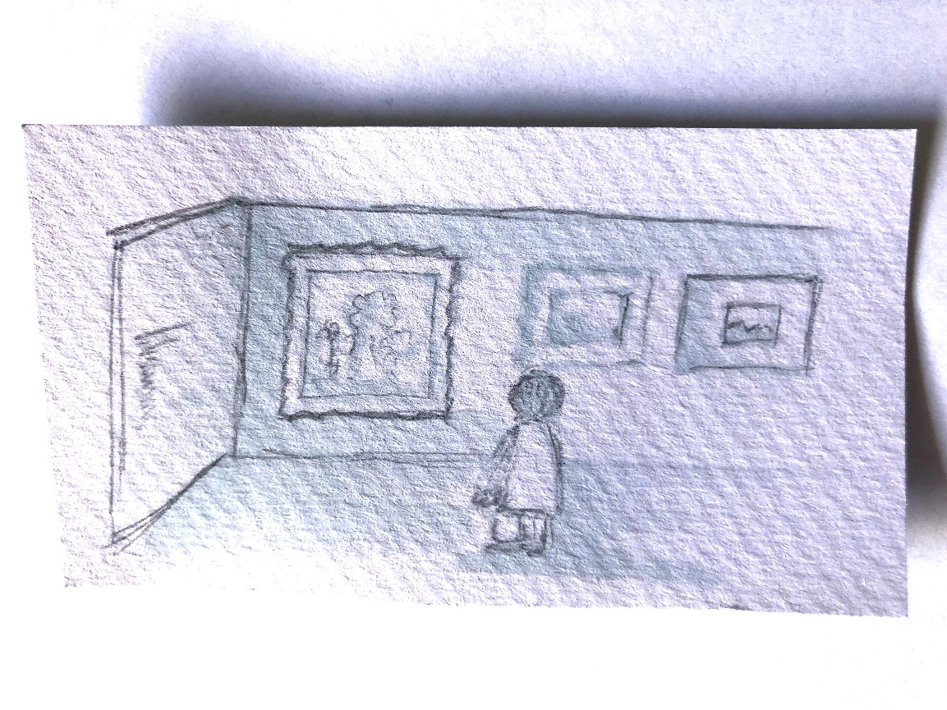
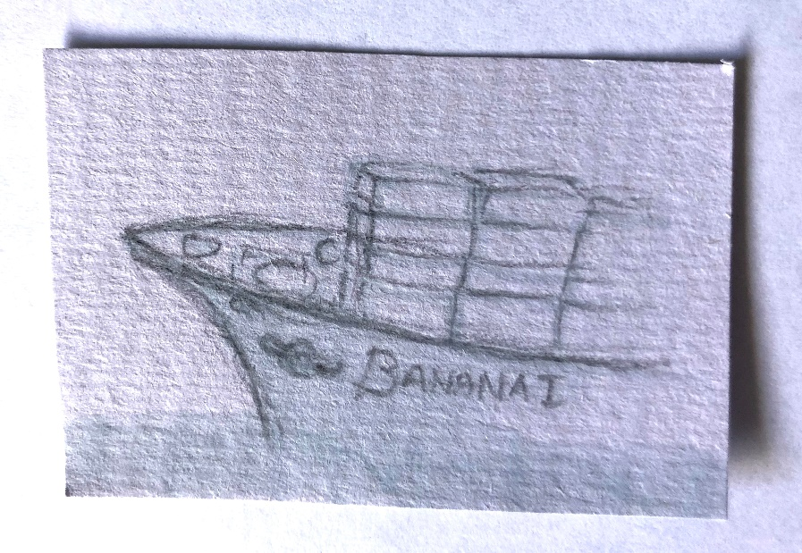
A. Organizations
Notes:
Organisation – like a building – have structures …and some key features
Most organizations are hierarchies, they are structured in ranks or levels, with each level having power or influence over the level immediately below it
Most hierarchies resemble pyramids, with a few people at the top and many at the bottom…
Generally speaking: the people at the to of the pyramid have more “power” and are better rewarded that those at the bottom of the pyramid
This hierarchy pyramid: we remember – is more likely to happen in a formal organization,
However, wee need to consider informal organizations as well, group dynamics etc.
In lupe: Organizational design & communication flows: flat/tall, network, centralized/decentralized

Slide 7

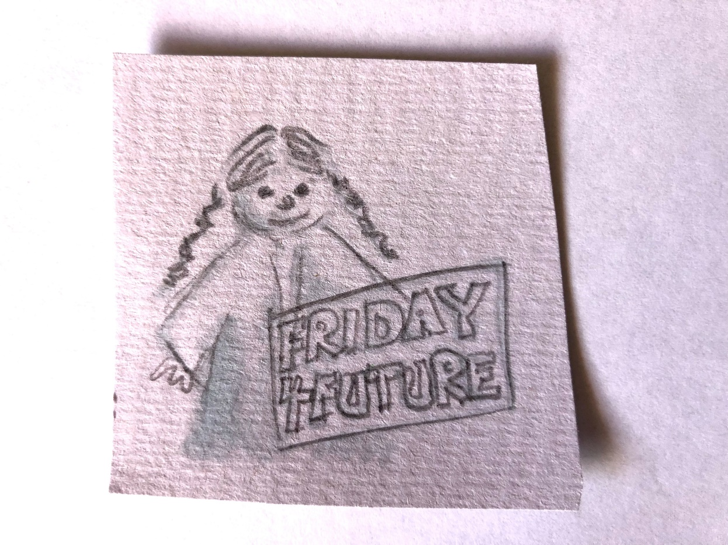
A. Organizations
_formal _informal
Notes:
_are ‘social forms’ which seek to reach a special goal
_have ‘members’
_have a special shape and a special structure which with all the activities of the members of the organization are focused on the overall goal
In Lupe: _are ‘social forms’ which seek to reach a special goal
_have ‘members’
_have a special shape and a special structure which with all the activities of the members of the organization are focused on the overall goal
In telescope:
_are systems of coordinated actions between individuals and groups;
_they differ when it comes to preferences, interests, information, knowledge

Slide 8
A. Organizations
An organization
consists of a group of people
… who work together to achieve a common purpose;
an organization is bigger than the individuals and groups that comprise it, but smaller than the society that gives it its context and environment

Slide 9
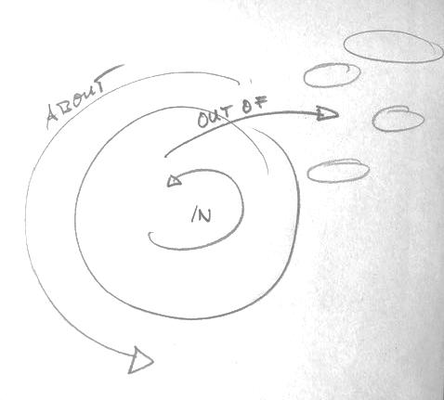
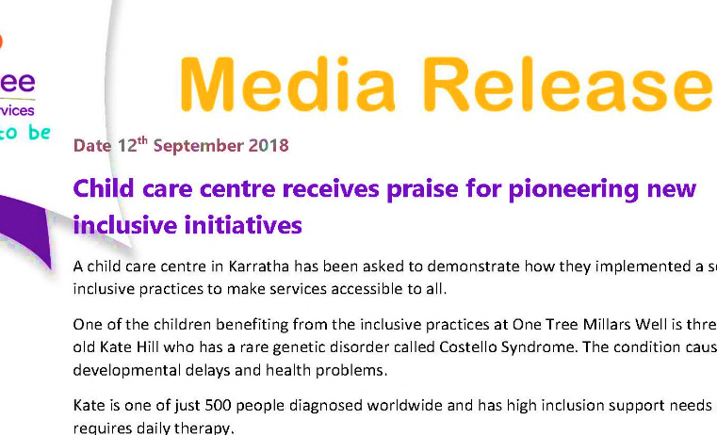
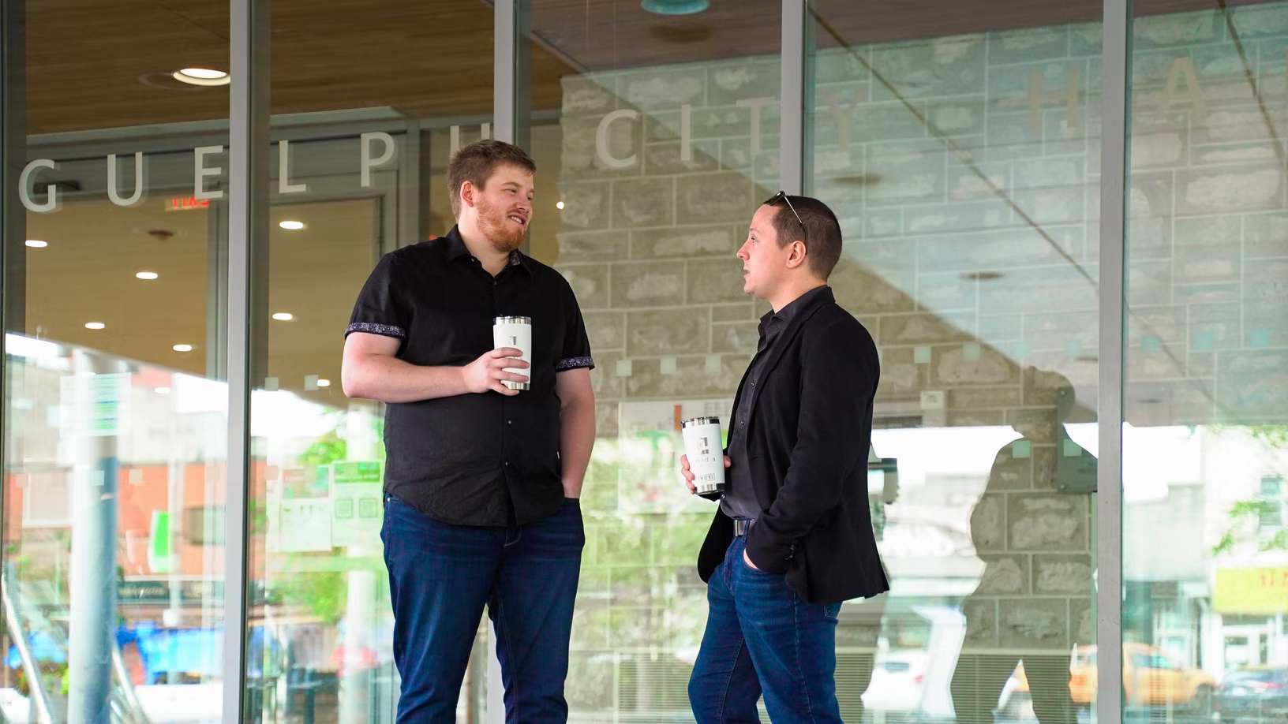

B. Organizations & Communication
Organizational Communication
Media
Release
Sources:
Photo “Newspaper” by AbsolutVision on Unsplash
Photo “Meeting” by 2H Media on Unsplash

Slide 10


B. Organizations & Communication
objective interpretive
pragmatic
constitutive
Icon made by Raj Dev from www.freeicons.io
Notes:
Bringing in the two perspectives on communication….

Slide 11
B. Organizations & Communication
communication is not only an outcome of „organization“ (a structure)…
…but as well a basic process of „organization“ (organizing; organization as a process), communication as social practice
Icon made by Raj Dev from www.freeicons.io

Slide 12
C. Strategic Communication
Strategic communication (structural perspective)
the purposeful use of communication by an organization to fulfill its mission (Hallahaan, 2007, p. 3; Holtzhausen & Zerfass, 2015)
understanding “how a certain set of audience attitudes, behaviours, or perceptions will support those objectives” is what makes communication strategic (Paul, 2011, p. 5).
Communication management (process related, constitutive perspective)
constitutive flows of communication (McPhee & Zaug, 1995, Putnam & Nicotera, 2007; Schoeneborn et al., 2016)
Questions: narratives, discourses, interaction, interrelatedness, power, negotiation processes
Icon made by Raj Dev from www.freeicons.io

Slide 13
Outlook
Organization are „embedded“ and therefore related to the society
Developments, change and transformation processes – as well as issues and crises affect organizations
Society & culture
Public discourses
Organizations & tribes
Individuals

Slide 14
Reflection
Think about any organization you‘re „embedded“ in, this can be your University, your „tribe“ / family, your sports club, the church or any kind of business you‘re working for.
  How would you describe the communication flows within the organization, hierarchical? Network like? What are the barriers in those communication flows?
  How does our organization communicate with the environment, the „stakeholder“, like competitors, potential new members / employees, guests etc.?
  What about the difference between formal communication (information flows), and informal communication /rumors, coffee kitchen chats etc.)? How much does informal communication actually „define“ the organization – or the organization‘s reputation, image and what you think it stands for?

