Slide 1
Theories & Perspectives
Lesson 01: Social and Cultural Sciences & Paradigms

Slide 2
Where are we?
Episode 1: Social & Cultural Sciences & Paradigms
Episode 2: Communication on an individual level
Episode 3: Communication on an organizational level
Episode 4: Communiation on a social level, communication as culture

Slide 3
Learning outcomes
Learning outcome 1:
Describe the diverse nature of contemporary practices of sustainability communication on an individual, organizational and societal level, the relationship of strategic communication practices to other public communication practices, the role of stakeholders and publics and the communication practitioners in and outside of organizations (corporate, NGO, political and educational institutions etc.)
Learning outcome 2:
Develop comprehensive and well-founded knowledge in sustainability communication as field of study, an understanding of how other disciplines relate to the field and an international perspective on the field.
Learning outcome 3:
Understand the key elements of communication theories, strategies and tactics, and, thus, the character and operationalization of best practice sustainability communication planning frameworks.
Learning outcome 4:
Advance your understanding of social and civic responsibility and develop an appreciation of the philosophical and social context of sustainability communication. Advance your knowledge and respect of ethics and ethical standards in relation to communication of, about and for sustainability.
Learning outcome 5:
Anticipate and Interpret current issues and challenges of a world in transformation and social change. Develop a deep understanding of and skills to create change, develop advocacy, leadership and authorship in and for sustainability communication.

Slide 4
Recap

Slide 5
Recap
Inter- / transdisciplinary approach to SD
Communication
Cultural change
SD agenda
Social change
Problem
Solution
Problem
Solution
Problem
Discipline 1
Discipline 2
Discipline 3
Discipline x

Slide 6
Recap
Science & Risk Communication
Strategic / CSR Communication
Sustainability Communication
Environmental and Social Change Communication
Disciplines
Communication
Discipline 1
Discipline 2
Discipline 3
Discipline x

Slide 7
Recap
Perspectives on Sustainability
Science / CC Communication:
Sustainability as counter narrative (solution?) to climate change
Environmental Communication:
Sustainability as (moral) principle of change
Sustainability as principle of restoration / regeneration
CSR Communication:
Sustainability as principle (moral compass) of action
Sustainability as label for “good behavior”, “used” in communication

Slide 8
Recap
Challenges
Communication about & of environment, risk, CC, CSR
Communication for transformation

Slide 9
What is needed?
Media & communication perspective & theories, concepts, methodologies
Science & Risk Communication
Strategic / CSR Communication
Sustainability Communication
Environmental and Social Change Communication
Notes:
But what is behind this? What is media / comm studies? What is the background, what do we need to understand to better understand the science of sustainability communication

Slide 10
Where are we (again ☺)?
Episode 1: Social & Cultural Sciences & Paradigms
Episode 2: Communication on an individual level
Episode 3: Communication on an organizational level
Episode 4: Communiation on a social level, communication as culture

Slide 11
Overview
Science Theory
„Theories“ – what for?
Paradigms of Sustainability Communication
Notes:
Science Theory
Why do we need „theories“?
What are the main paradigms we need to understand Sustainability Communication phenomena?
Is “science” needed? Why – and what aspects do we need?
Isn’t “sustainability” sth that needs more practical, problem-focused and solution-oriented approaches? Well – a bit of theory is needed!

Slide 12
A. Science theory
Ontological exploration (How is it?)
Phenomenological (What happens?)
Causal (Why is it like that?)
Normative (What should we do? What has to be done?)
Critical (What can be changed – and how?)
Prognostic (What will be the future? How will xx develop?)
Pragmatic (generating practical knowledge, „work knowledge“, knowledge for education)
Notes:
Identisch mit Folie 50

Slide 13
B. Theories
Everyday Theories
Scientific Theories and Hypotheses
T H E O R Y
Background knowledge on problem area(s)
Survey Data respectively Results
Source: Astleitner, Hermann. Theorieentwicklung für SozialwissenschaftlerInnen. Wien 2011, Böhlau Verlag, S. 115
Notes:
Studying sustainability communication means … what do we need?
In everyday usage, “theory” often refers to a hunch or a speculation. When people say, “I have a theory about why that happened,” they are often drawing a conclusion based on partial or inconclusive evidence. Scientists have hunches, too, but they call them hypotheses, which are the starting point of all good science.

Slide 14
B. Theories
Theories are ...
Greek: „the“ = look at, „theoria“ = scientific examination
The act of seeing, beholding
„To understand & explain something by looking at it or examining it“
Notes:
Toolbox!

Slide 15
B. Theories
Theories shape our reality
They can determine how we perceive reality
Theories provide a ‚lense‘ through which we can interpret/make sense of our reality/experiences
The biggest question:
What ‚lense‘, in our words: which tools will we select?
Which tools help to understand sustainability, sustainable development and all related phenomena?

Slide 16
B. Theories
... are
thinking about ideas
extracting regularities
reducing complexity
structuring ideas
Theories can explain how/why things are the way they are
Theories help us to understand
Theories can predict how things might be in the future
Theories can effect social change and empowerment

Slide 17
B. Theories
Some theories ...
are based on research and are the product of carefully-designed studies of phenomena, e.g. theories of media effects
Others are philosophically derived, e.g. – semiotics – a philosophical theory of the functions of signs and symbols
On the other hand ...
Is most of the research based on theory – the theory produces a way of working, a methodology
then research tests and challenges the thesis, hypothesis
and – maybe – develops (new) theory

Slide 18
B. Theories
So a theory is
a) a framework that helps us structure our own behaviours as well as society more broadly
b) an abstract system of concepts with indications of the relationships among these concepts that help us to understand a phenomenon (West & Turner, 2004)

Slide 19
B. Theories
Paradigm – a way of viewing the world; an intellectual tradition with its own values, goals, research approaches
Grand theories – all instances (abstract, theorising in which the formal organisation and arrangement of concepts takes priority over understanding the social world)
Mid-range theories – specific group (moderately abstract and inclusive but are composed of concepts and propositions that are measurable)
Narrow theories – certain people, certain situations (not abstract, context specific – precise, measurable)
!
Notes:
If we‘re want to demarcate sustainability communication as research area or even a discpline – we need to think about
...

Slide 20
C. Paradigms of Sustainability Communication
Two ‚poles‘, two distinct approaches in theory
objective interpretive
pragmatic
constitutive

Slide 21
C. Paradigms of Sustainability Communication
Differences
New understanding of people/society
Explanation of the data
Prediction of future events
Clarification of values
Qualitative research
objective interpretive
Reform of society
Simplicity
Hypothesis/can be tested
Aesthetic appeal
Practical utility
Community of agreement
Quantiative research

Slide 22
C. Paradigms of Sustainability Communication
Grand Theory
Media & communication studies
paradigms
Theory
Concept/ Model
Empirical research
Approach/ Perspective
Quant./ qual.

Slide 23


C. Paradigms of Sustainability Communication
objective interpretive
pragmatic
constitutive
Icon made by Raj Dev from www.freeicons.io
Notes:
Introduce glasses
Material: cut them out – color them … use them … you will need them eventually ☺

Slide 24
C. Paradigms of Sustainability Communication
Communication
_act of developing meaning
among individuals,
groups and organizations
and in wider public discourses
through the use of sufficiently mutually understood signs, symbols, and semiotic conventions.
Notes:
While … communication is generally described as …
We must differentiate …

Slide 25
C. Paradigms of Sustainability Communication
Communication
Objective: techno-scientific understanding of communication (which has yielded a number of complex transmission models)
Critical: the social and human science description of communication begins with face-to-face contact: Communication as human and technology based activity of the reciprocal use of signs and the reciprocal interpretation of signs for the purpose of succesful understanding, coordinating action and shaping reality
Communication as:
Social practice &
Social process, +
Sustainability as principle of societal organization
Icon made by Raj Dev from www.freeicons.io
Notes:
communication as a process underpinned by social relations. It was based on the sociology of knowledge (see e.g., Berger and Luckmann, 1966) and subsequently developed by discourse analysis (Keller et al., 2013). Communication serves not only to transmit information, but also to coordinate human actions to create social meaning, significance, and shared reality.

Slide 26
C. Paradigms of Sustainability Communication
„Sustainability Communication“ as structure;
as transmission of:
signals
messages
structures
symbols
meaning
Icon made by Raj Dev from www.freeicons.io

Slide 27
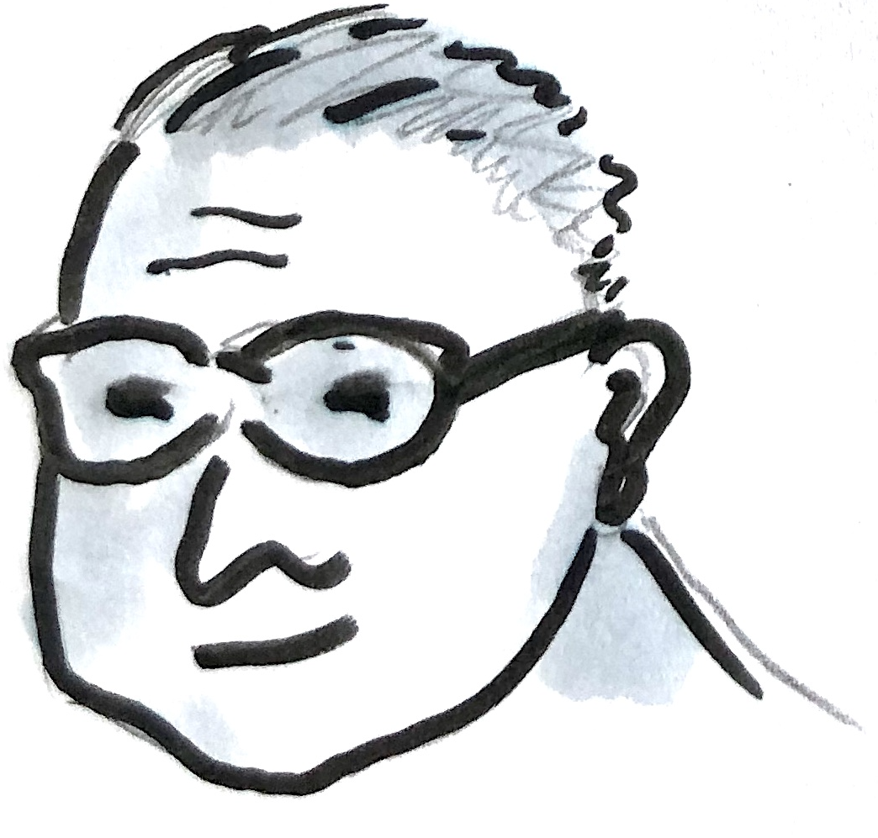
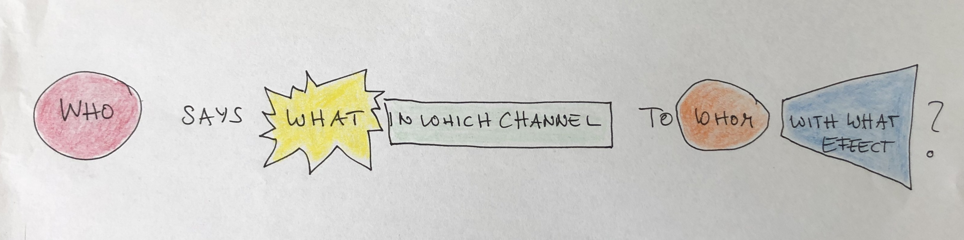
C. Paradigms of Sustainability Communication
_who says what to whom in what channel with what effect? (Harold D. Lasswell)
Icon made by Raj Dev from www.freeicons.io

Slide 28
C. Paradigms of Sustainability Communication
Sustainability Communication as process & practice of...
understanding
exchange
participation
relationship
social practice
social behavior
interaction
Icon made by Raj Dev from www.freeicons.io

Slide 29
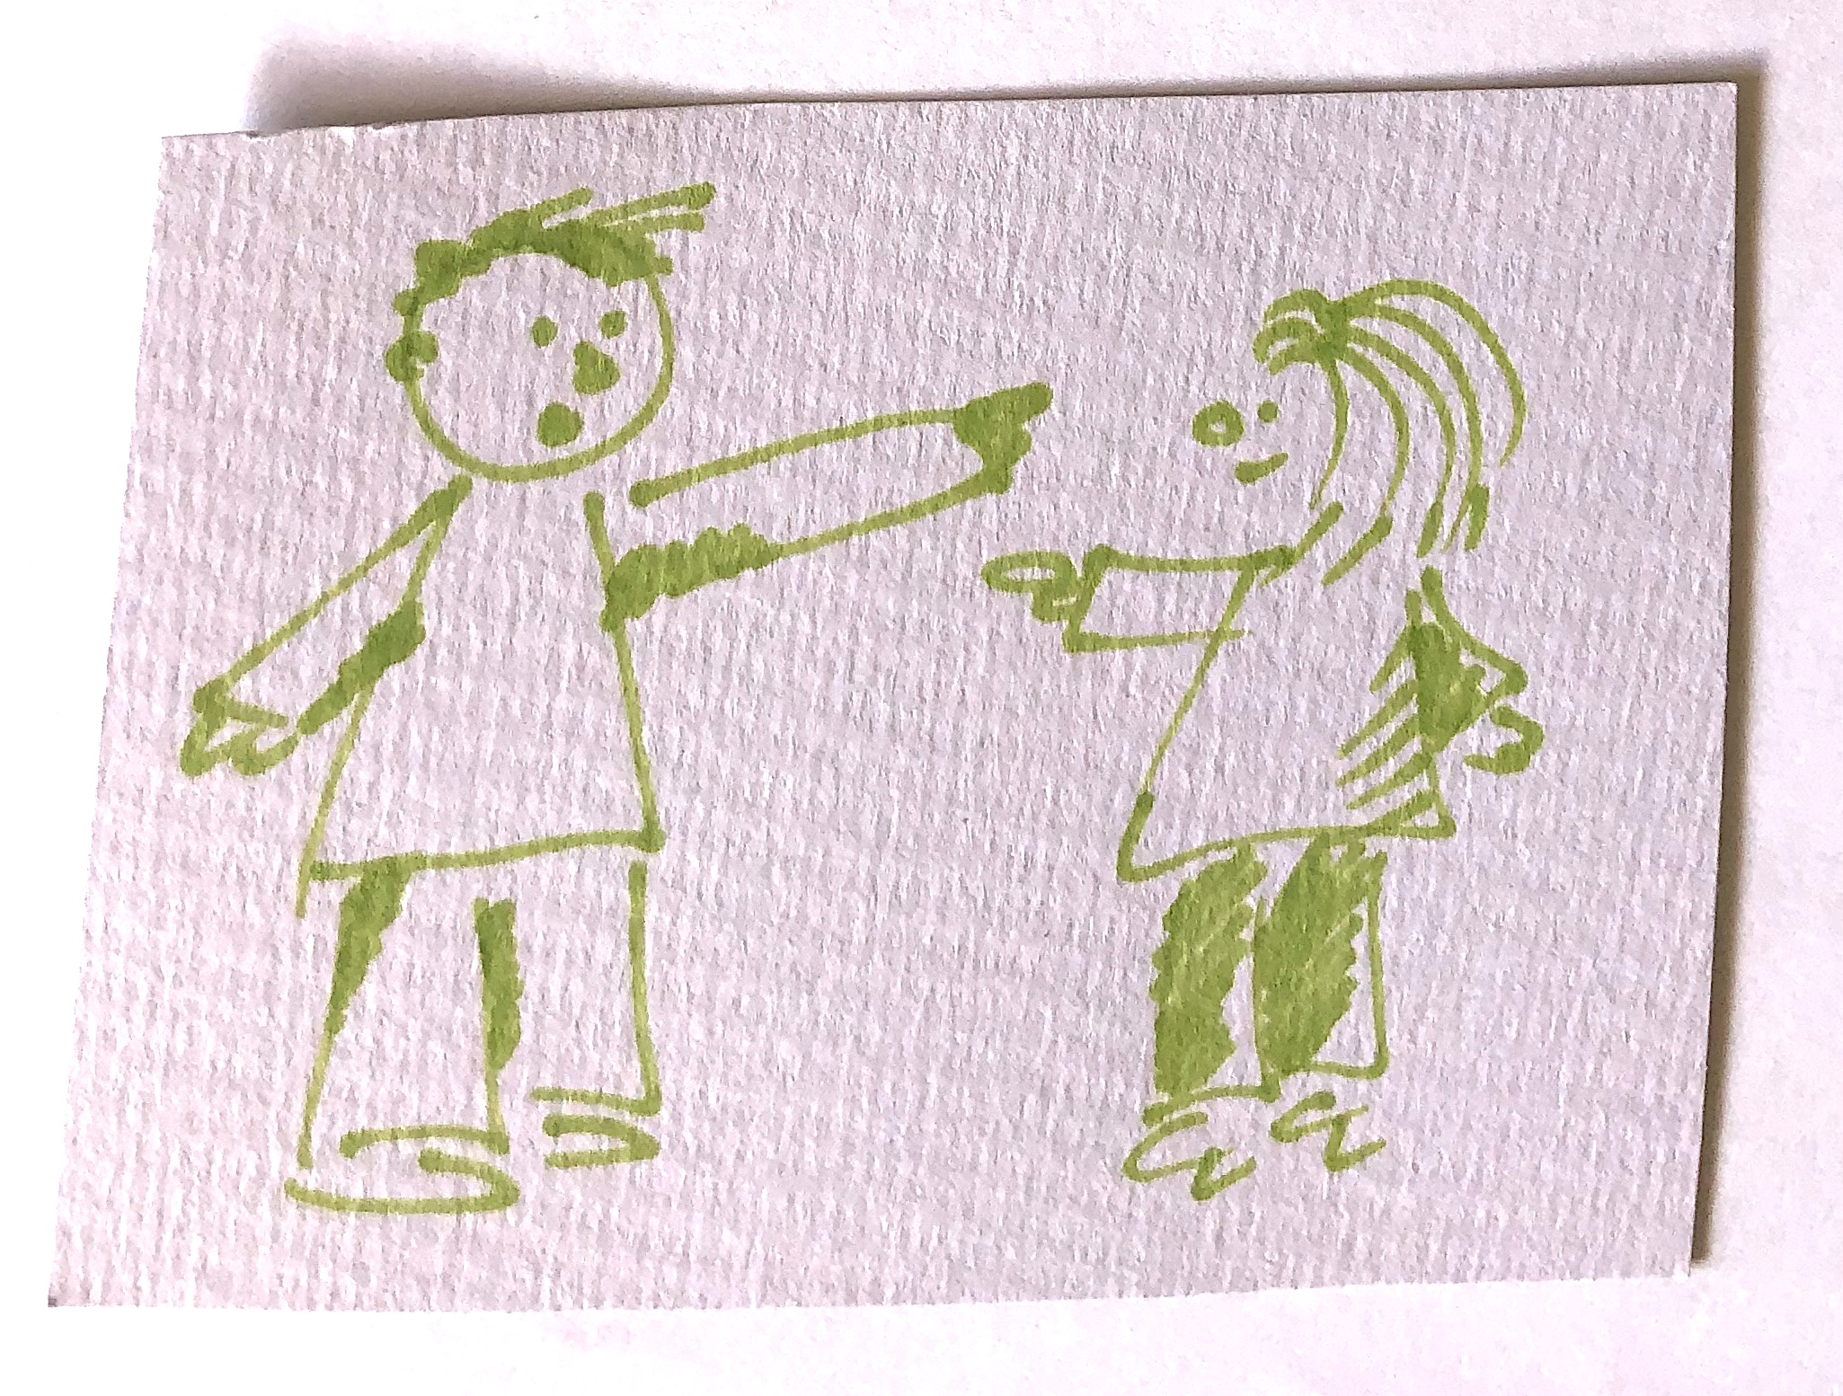
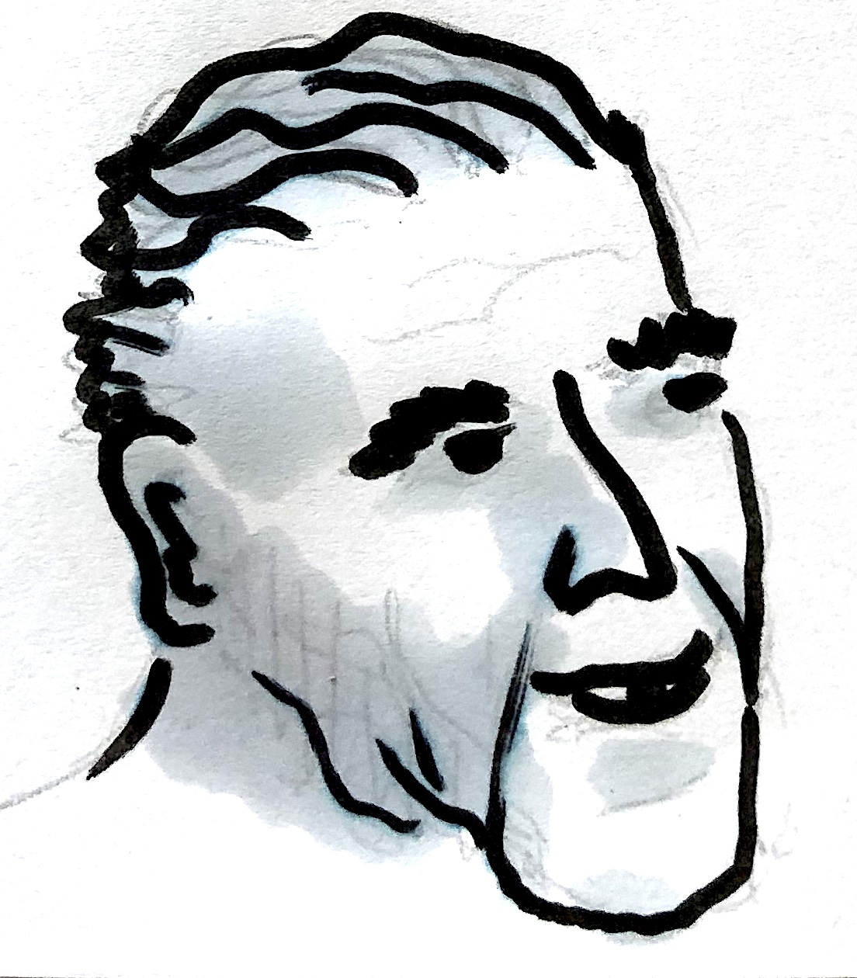
C. Paradigms of Sustainability Communication
_you can not not communicate (P. Watzlawick)

Slide 30
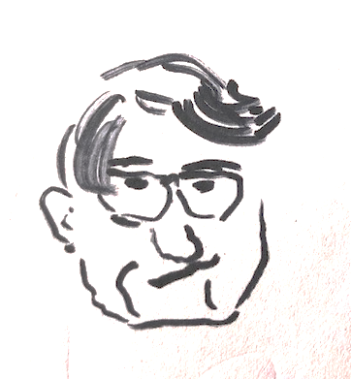
C. Paradigms of Sustainability Communication
_communication always aims at understanding (consensus) (J. Habermas)
Notes:
Jürgen Habermas, 1929 in Düsseldorf geboren, deutscher Philosoph und Soziologe. Werke: Strukturwandel der Öffentlichkeit
Theorie des Kommunikativen Handelns
Habermas versteht Sprechen als Sprechakte, also als Sprechhandlungen, als sprachliche Handlungen. Sprache ist für Habermas das Medium menschlicher Verständigung, auch nonverbale Äußerungen etc. verweisen ihm zufolge wiederum auf Sprache.
***
Jürgen Habermas steht in der Tradition der kritischen Theorie, Frankfurter Schule, Theoror W. Adorno, Max Horkheimer
Habermas entwickelt Gesellschaftstheorie als eine Theorie der Kommunikativen Handelns. Die kommunikativen Strukturen der Lebenswelt sind für ihn Bestandsbedingungen von Gesellschaft, aus deren Untersuchung sich zugleich Maßstäbe für eine Kritik gesellschaftlicher Herrschaftsverhältnisse gewinnen lässt.
Unsere Kommunikation (Habermas spricht von „lebensweltlicher Kommunikation“) ist dadurch charakterisiert, dass sprachliche Verständigung auf der Grundlage von Geltungsansprüchen basiert, die der Sprache und ihren Sturkturen bereits innewohnen. Geltungsansprüche sind: Verständlichkeit, Wahrheit, Wahrhaftigkeit, Richtigkeit
Q: Schäfers, S. 158 f.

Slide 31
C. Paradigms of Sustainability Communication
Paradigms
Pragmatic (communication as structure; information, education, instrumental sense of communication, functionalist/structural perspective, description of reality)
Constitutive (communication as process; symbolic action, social constructivism, sense making, define sth as problem, creates attention, evokes values, orientation, activates/stimulates engagement, exploration)
Icon made by Raj Dev from www.freeicons.io
Notes:
Did you bring your „glasses“?!? What are the persepctives from which we‘re coming analysing wahts going on out there? ...
When we started on our „trip“ to understanding strategic communication we started with various theoretical approaches ... all exploring and explaining organizational communication and communictaio management with a „paradigm“/basic understanding in the background ...

Slide 32
C. Paradigms of Sustainability Communication
Lens 1: objective/pragmatic: the transmission model, the social scientific perspective
  Who is the sender?
  Who is the receiver?
  What is the medium?
  What is the message?
  What is the purpose of the text?
  What potential “noise” is there?
  What potential feedback is there?
Icon made by Raj Dev from www.freeicons.io

Slide 33
C. Paradigms of Sustainability Communication
Lens 2: interpretive/constitutive: the constructivist, critical, cultural view
  Who are the actors in this drama?
  What is the purpose of this text?
  How does this text create a culture?
Icon made by Raj Dev from www.freeicons.io

Slide 34
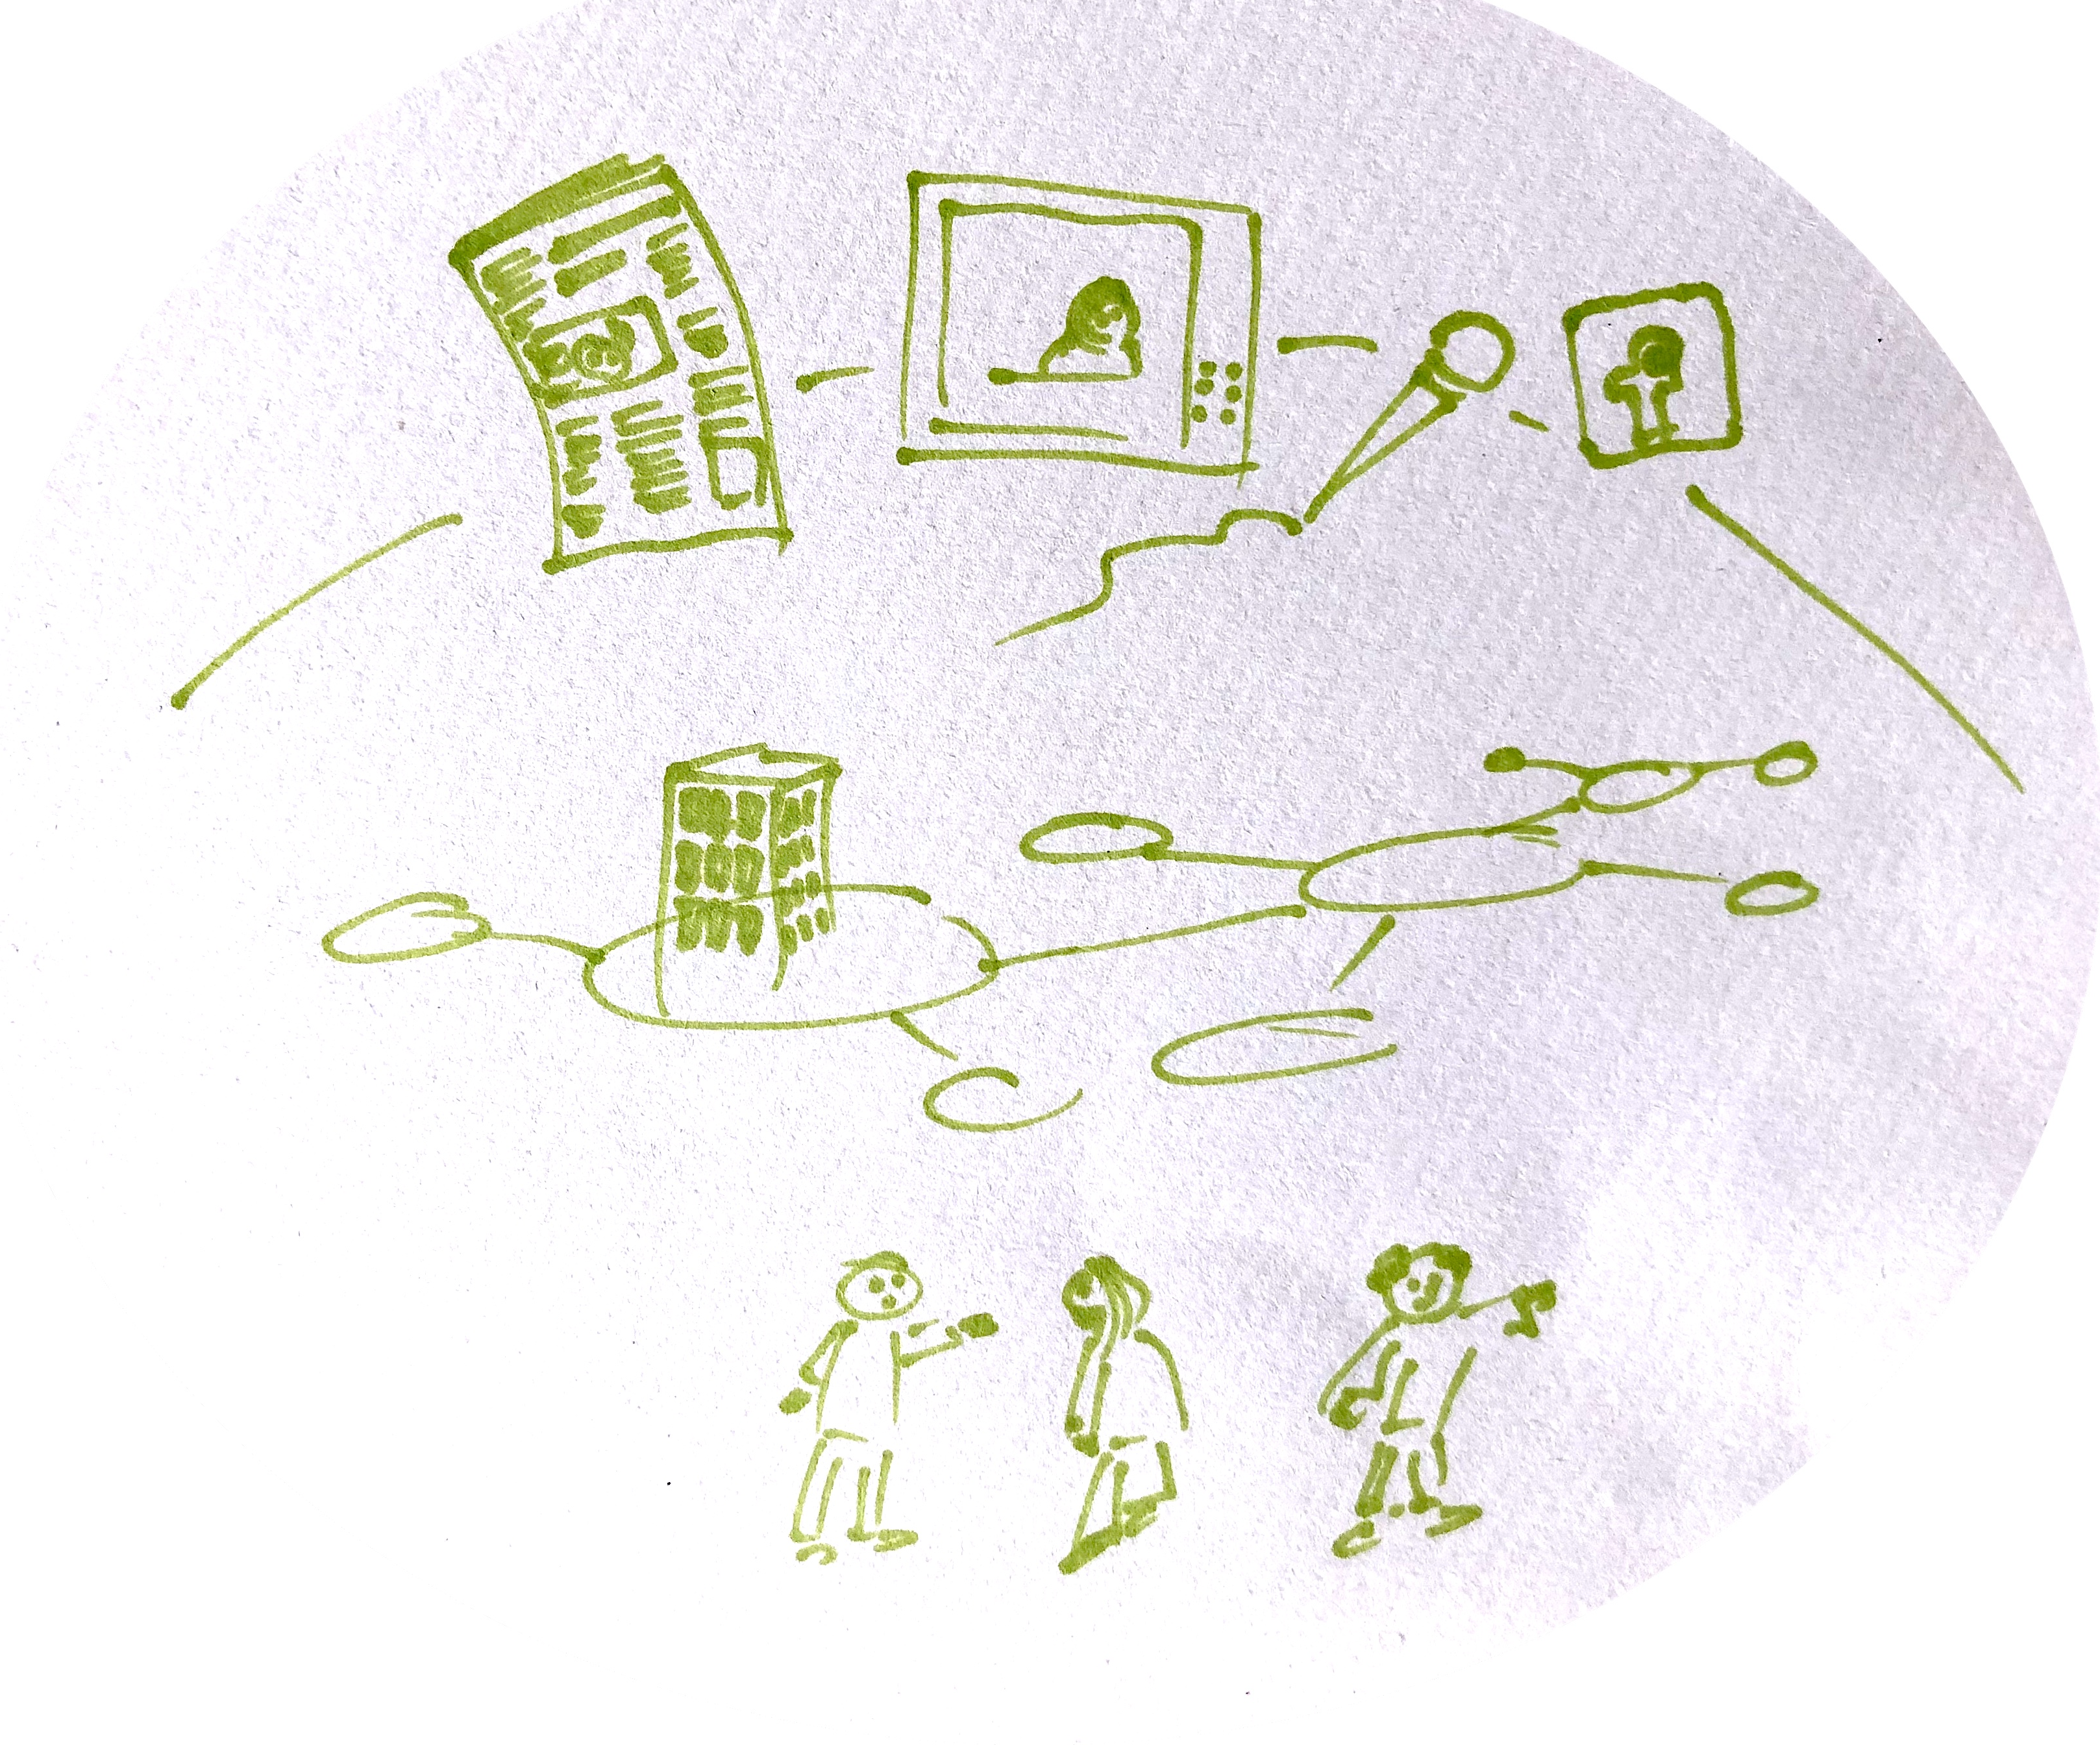
Outlook
_MACRO: social system, cultural context, public discourses/public sphere
Communication
_MESO: organizations, institutions, stakeholder/audiences
_MICRO: intra-/interpersonal communication
Notes:
Communication as structure & process
We can look at communication as structure and process on three different levels!…

Slide 35
Reflection
1. Try to use your sustainability communication examples (media, products, advertisement) and look at it from both paradigmatic perspectives; ask yourself:
  Who is the sender?
  Who is the receiver?
  What is the medium?
  What is the message?
  What is the purpose of the text?
  What potential “noise” is there?
  What potential feedback is there?
2. Answer the following questions:
  Who are the actors in this drama?
  What is the purpose of this text?
  How does this text create a culture?

