Slide 1
Disciplines / Key Terminology
Lesson 04: CSR / CSR Communication

Slide 2
Where are we?
Episode 1: Phenomena & key terminology
Episode 2: Science Communication / Climate Change Comm.
Episode 3: Environmental Studies / Environmental Communication
Episode 4: CSR / CSR Communication
Science & Risk Communication
Strategic / CSR Communication
Sustainability Communication
Environmental and Social Change Communication

Slide 3
Learning outcomes
Learning outcome 1:
Describe the diverse nature of contemporary practices of sustainability communication on an individual, organizational and societal level, the relationship of strategic communication practices to other public communication practices, the role of stakeholders and publics and the communication practitioners in and outside of organizations (corporate, NGO, political and educational institutions etc.)
Learning outcome 2:
Develop comprehensive and well-founded knowledge in sustainability communication as field of study, an understanding of how other disciplines relate to the field and an international perspective on the field.
Learning outcome 3:
Understand the key elements of communication theories, strategies and tactics, and, thus, the character and operationalization of best practice sustainability communication planning frameworks.
Learning outcome 4:
Advance your understanding of social and civic responsibility and develop an appreciation of the philosophical and social context of sustainability communication. Advance your knowledge and respect of ethics and ethical standards in relation to communication of, about and for sustainability.
Learning outcome 5:
Anticipate and Interpret current issues and challenges of a world in transformation and social change. Develop a deep understanding of and skills to create change, develop advocacy, leadership and authorship in and for sustainability communication.

Slide 4
Overview
Responsibility
CSR
CSR Communication

Slide 5
Recap
Climate change communication is about educating, informing, warning, persuading, mobilizing and solving a very critical problem / risk
Deeper level: climate change communication is shaped by our different experiences, mental and cultural models, and underlying values and worldviews
Science / CC Comm: Communication about & of climate change
Communication for change?
Notes:
Sustainability is not really talked about – and therefore not much „sustainability communication“ happening in the disciplinary area of science and climate change communication .
What is predominantly missing – at least until just recently – is a constructivist perspective; what is missing are participatory approaches to science communication and concept to better understand communication for change!

Slide 6
A. Responsibility
Recap
Climate change & environmental communication: human-nature relationship, nature has no voice,
EC: Communication about environmental affairs
Communication for change!
Notes:
Also: Environmental communication research does not uses sustainability as normative principle, as potential universal value that can guide action for change.

Slide 7
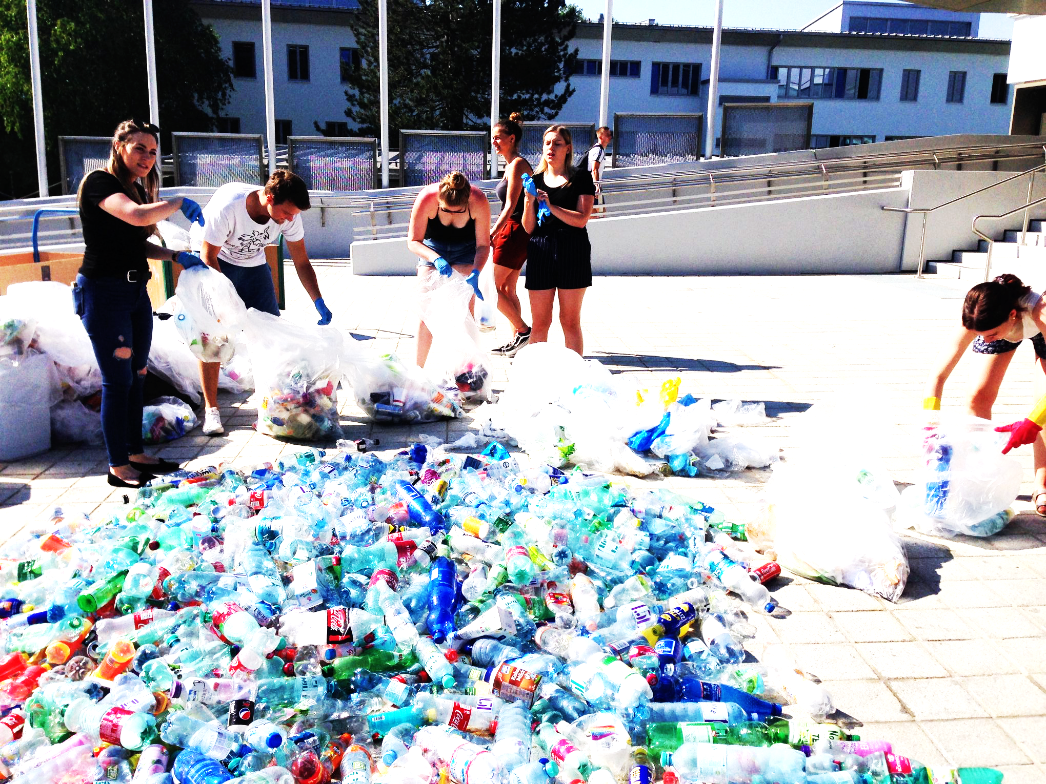
A. Responsibility
But who is responsible for “taking a voice” for nature, who are the “authors” of change??
Source: private
Notes:
We as individuals, organizations and political institutions – or the society?

Slide 8
A. Responsibility
Organizations of all kind are responsible towards their environment / the society
The are embedded in the society – and therefore responsible for their action
CSR: „a concept whereby companies integrate social and environmental concerns in their business operations and in their interaction with their stakeholders on a voluntary basis“
EU, green book, 2001: Corporate Social Responsibility

Slide 9
A. Responsibility
Background
Responsibility is a “relational term”
Prospective: obligation, liability, license to operate
Retrospective: justification, legitimatization

Slide 10
A. Responsibility

Slide 11
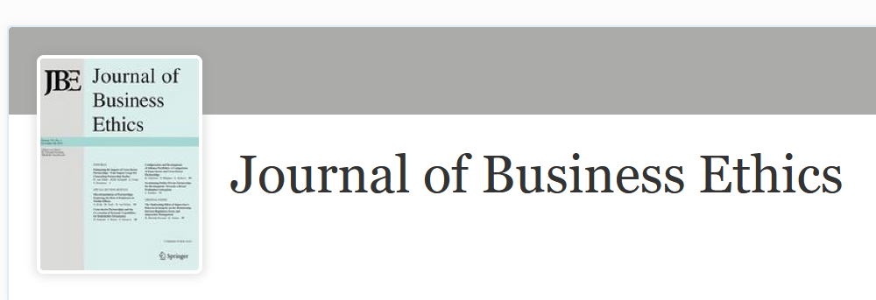
B. CSR
Background: Business Ethics
Big question:
Ethical / economic values, what comes first?
Source: Screenshot www.springer.com/Journal/10551

Slide 12
B. CSR
... is a self-regulating concept or business model
... it helps a company being socially accountable to itself, its stakeholders, and the public (social license to operate)
CSR means being conscious of and responsible for the kind of impact they are having on all aspects of society, including economic, social, and environmental
Notes:
Most of all.. CSR is understood as …

Slide 13
C. CSR Communication
CSR communication: “process of anticipation stakeholder’s expectations, articulation of CSR policy and managing different … tools designed to provide true and transparent information about a company`s or a brand`s integration of its business operations, social and environmental concerns, and interactions with stakeholders” (Podnar, 2008: 85)
Integrative perspective on CSR communication: “harmonization of all CSR-related communication strategies and activities” (Diehl et al., 2017)
Information, response, and involvement as “guides” for communication management (Morsing, 2017; Morsing & Schultz, 2006; Grunig & Hunt, 1984)

Slide 14

C. CSR Communication
Source: private

Slide 15
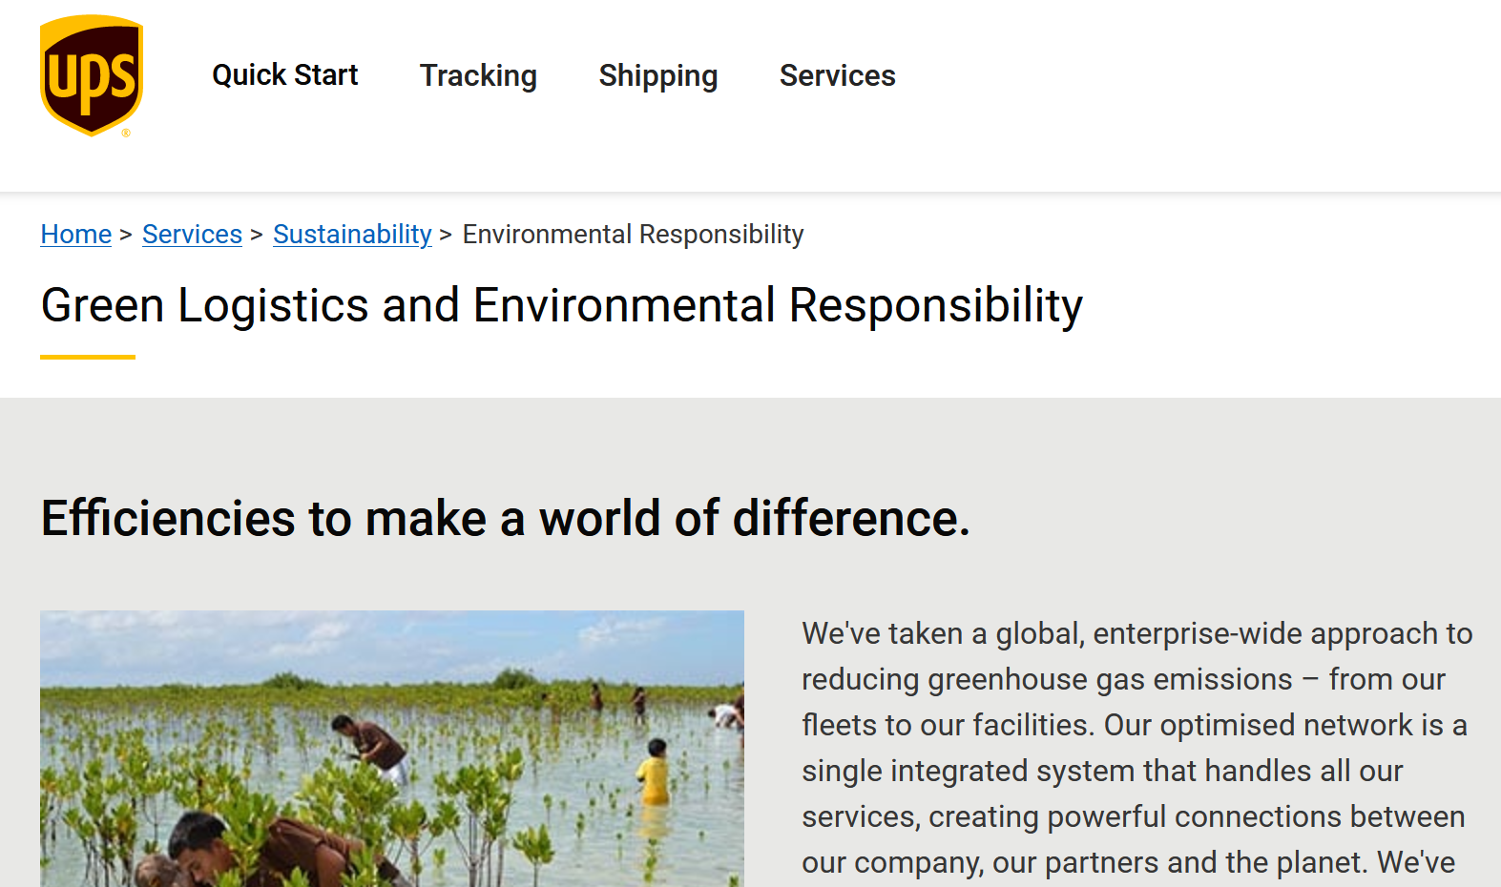
C. CSR Communication
Go Green!
Our Responsibility!
Be Green!
Source: https://www.ups.com/mt/en/services/sustainability/environmental-responsibility.page?

Slide 16
C. CSR Communication
Theoretical approaches to CSR Communication
Instrumental approaches (CSR = a mere means to the end of profits) (Friedman 1970; Porter & Kramer 2002; 2006)
Integrative approaches (CSR = integration of social demands) (Sethi1975; Preston & Post, 1975; Mitchell et al., 1997; Carroll, 1979)
Ethical approaches (CSR = ethical values/obligation) (Freeman, 1984; Brundtland Report 1987)
Political approaches (CSR = social duties/rights & participation in a certain social cooperation) (Davis 1960; Donaldson & Dunfee 1994; Andriof & McIntosh 2001; Matten & Crane 2005; Garriga & Melé 2004)
But: ”The field of scholarship that CSR represents is a broad and diverse one, encompassing debates from many perspectives, disciplines, and ideological positions.” (Crane et al., 2008, p. 7; Diehl et al., 2017; Golob et al., 2013; Elving et al., 2015)

Slide 17
C. CSR Communication
Perspective on Sustainability (Science / CC Comm):
Sustainability as counter narrative (solution?) to climate change
Notes:
We remember:
So what role does sustainability play in science & climate change communication research?

Slide 18
C. CSR Communication
Perspective on Sustainability (Environmental Comm)
Sustainability as (moral) principle of change
Sustainability as principle of restoration / regeneration

Slide 19
C. CSR Communication
Perspective on Sustainability (CSR Com)
Sustainability as principle (moral compass) of action
Sustainability as label for “good behavior”, “used” in communication

Slide 20
Outlook
Fields & disciplines feeding in CSR Com as field of research
Management communication
Public Relations
Organizational communication
Marketing communication
Rhetoric
CSR Com: Communication about & of CSR (reporting)
Communication for transformation!
Notes:
Again – we can see a dominance of research theories and methodologies looking at how to communicate about organizational responsibilities and related action & activities – but not much is done in terms of how core values for organizations are negotiated within the organization for example, or co-created with the stakeholders.

Slide 21
Reflection
Try to identify examples of CSR communication on corporate websites.
What are the key words that are used?
Where and how is sustainability used (and possibly abused)?
Whom are corporates talking to when they communicate about their responsibility?
What are the dimensions of CSR and Sustainability that are communicated the most (environmental, economic, social) – and what about culture?

Slide 22
Overall reflection to the whole lecture unit
What are the perspectives and understandings of and approaches to sustainability from
A science / climate change communication perspective
An environmental communication perspective
A CSR communication perspective
In which of the disciplines is sustainability more debated, in which of the disciplines is sustainability not (yet) debated – and why?

