Slide 1
Disciplines / Key Terminology
Lesson 03: Environmental and Sustainability Studies / Environmental Communication

Slide 2
Where are we?
Episode 1: Phenomena & key terminology
Episode 2: Science Communication / Climate Change Comm.
Episode 3: Environmental and Sustainability Studies / Environmental Communication
Episode 4: CSR / CSR Communication
Science & Risk Communication
Strategic / CSR Communication
Sustainability Communication
Environmental and Social Change Communication

Slide 3
Learning outcomes
Learning outcome 1:
Describe the diverse nature of contemporary practices of sustainability communication on an individual, organizational and societal level, the relationship of strategic communication practices to other public communication practices, the role of stakeholders and publics and the communication practitioners in and outside of organizations (corporate, NGO, political and educational institutions etc.)
Learning outcome 2:
Develop comprehensive and well-founded knowledge in sustainability communication as field of study, an understanding of how other disciplines relate to the field and an international perspective on the field.
Learning outcome 3:
Understand the key elements of communication theories, strategies and tactics, and, thus, the character and operationalization of best practice sustainability communication planning frameworks.
Learning outcome 4:
Advance your understanding of social and civic responsibility and develop an appreciation of the philosophical and social context of sustainability communication. Advance your knowledge and respect of ethics and ethical standards in relation to communication of, about and for sustainability.
Learning outcome 5:
Anticipate and Interpret current issues and challenges of a world in transformation and social change. Develop a deep understanding of and skills to create change, develop advocacy, leadership and authorship in and for sustainability communication.

Slide 4
Recap
Climate change communication is about educating, informing, warning, persuading, mobilizing and solving a very critical problem / risk
Deeper level: climate change communication is shaped by our different experiences, mental and cultural models, and underlying values and worldviews
Science / CC Comm: Communication about & of climate change
Communication for change?
Notes:
In the last episode, we talked about science, risk and climate change communication ... And the challenge of these disciplines looking predominantyl into the dissemination of scientific facts, knowledge transfer and education.
Sustainability is not really talked about – and therefore not much „sustainability communication“ happening in the disciplinary area of science and climate change communication .
What is predominantly missing – at least until just recently – is a constructivist perspective; what is missing are participatory approaches to science communication and concept to better understand communication for change!

Slide 5
Overview
Sustainability Studies
Environmental Studies
Environmental Communication
Notes:
Therefore: let‘s have alook into ...

Slide 6
A. Sustainability Studies
Sustainability research: paradigm shift within science
Focus: Human-environment relationships
Research as „integrated approcah to cooperative problem-solving“ (Godemann & Michelsen, 2011: 5).
Notes:
The first complement to science and risk communication are sustainability studies; the most important aspect to mention is that the emergence of sustainability studies around the year 2000 as a demarcated research field means a paradigm shift in science.
Human-nature relationships and eco-cultural identities moved in the center of the discussion, and research became inter- and – much more important – transdisciplinary.
Research is more and more seen as :

Slide 7
A. Sustainability Studies
Inter- & transdisciplinary research
new questions are needed, even awkward ones;
new modes of knowledge production;
problem-oriented research instead of traditional science practices;
answers needed to the questions of today‘s complex society
interests of social, economic and political actors are constitutive elements of the research process, expanding awareness of the problem and its potential solutions (Hirsch Hadorn et al., 2008);
research needs to be embedded in cultural perception & action / cultural context;
engagement and individual participation needed.
Notes:
What does inter- and transdisciplinarity mean?
…
This is exactly where sustainability and environmental studies go hand in hand …

Slide 8
B. Environmental Studies
Broad, multidisciplinary academic field
Focus: human interactions with the environment, human-nature relationships
Includes both, the natural environment (and animals) and the „built environment“ – and the relationship between them

Slide 9
B. Environmental Studies
Key issues (from sustainability perspective)
biodiversity,
land and water sustainability,
renewable energy,
energy conservation,
carbon capture and emission management,
sustainable building design, urban planning,
public health and well-being,
economic development, triple bottom line analysis, and
environmental, national and international treaty law.

Slide 10
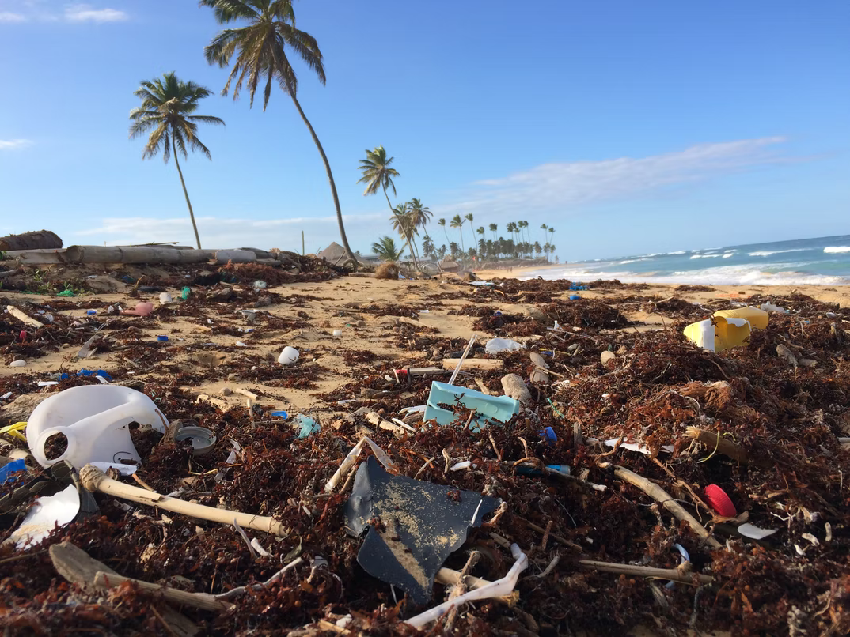
B. Environmental Studies
Nature has no voice …
Source: Photo by Dustan Woodhouse on Unsplash

Slide 11
B. Environmental Studies
Environment
Society
Media
Nature has no voice
We need to consider:
And ... the Public sphere: „the sphere of influence created when different individuals engage each other in communication – through conversation, argument, debate, and questions – about subjects of shared concern or that affect a wider community“ (Cox, 2013, p. 6)

Slide 12
C. Environmental Communication
1970 (USA, Europe): news media framing of the environment & how the public understands and responds to environmental issues (Hansen & Cox, 2015)
Establishment in USA – particularly among rhetorical scholars (Cantrill & Oravec, 1996): how humans make sense of nature and environmental problems
Today: Critical, constructivist, interpretative approach is still a strong foundation of current research (Takahashi et al., 2021)
Increasing relevance of communication research in the face of potentially catastrophic issues (CC) -> establishment of the discipline/institutionalization (w. journals, departments, positions etc.)
Handbooks: Hansen & Cox, 2015; Takahashi et al, 2021

Slide 13
C. Environmental Communication
Dominant research agendas
public communication about ecological problems as well as the related challenges for society;
dissemination of information and implementation of communication practices that are related to the environment;
research field that includes research and practices regarding how different actors (e.g., institutions, states, people) interact with regard to topics related to the environment and how cultural products influence society toward environmental issues;
human interactions with nature and the environment (interpersonal communication, participatory decision-making, environmental media coverage);
application of communication approaches, principles, strategies, and techniques to environmental management and protection;
well researched issues: climate change, energy communication, representations of nature in the media, food & consumption studies

Slide 14
C. Climate Change Communication
Perspective on Sustainability (Science / CC Comm):
Sustainability as counter narrative (solution?) to climate change
Notes:
We remember:
So what role does sustainability play in science & climate change communication research?

Slide 15
C. Environmental Communication
Perspective on Sustainability (Environmental Comm)
Sustainability as (moral) principle of change
Sustainability as principle of restoration / regeneration

Slide 16
Outlook
New fields: neuroscience, virtual reality
EC research does not particularly reflected on…
  increasing number of social movements – what’s the ethical duty of a scholar then?
  sustainability
EC: Communication about environmental affairs
Communication for change!
Notes:
Environmental Communication embraces science, risk and climate change communication; overlaps with Corporate Communication, which we will look at in the fourth episode,
So again, after looking at science / risk communication in the previous episode of this second lecture unit, we can see a gap –
a gap between well researched communication about nature and the environment … but not so much communication for change.

Slide 17
Reflection
Try to identify how the human-nature relationship is presented and framed in the media
What are the facets of the environmental issues that are being discussed?
  Why are some emphasized over others?
  What are the implications?
How are people communicating?
  Why are they using certain words, metaphors, visuals, frames, music, art, narratives, and other rhetorical devices?
  Why not different words, etc.?
  What are the consequence for those who hear and see these messages?
  How should people be communicating?

