Slide 1
Disciplines / Key Terminology
Lesson 02: Science Communication / Risk Communication

Slide 2
Where are we?
Episode 1: Phenomena & key terminology
Episode 2: Science Communication / Risk Comm.
Episode 3: Environmental and Sustainability Studies / Environmental Communication
Episode 4: CSR / CSR Communication
Science & Risk Communication
Strategic / CSR Communication
Sustainability Communication
Environmental and Social Change Communication
Notes:
Episode 1.2. will look at how (much) science, risk and climate change communication as disciplinary fields actually look at „sustainability“ as a new norm, a guiding principle for individual, organizational and societal action

Slide 3
Learning outcomes
Learning outcome 1:
Describe the diverse nature of contemporary practices of sustainability communication on an individual, organizational and societal level, the relationship of strategic communication practices to other public communication practices, the role of stakeholders and publics and the communication practitioners in and outside of organizations (corporate, NGO, political and educational institutions etc.)
Learning outcome 2:
Develop comprehensive and well-founded knowledge in sustainability communication as field of study, an understanding of how other disciplines relate to the field and an international perspective on the field.
Learning outcome 3:
Understand the key elements of communication theories, strategies and tactics, and, thus, the character and operationalization of best practice sustainability communication planning frameworks.
Learning outcome 4:
Advance your understanding of social and civic responsibility and develop an appreciation of the philosophical and social context of sustainability communication. Advance your knowledge and respect of ethics and ethical standards in relation to communication of, about and for sustainability.
Learning outcome 5:
Anticipate and Interpret current issues and challenges of a world in transformation and social change. Develop a deep understanding of and skills to create change, develop advocacy, leadership and authorship in and for sustainability communication.

Slide 4
Overview
Changing Climate
Science Communication
Climate Change Communication
Notes:
In this episode ...

Slide 5
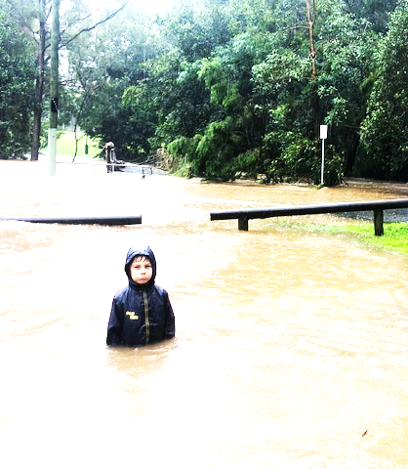
A. A changing climate
Source: private
Notes:
Deforestation, species extinction, biodiversity loss, wildlife trafficking, extreme weather events, energy production, environmental justice and racism … and the related changing climate are just a few of the “risks” and “threats” that people around the world hear and talk about.

Slide 6
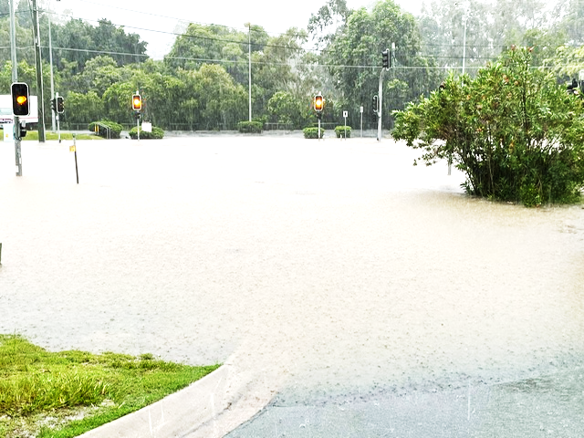
A. A changing climate
Source: private
Notes:
Climate change refers to long-term shifts in temperatures and weather patterns. These shifts may be natural, but since the 1800s, human activities have been the main driver of climate change, primarily due to the burning of fossil fuels (like coal, oil and gas), which produces heat-trapping gases.

Slide 7
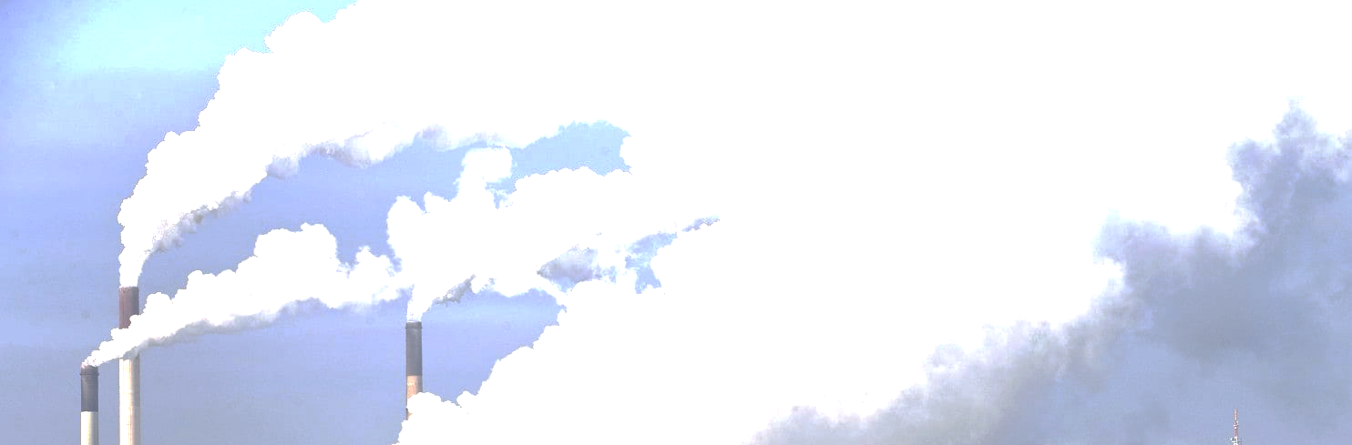
A. A changing climate
Source: private
Notes:
Primarily Problem of technology – economics and public policy & result of social ecologies that are dysfunctional

Slide 8
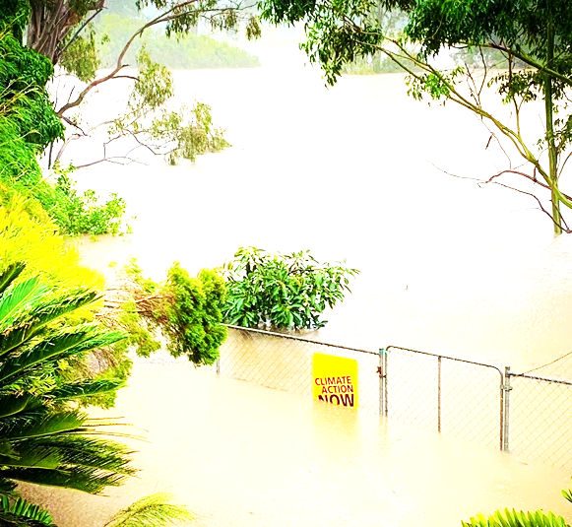
A. A changing climate
Source: private
Notes:
People learn about these issues in a number of ways … Including
personal experience
Town hall meetings
Newspapers
TV
Films
Bowling alleys
Social media and
Classrooms
Social movements, demonstrations, strikes
The communication of environmental and nature-related issues, whether it takes place in the form of mediated messages, interpersonal channels or direct experience, shapes & reshapes our understanding of such issues and the stakeholders involved

Slide 9
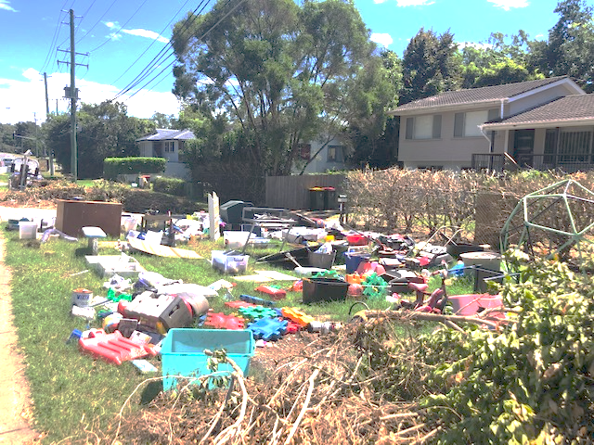
A. A changing climate
Source: private
Notes:
Politicians, Indigineous populations, journalists, environmental activists, industry representatives, scientists and other actors create and negotiate meaning about those environmental issues and other, non-human species.

Slide 10
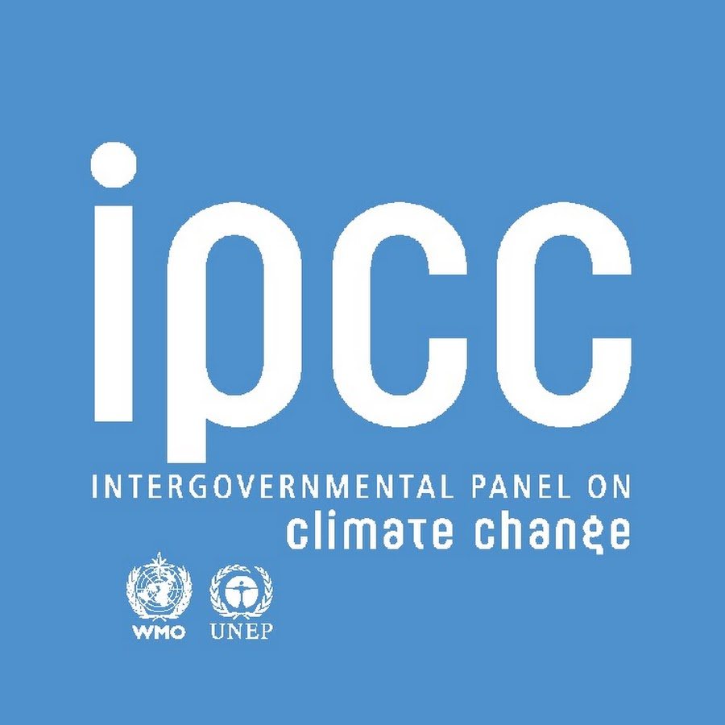
A. A changing climate
xxx
Scientific facts:
Observed warming of the Earth's surface
Attribution of observed warming to human activities
In detail:
Projected increases in future global mean temperature,
rising sea levels, and
increased frequency of heat waves.
Source: www.ipcc.ch
Notes:
Here, taking aboz a changing climate and related crises, we mostly refer to scientific data, regular assessments on cc, implications & future risks

Slide 11
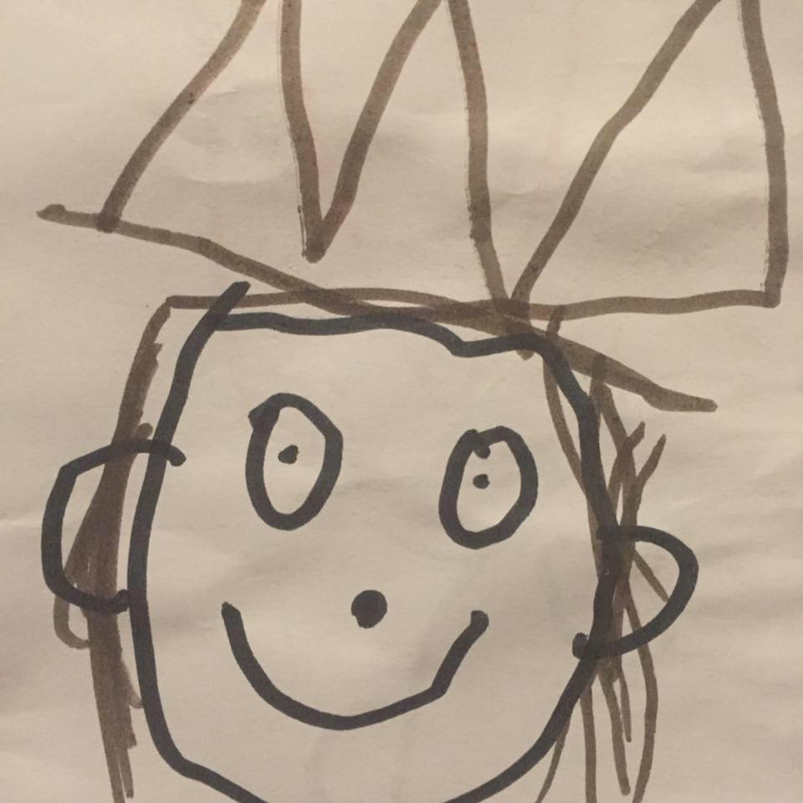
A. A changing climate
Do we (want to) understand this?
Notes:
And how do we react? – what do we do with the scientific facts, with evidence?

Slide 12
B. Science Communication
public sphere
experts
science
Question of knowledge transfer
Notes:
Science communication generally refers to public communication presenting science-related topics to non-experts.
It includes science exhibitions, journalism, policy or media production. Science communication also includes communication between scientists (for instance through scientific journals), as well as between scientists and non-scientists (especially during public controversies over science and in citizen science initiatives. –expert/lay communication
SC: examines the nature of expertise, the diffusion of knowledge, and the communication of science and technology among professionals and to the public.

Slide 13
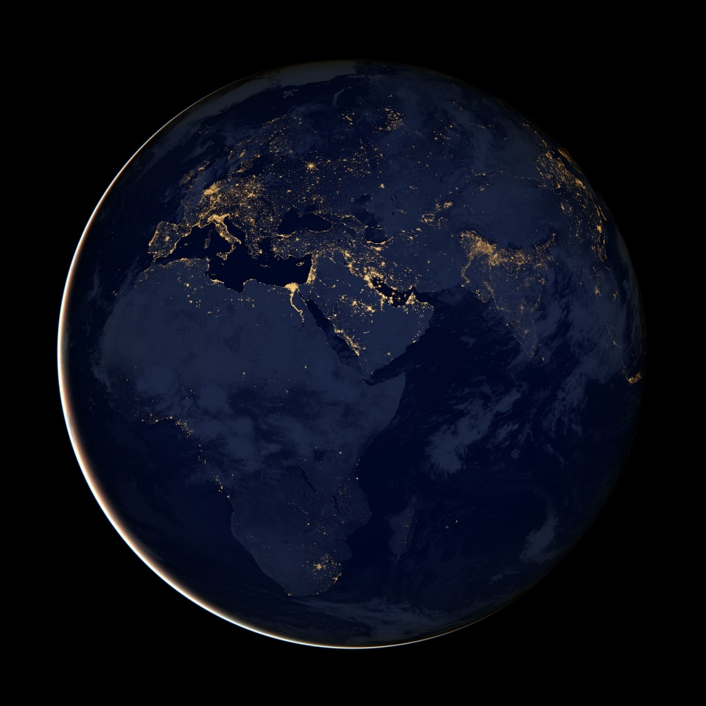
B. Science Communication
Developments
Formats and actors of science communication are diversifying (Bucchi & Trench, 2021)
Source: Photo on PxHere, Licence: CC-0
Light Pollution
Notes:
Here, facing a climate and – recently – a public health crisis, science communication itself has changed as well, formats and actors of science communication are diversifying – not only but mainly stimulated through new pathways of communication and digital media innovations (Bucchi & Trench, 2021)

Slide 14

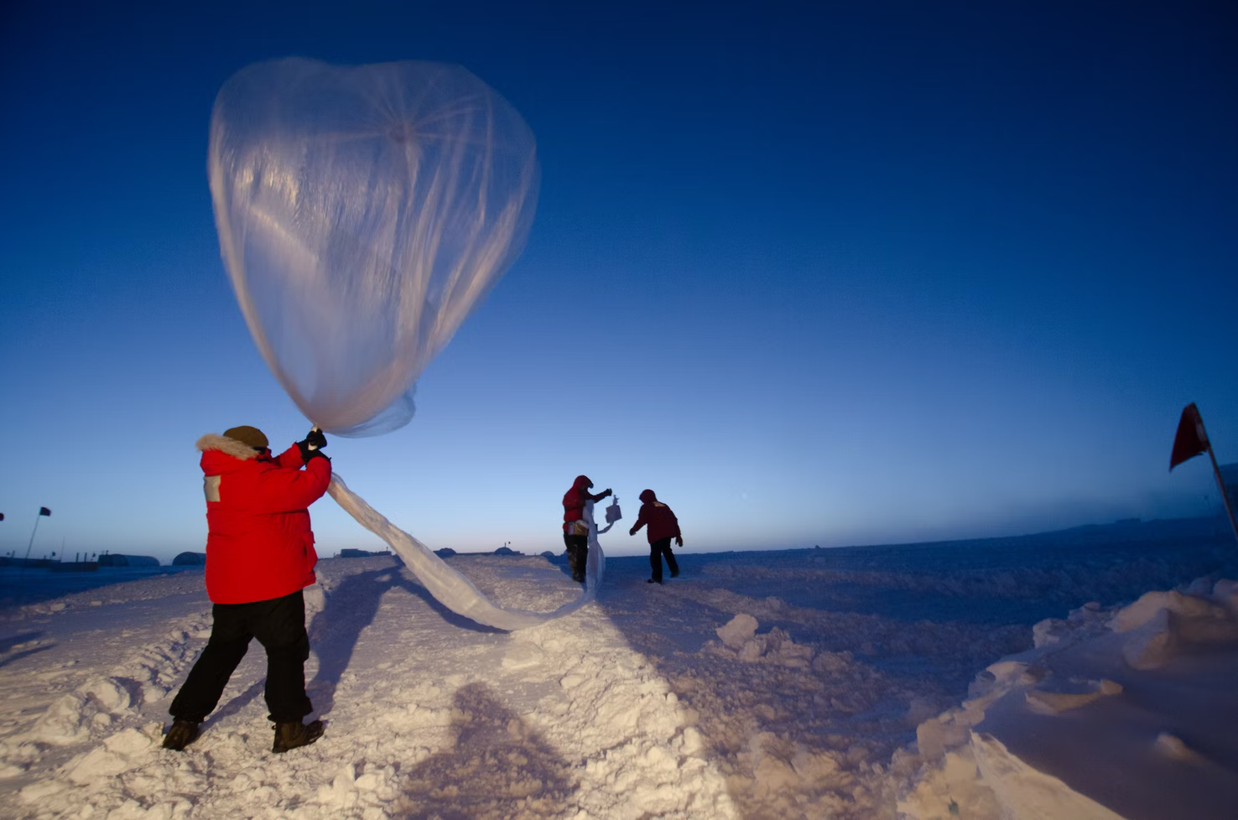
B. Science Communication
Developments
Formats and actors of science communication are diversifying (Bucchi & Trench, 2021)
Science communication is increasingly seen “as culture” (Davies & Horst, 2021)
Source: Photo by NOAA on Unsplash, Licence: CC-0
Source: Photo on PxHere, Licence: CC-0
Notes:
Equally important for this lecture at hand is that science communication is increasingly seen “as culture” (Davies & Horst, 2021);
instead of the functional, instrumental idea of communication of science, mentioned as dominating perspective in the science of science communication above,
increasingly authors focus on the creation of meaning and (common) sense.
From this social-constructivist perspective, science communication is how particular societies or groups (rather than individual communicators) explain the world (Davies et al., 2019, p. 3).

Slide 15
B. Science Communication
Developments
Formats and actors of science communication are diversifying (Bucchi & Trench, 2021)
Science communication is increasingly seen “as culture” (Davies & Horst, 2021)
Presence of science in public conversations (Bauer, 2009)
Notes:
The core of this idea is the presence of science in public conversations (Bauer, 2009).

Slide 16
B. Science Communication
Developments
Formats and actors of science communication are diversifying (Bucchi & Trench, 2021)
Science communication is increasingly seen “as culture” (Davies & Horst, 2021)
Presence of science in public conversations (Bauer, 2009)
Social conversations around science (sense / meaning making) (Bucchi & Trench, 2021)
Notes:
Recently, Bucchi and Trench (2021) asked: how does society then talks about science?
At this point, climate change and the question of how society talks about a changing environment and climate helps to answer this question.

Slide 17
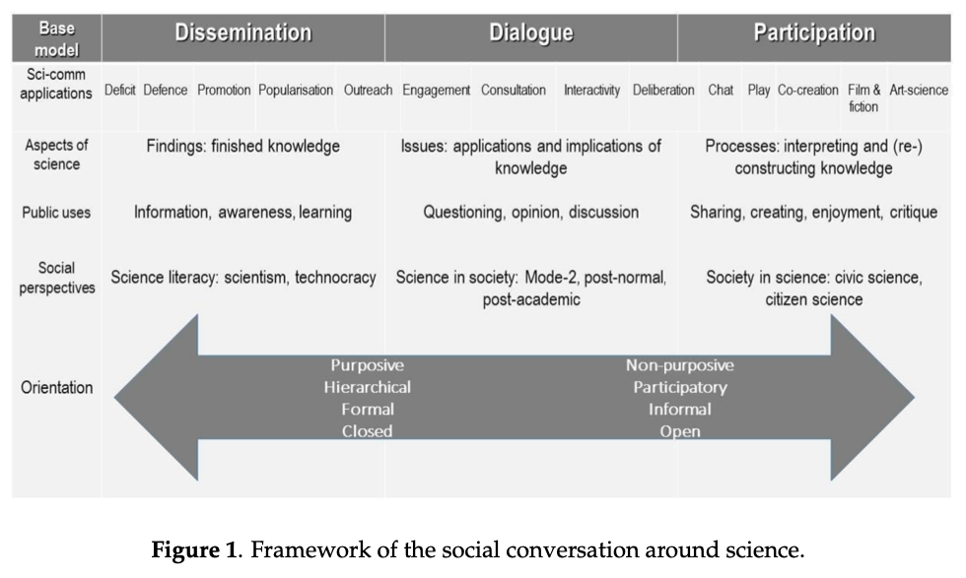
B. Science Communication
Bucchi, M., & Trench, B. (2021). Rethinking science communication as the social conversation around science. Journal of Science Communication, 20(3), Y01. p. 8
Notes:
To understand what climate change and science communication is, we need to differentiate between the idea of knowledge transfer via dissemination of facts, dialogue formats and participatory approaches.

Slide 18

C. Climate Change Communication
Source: Photo by Jonathan Borba on Unsplash
Notes:
A participatory perspective includes new ways of climate change education ...

Slide 19

C. Climate Change Communication
Source: Photo by Jonathan Borda on Unsplash
Notes:
Includes research on constructions of a crisis and possible solutions in childrens books...

Slide 20
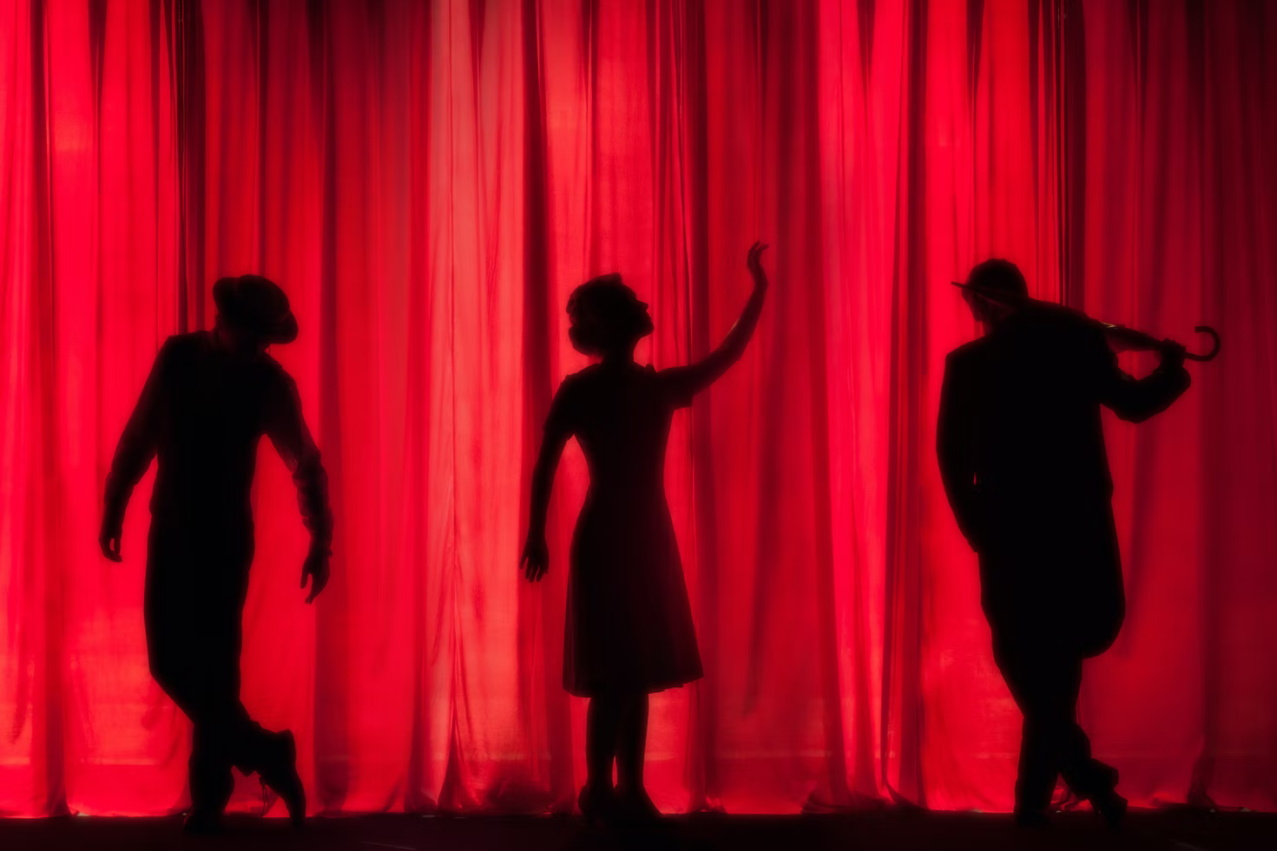
C. Climate Change Communication
Source: Photo by Kyle Head on Unsplash
Notes:
And includes art, creative writing and drama

Slide 21
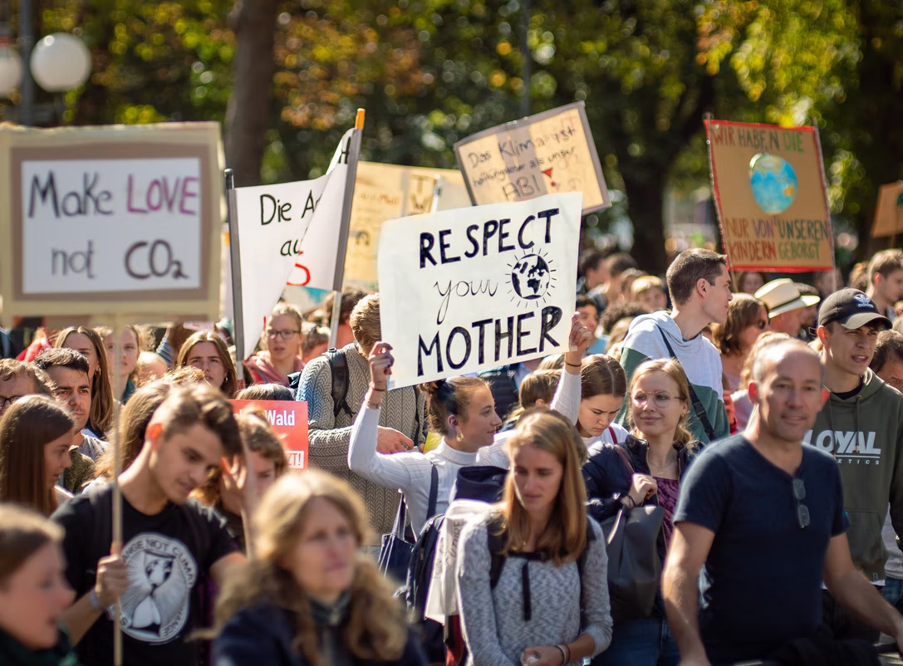
C. Climate Change Communication
Source: Photo by Mika Baumeister on Unsplash
Notes:
We also need to include co-creational approaches, social movements and the social construction of meaning in the public sphere

Slide 22
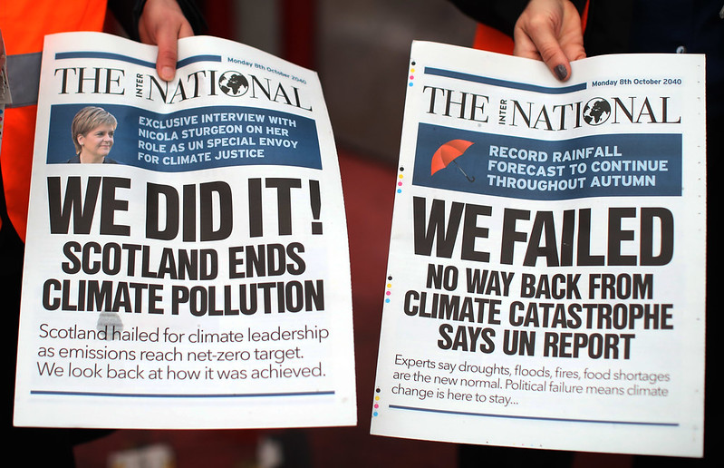
C. Climate Change Communication
Source: Photo by Friends of the Earth Scotland on flikr, Licence: CC-By-2.0
Notes:
The challenge:

Slide 23
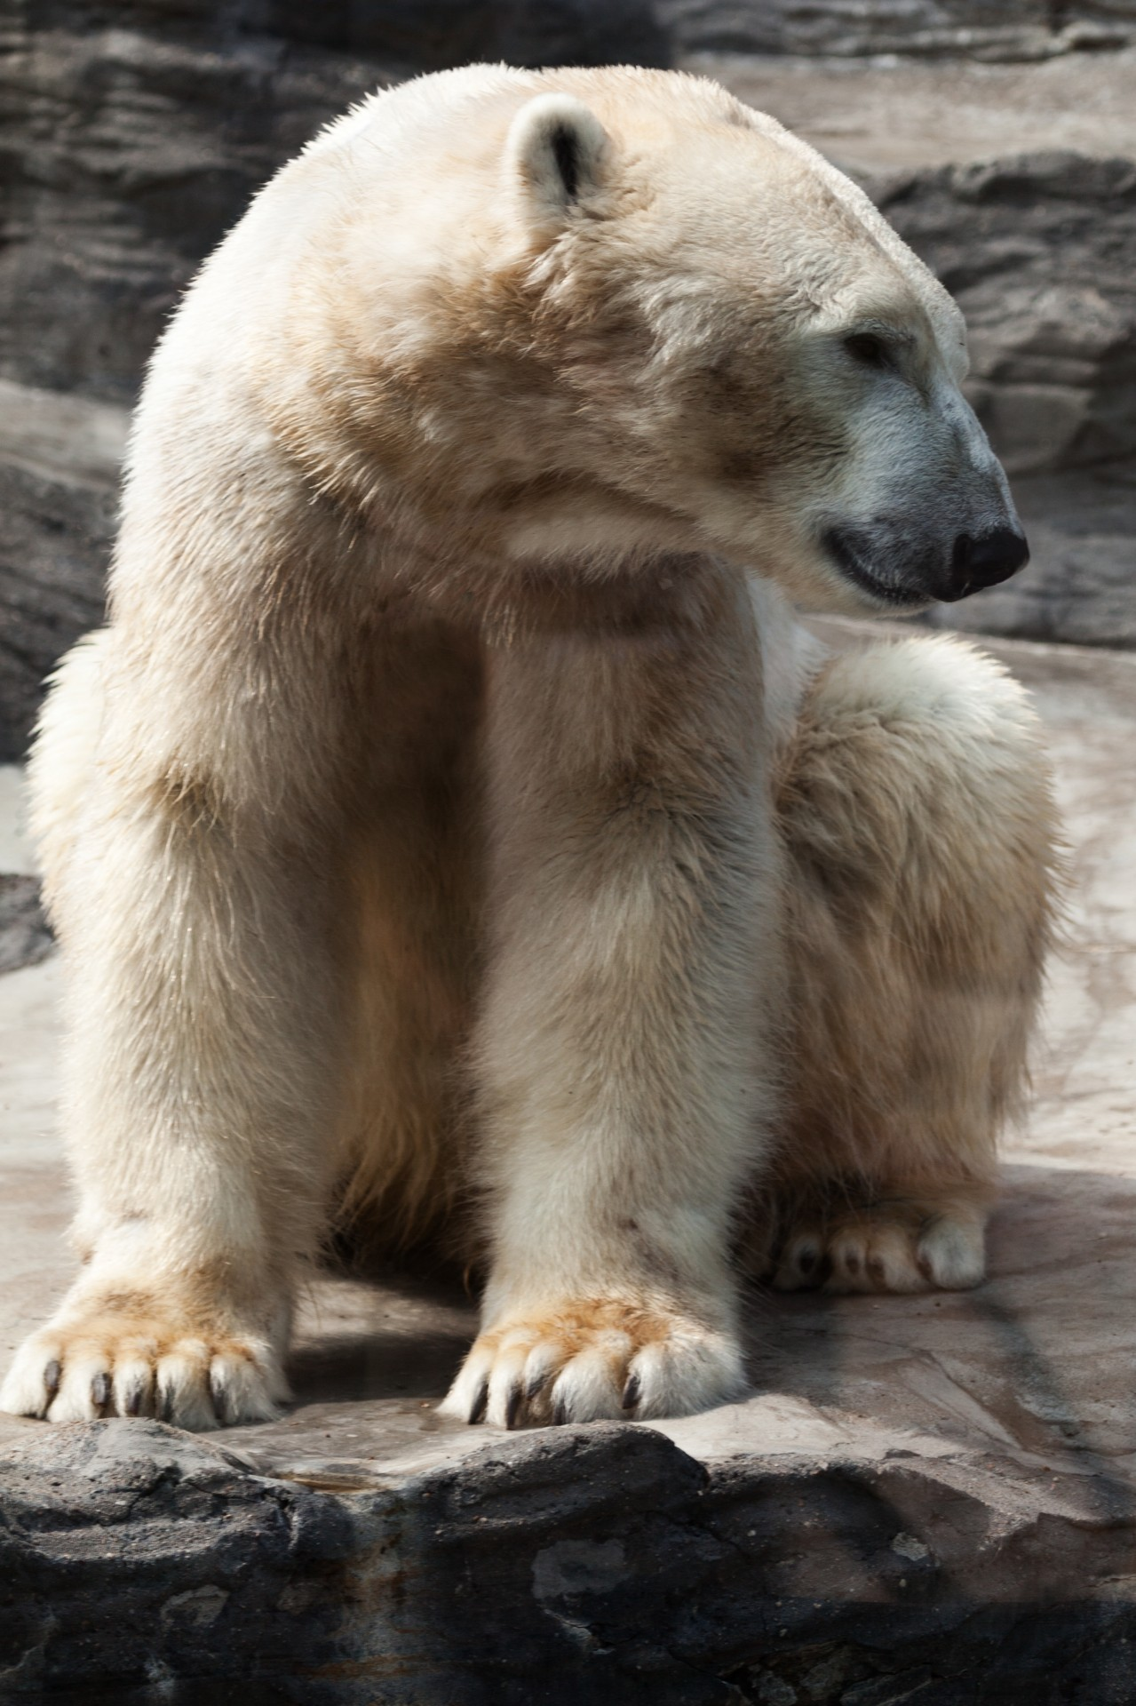
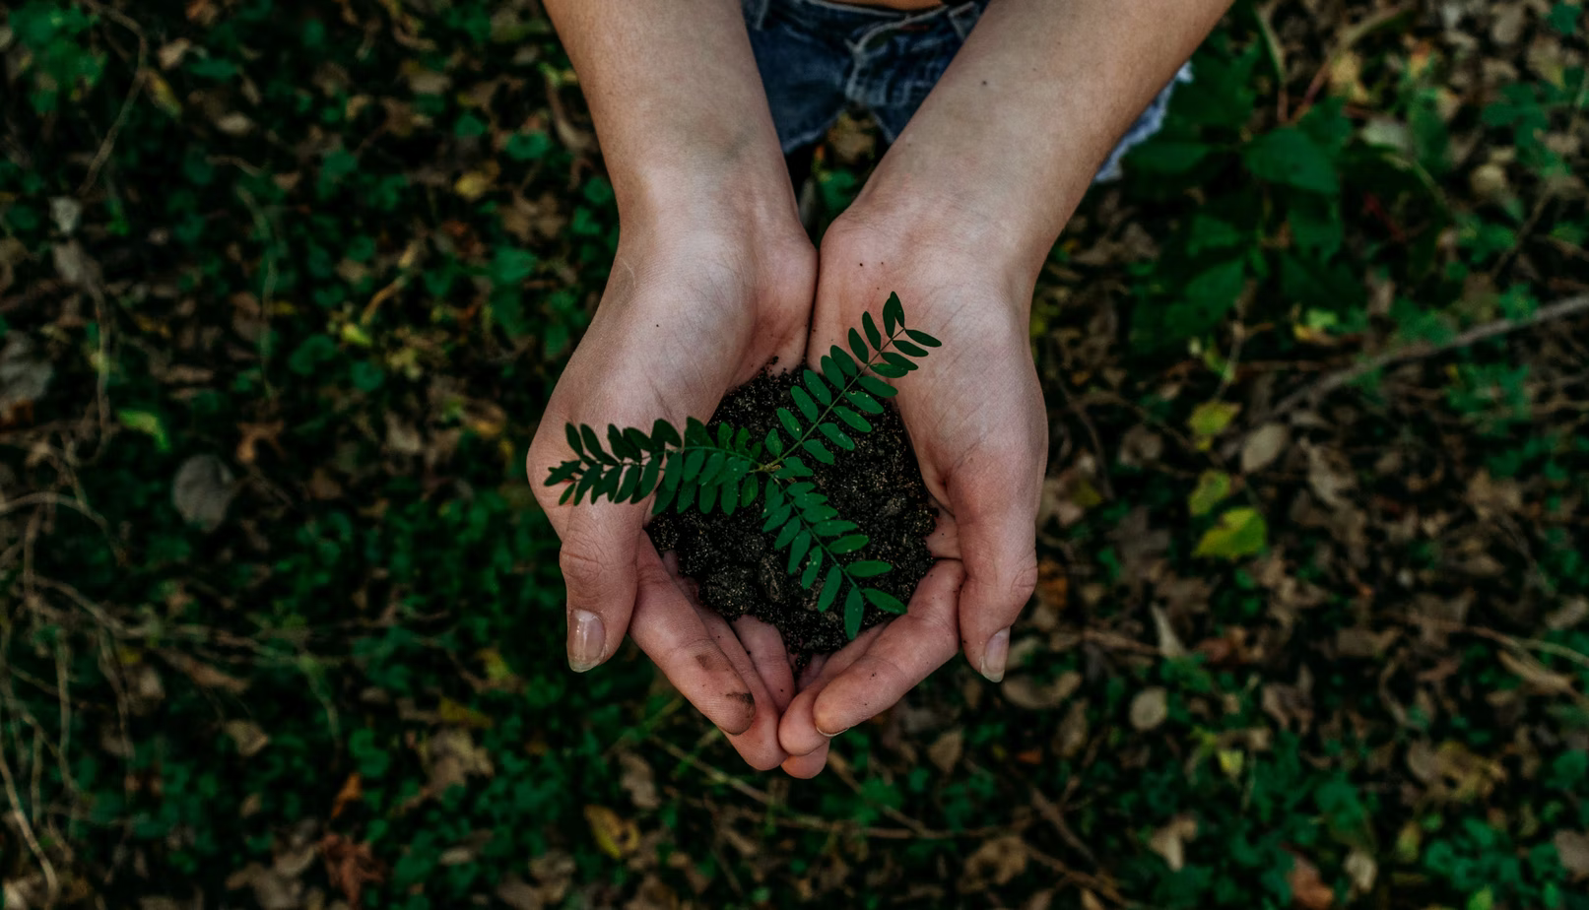
C. Climate Change Communication
Old story
Separation
Technological dominance
Human superiority over nature
Cooperation
Balance
Individual consumerism
Interbeing
New story
Scarcity
Ecological desctruction
Collective co-creation
Abundance
Post-growth
Wellbeing
Source: Photo by Noah Buscher on Unsplsh
Source: Photo by Petr Kratochvil on publicdomainpictures, Licence: CC-0
Ecological & social crisis (un-stainability)
Notes:
A science communication perspecive on climate change faces the challenge, that existing sicence communication can contribute to the question of how to tell the story about the “climate crisis” …
However it is challenged to develop new ideas for telling the new story, the sustainability story – which is not solely based on scientific facts, because it is about envisions the future, developing solutions for future problems and a long-term transformation process….

Slide 24
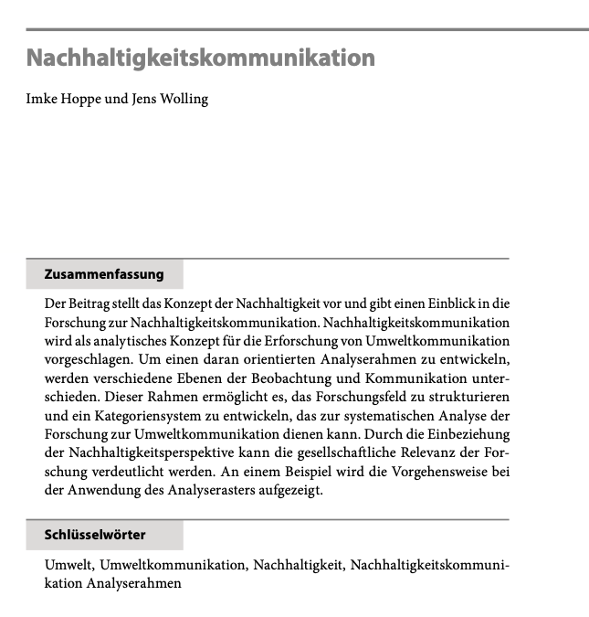

C. Climate Change Communication
Perspective on Sustainability:
„Nachhaltigkeitskommunikation wird als analytisches Konzept für die Erforschung von Umweltkommunikation vorgeschlagen.“ (Hoppe, Wolling, 2016)
Sustainability communication as analytical concept for climate change communication / research.
Notes:
One first example: work of my colleagues Hoppe & Wolling …

Slide 25
C. Climate Change Communication
Perspective on Sustainability:
„Durch die Einbeziehung der Nachhaltigkeitsperspektive kann die gesellschaftliche Relevanz der Forschung verdeutlicht werden“ (ibid.)
Notes:
Bringing in sustainability as framework to understand science & CC communication – and to do it better

Slide 26
C. Climate Change Communication
Perspective on Sustainability:
Sustainability as counter narrative (solution?) to climate change
Notes:
So what role does sustainability play in science & climate change communication research?

Slide 27
Outlook
Challenge!
Science / CC Comm: Communication about & of climate change
Communication for change?
Notes:
XXX
So, on the surface, climate change communication is about educating, informing, warning, persuading, mobilizing and solving this critical problem. At a deeper level, climate change communication is shaped by our different experiences, mental and cultural models and backgroud, and underlying values and worldviews.
Early scholars described a simple transmission model of communication, comprised of a messenger, who transmits a message, through particular channels, to specific audiences. This simple model is still commonly used in science communication, but it inherently describes a one-way process and too often assumes a passive audience who simply receives the information conveyed by the message.
More recently, as shown, scholars have recognized that this transmission model of knowledge transfer is often too simplistic. In many situations there are a variety of messengers, who craft and transmit different and sometimes opposing messages, through an ever-growing number and complexity of channels, to diverse audiences who have their own pre-existing beliefs, attitudes and values, and who actively interpret and construct their own meanings from the messages they receive, which they in turn communicate through their own networks.
Thus communication occurs within a rich, highly complex, and dynamic system of individuals, organizations, and institutions, with sometimes widely divergent knowledge, politics, and cultures. And it is through these dynamic processes that societies develop climate change awareness, concern, resilience and action.
Individuals, communities, and societies come to understand, care, and act on climate change through their communication with other people. Here, environmental studies and environmental communication is another discipline, that offers new perspectives in the intersection sof communication of media, society and the environment.

Slide 28
Reflection
Try to identify risk and climate change communication in the media
  Where is it communicated?
  How is it communicated?
What are the barrieres in communicating about climate change?
  Why is iteasy to communicate about the crisis – but not so easy to communicate about „change“ and long term developments?
  Who are the dominant voices in the climate change discourse?
Try to define „expertise“.
  Who are the „experts“ always quoted / referred to in the media?
  What makes them an „expert“?
  Try to differentiate between expert and „public authority“.

