Slide 1
Disciplines / Key Terminology
Lesson 01: Phenomena & Key Terminology

Slide 2
Where are we?
Episode/Lesson 1: Phenomena & Key Terminology
Episode/Lesson 2: Science Communication / Risk Communication
Episode/Lesson 3: Environmental and Sustainability Studies / Environmental Communication
Episode/Lesson 4: CSR / CSR Communication

Slide 3
Learning outcomes
Learning outcome 1:
Describe the diverse nature of contemporary practices of sustainability communication on an individual, organizational and societal level, the relationship of strategic communication practices to other public communication practices, the role of stakeholders and publics and the communication practitioners in and outside of organizations (corporate, NGO, political and educational institutions etc.)
Learning outcome 2:
Develop comprehensive and well-founded knowledge in sustainability communication as field of study, an understanding of how other disciplines relate to the field and an international perspective on the field.
Learning outcome 3:
Understand the key elements of communication theories, strategies and tactics, and, thus, the character and operationalization of best practice sustainability communication planning frameworks.
Learning outcome 4:
Advance your understanding of social and civic responsibility and develop an appreciation of the philosophical and social context of sustainability communication. Advance your knowledge and respect of ethics and ethical standrads in relation to communication of, about and for sustainability.
Learning outcome 5:
Anticipate and Interprete current issues and challenges of a world in transformation and social change. Develop a deep understanding of and skills to create change, develop advocacy, leadership and authorship in and for sustainability communication.

Slide 4
Overview
Current developments
  Crises
  Inter- / transdisciplinary responses needed
B. Where is Sustainability communicated?
  Political Communication
  Corporate Communication
  Individual Communicators (sustainability influencers)
C. Communication phenomena on three levels:
  Macro level
  Meso level
  Micro level

Slide 5
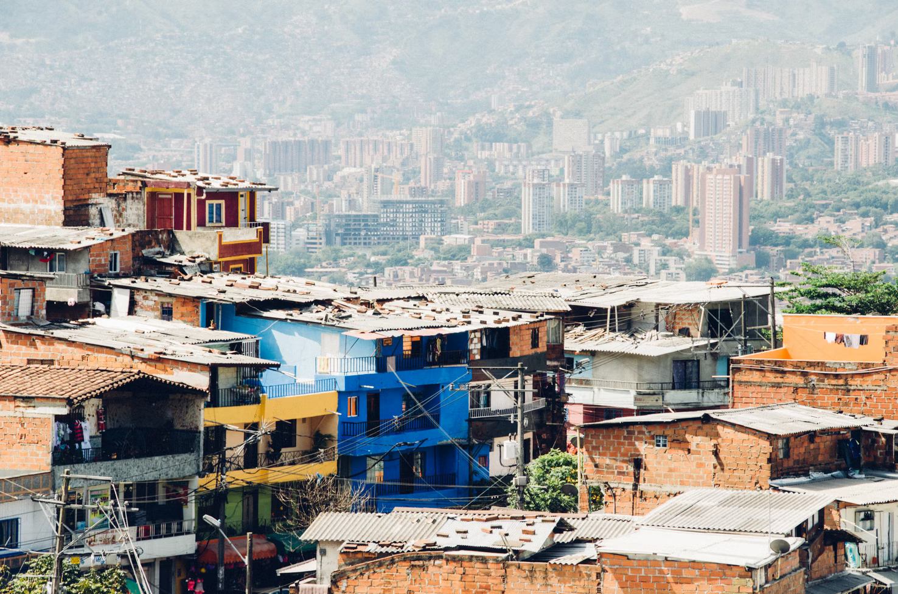
A. Current developments
Source: Photo by Milo Miloezger on Unsplash
Notes:
We are living in a rapidly changing world …
Despite some improvement in poverty levels, inequality is rising

Slide 6
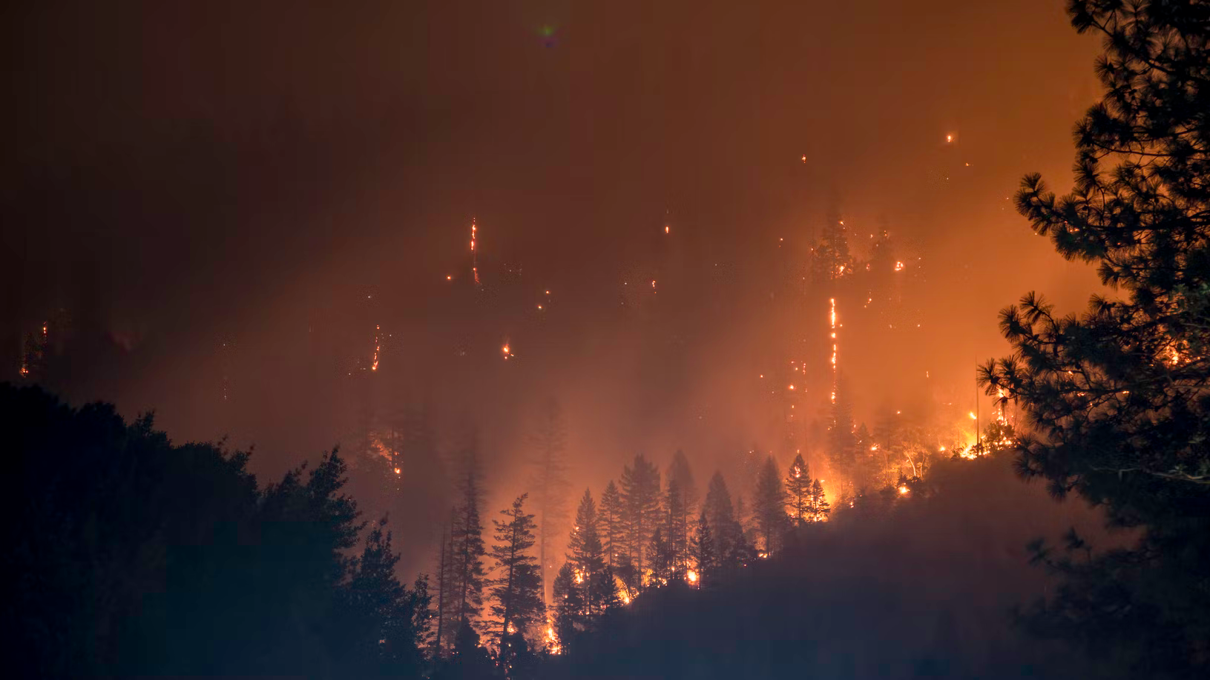
A. Current developments
Source: Photo by Matt Howard on Unsplash
Notes:
Climate crisis

Slide 7
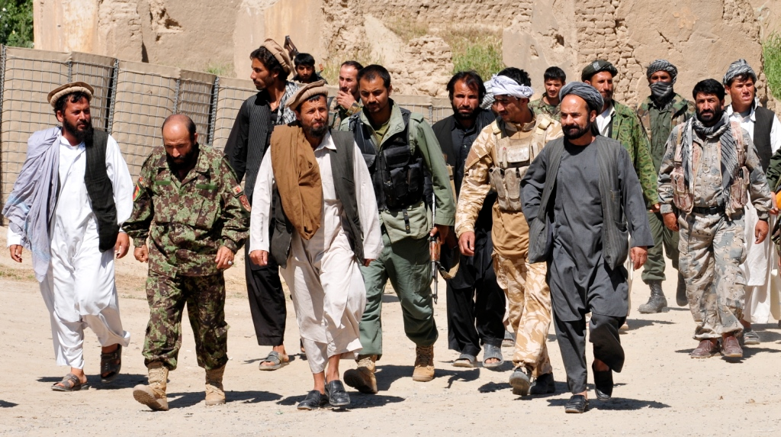
A. Current developments
Source: Photo by isafmedia on flickr, Liicence: CC-By-2.0
Notes:
Conflict and disaster to humantiy

Slide 8
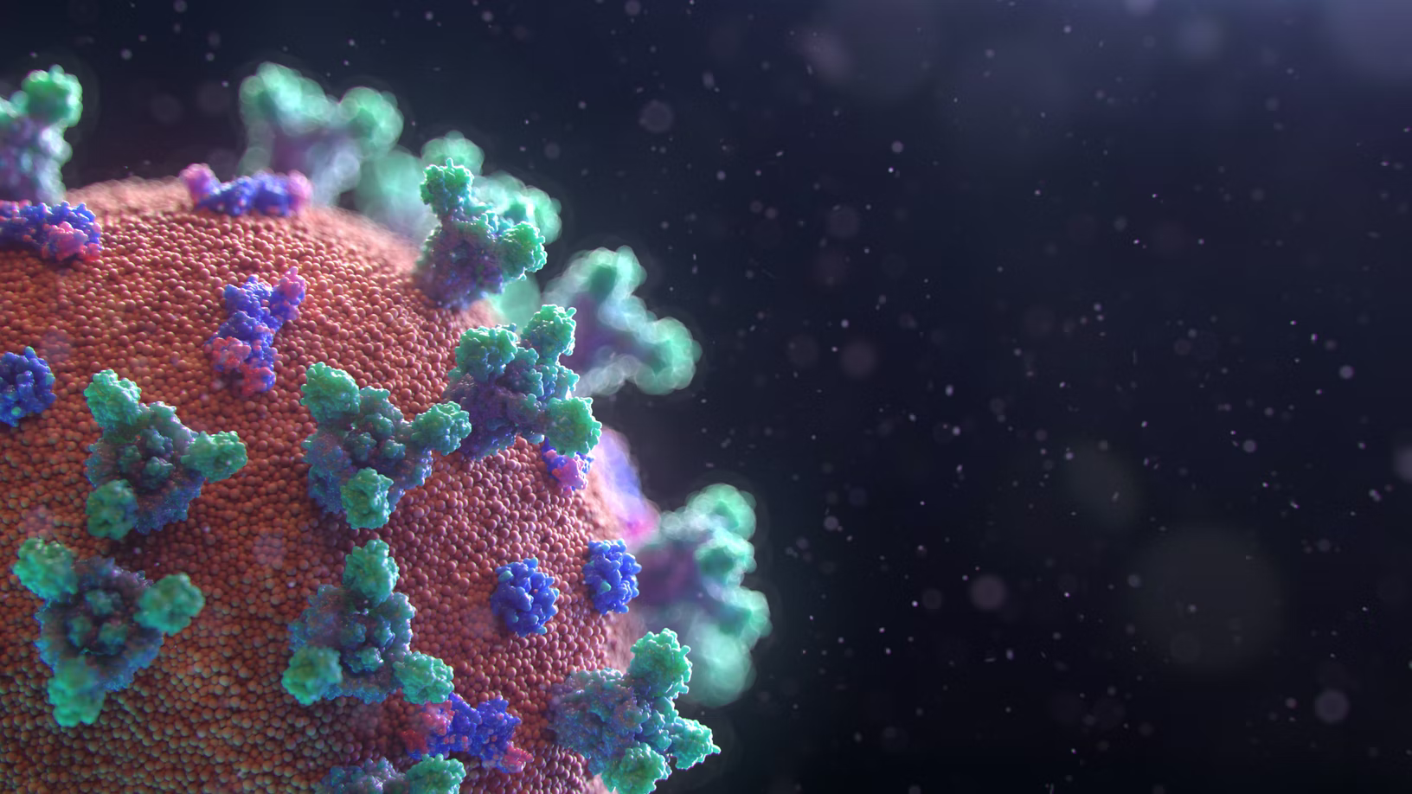
A. Current developments
Source: Photo by Fusion Medical Animation on Unsplash
Notes:
A global pandemic
All challenges for all countries

Slide 9
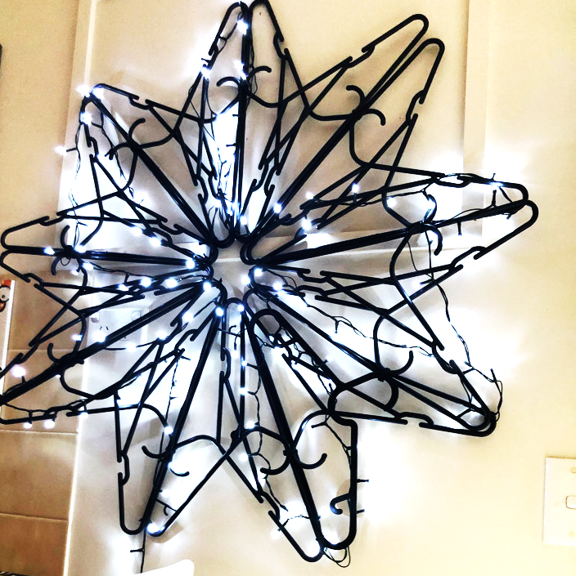
A. Current developments
Source: private
Notes:
Explosive increase of available information / Mediatization
Digitalization changes in information and communication technologies
-> Growth of data networks
However what is available worldwide is not necessarily available on a local level
Digital divide – winners and losers of global communication

Slide 10
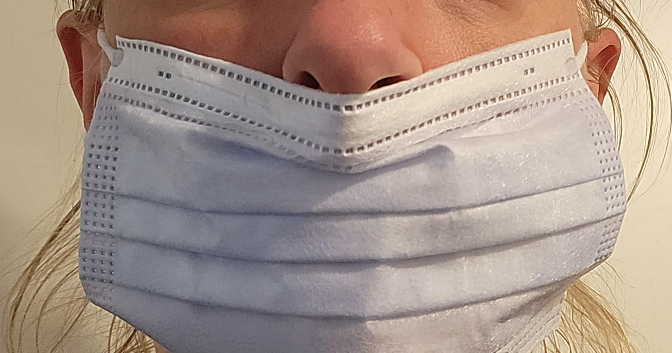
A. Current developments
Source: private
Notes:
What we experience as well: narrow solutions or individual approaches are ineffective to address complex issues in a sustainable way.
Nations working individually doesn’t work – partnerships needed – on a global scale

Slide 11
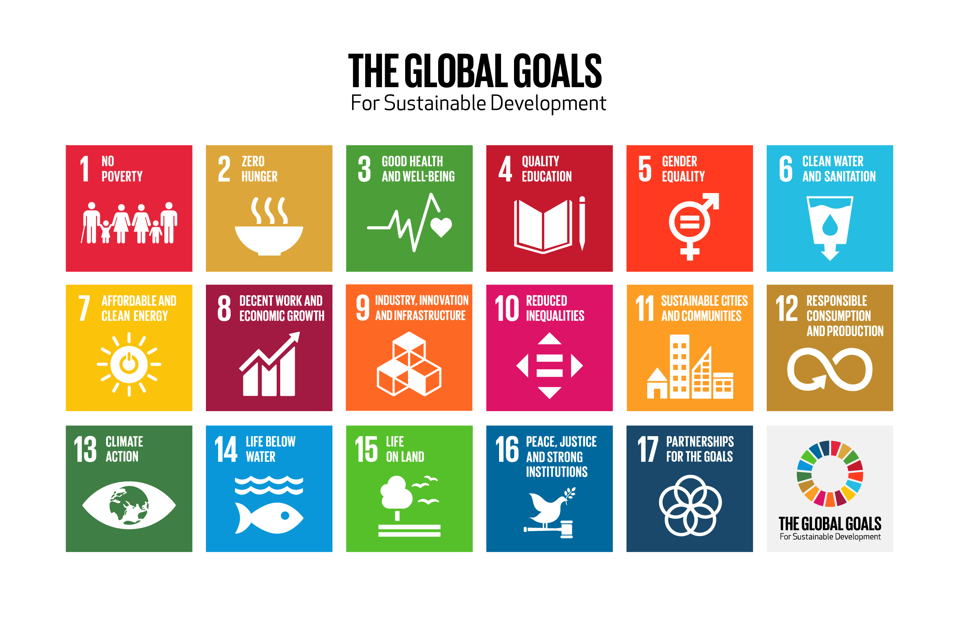
A. Current developments
Source: www.theglobalgoals.org/resources
Notes:
Here, the SDGs come into play = current global consensus on tackling issues / problems –
For sure: they are the ”best shot” so far … but how can you contribute? What is the role of organizations and institutions of all kind and shape?

Slide 12
A. Current developments
Sustainability
„Sustainable development is development that meets the needs of the present without compromising the ability of future generations to meet their own needs“ (WCED, 1987: 43)
Sustainability – principle, goal
Sustainable development – ethically motivated normative concept referring to a form of economics and lifestyle that does not endanger our future (based on „strong sustainability“)
Need for transdisciplinary response (complexity and systems thinking, transdisciplinarity, social change = cultural change)
Notes:
The underlaying understanding is based on the the Brundlandt report / “Our common future”: it tells us that …
XXX
-> let’s try to model this:

Slide 13
A. Current developments
Crisis
Facing the crisis / global pandemics and emergencies
The shortfall (lacking life's essentials; inequality and injustice)
The overshoot (global overshoot, losses to nature)
Players (spectrum of players, implementing the SDGs)
Ambiguity, imprecision and contradictions of „sustainability“
Need for transdisciplinary response (complexity and systems thinking, transdisciplinarity, teamwork, social change = cultural change)
Notes:
The complexity of the problems and the development of solutions need action – but mainly in terms of
Critical thinking
Reflection
Changed practices
Need to unpack causes and drivers that led to the developments …
Transdisciplinary responses – teamwork, not only science or theories needed – but the transfer of scientific facts into practice, into participatory approaches, planning, assessments of change and empowerment!

Slide 14
A. Current developments
Inter- / transdisciplinary approach to Sustainable Development
SD agenda
Problem
Solution
Problem
Solution
Problem
Notes:
So what does Sustainabiity as normative principle, and sustainable development as goal and agenda do – what is happening related to these frameworks?

Slide 15
A. Current developments
Inter- / transdisciplinary approach to Sustainable Development
SD agenda
Problem
Solution
Problem
Solution
Problem
Discipline 1
Discipline 2
Discipline 3
Discipline x
Notes:
From a scientific point of view, certain disciplines are working in this dialectic – of problems and solutions, of crises and possibities to overcome the crisis and to face the related challenges.

Slide 16
A. Current developments
Inter- / transdisciplinary approach to SD
Cultural change
SD agenda
Social change
Problem
Solution
Problem
Solution
Problem
Discipline 1
Discipline 2
Discipline 3
Discipline x
Notes:
The most fascinating aspect is – the more thinking, the more research, and conceptualizations are happening, the more we create change – kind of automatically! Social change, and with social change a cultural change, we can create a “culture of sustainability”

Slide 17
A. Current developments
Inter- / transdisciplinary approach to SD
Communication
Cultural change
SD agenda
Social change
Problem
Solution
Problem
Solution
Problem
Discipline 1
Discipline 2
Discipline 3
Discipline x
Notes:
And this is where communication comes into play! Communication is the process that facilitates! That facilitates the creation of solutions, and therefore it facilitates change.
It initiates, it stimulates and it facilitates the social construction of a culture of sustainability.

Slide 18
B. Where is Sustainability communicated?
But where does communication happen – and how?
Who communicates about sustainability?
And to whom?
And what are the communication channels?

Slide 19
A. Where is Sustainability communicated?
Political communication
Corporate / organizational communication
Media / public communication
Individual communication
Notes:
What we can see so far is …

Slide 20
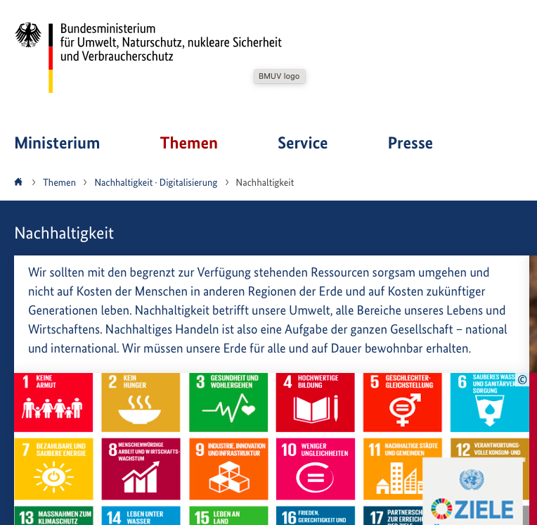

1. Political Communication
Source: www.theglobalgoals.org/resources
Source: https://www.bmuv.de/themen/nachhaltigkeit-digitalisierung/nachhaltigkeit

Slide 21
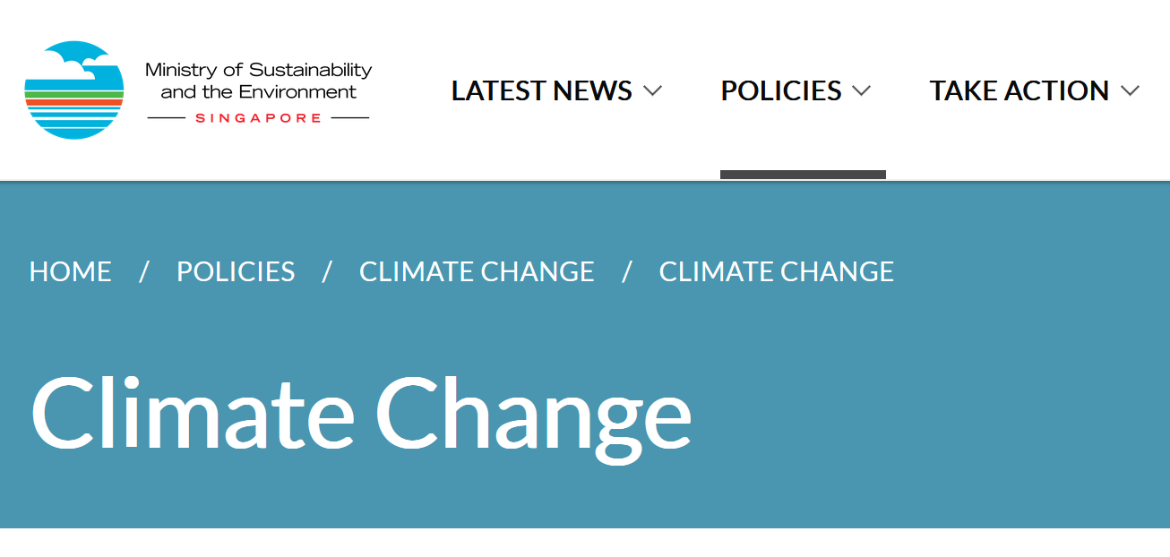
1. Political Communication
Source: Screenshot: msg.gov.sg, 1/2022

Slide 22
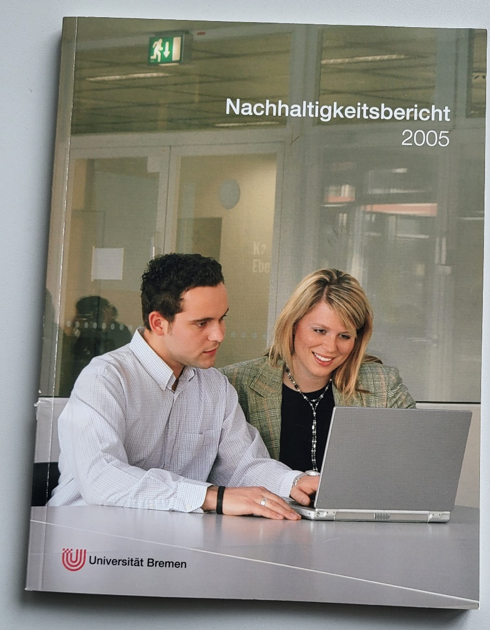
2. Corporate Communication
Source: private

Slide 23
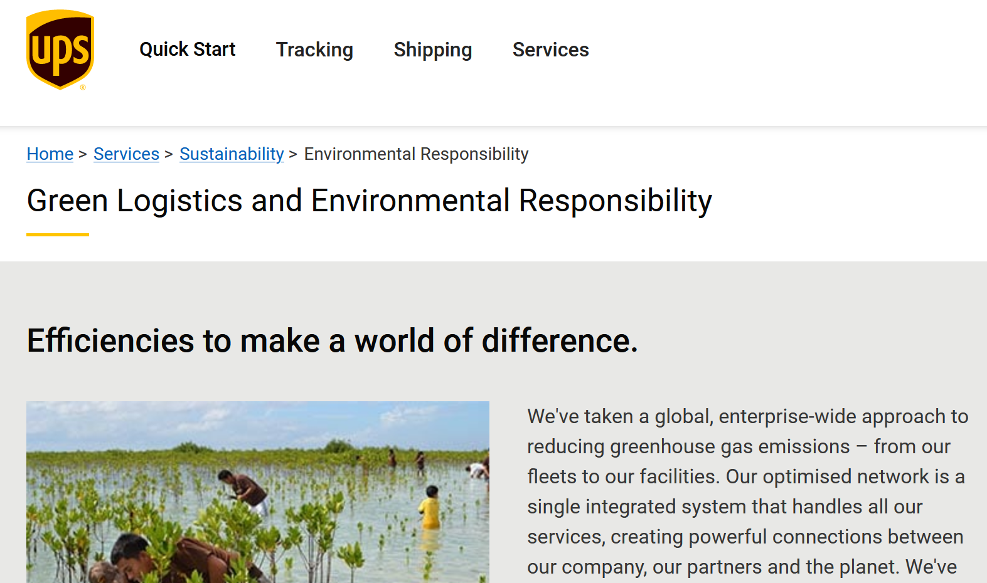
2. Corporate Communication
Go Green!
Our Responsibility!
Be Green!
Source: https://www.ups.com/mt/en/services/sustainability/environmental-responsibility.page?

Slide 24
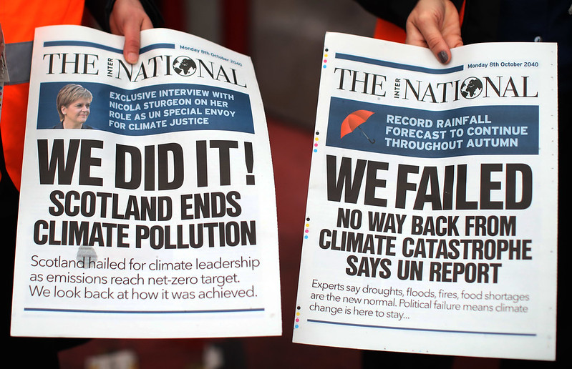
3. Public Communication / Media
Source: Photo by Friends of the Earth Scotland on flikr, Licence: CC-By-2.0

Slide 25
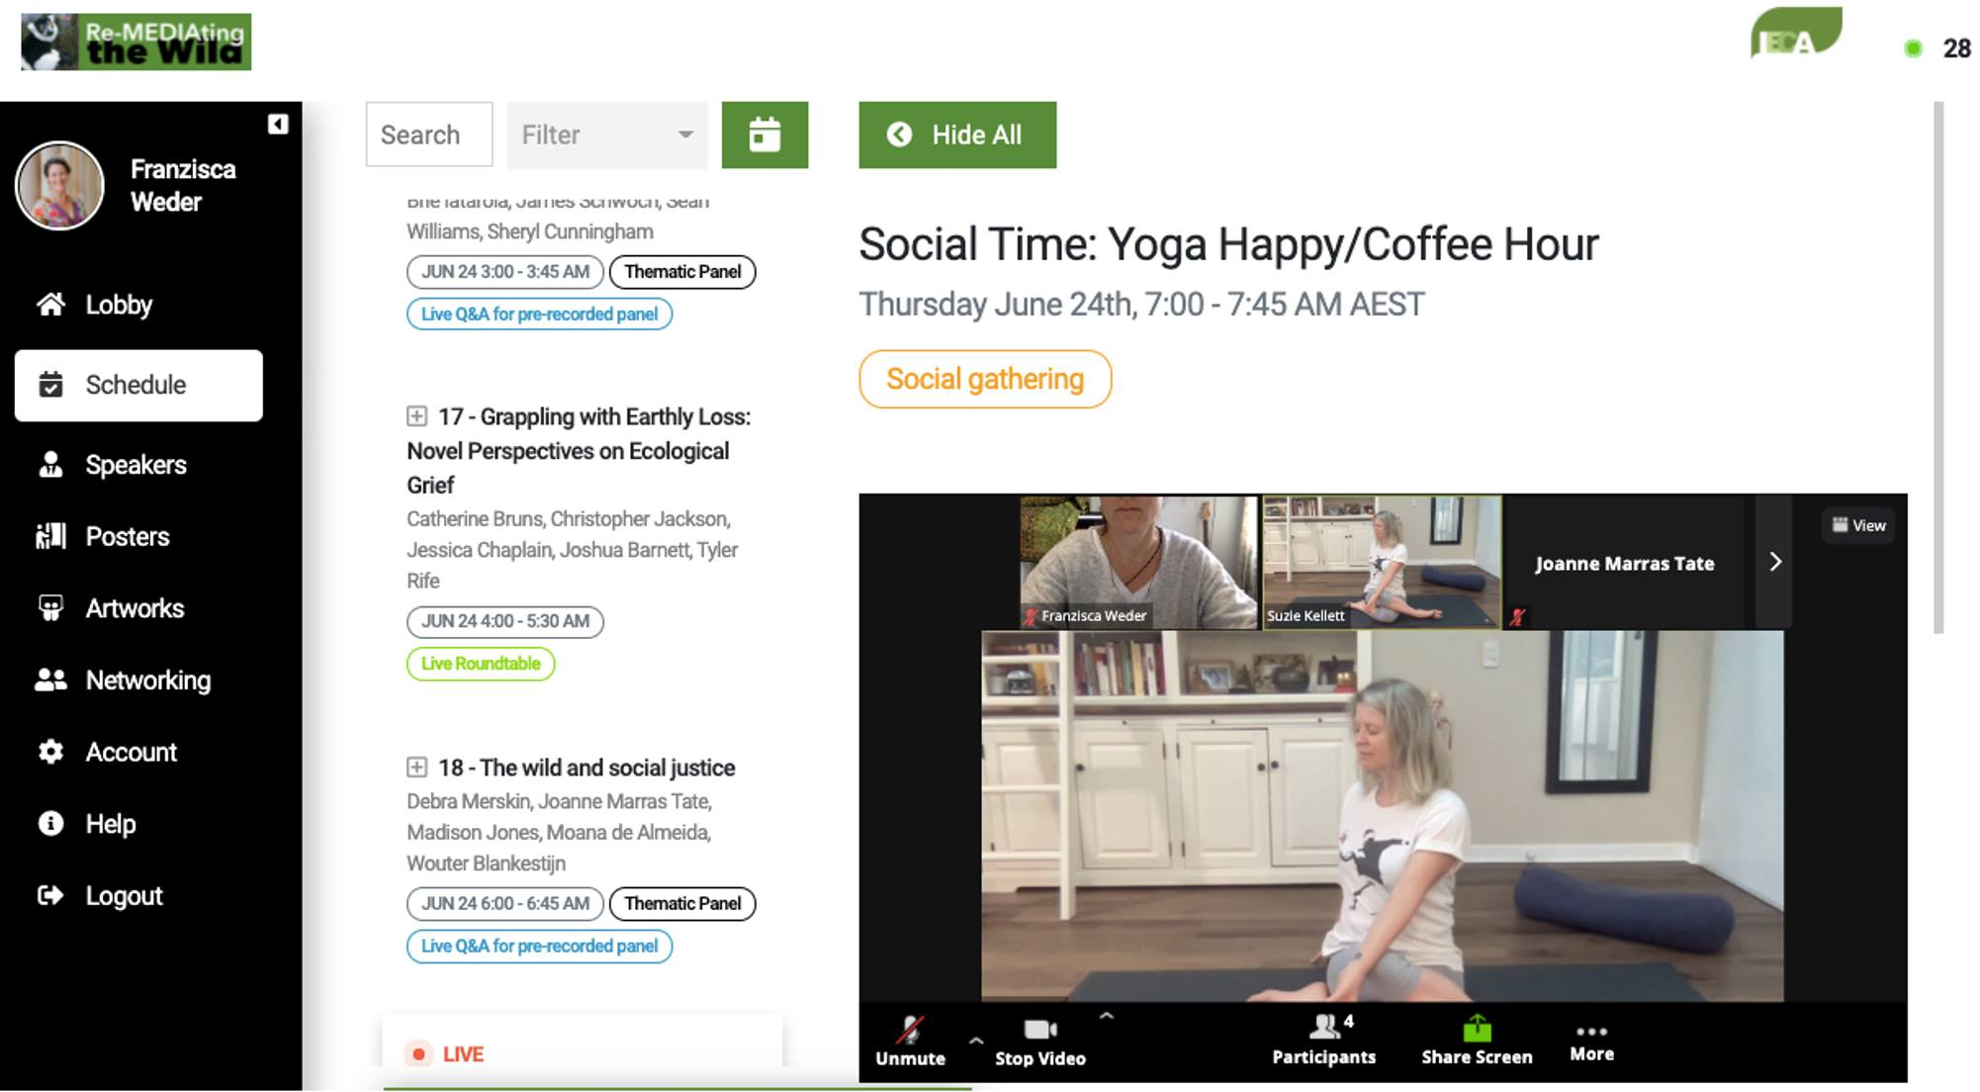
4. Social Media / Individual Communication
Source: private

Slide 26
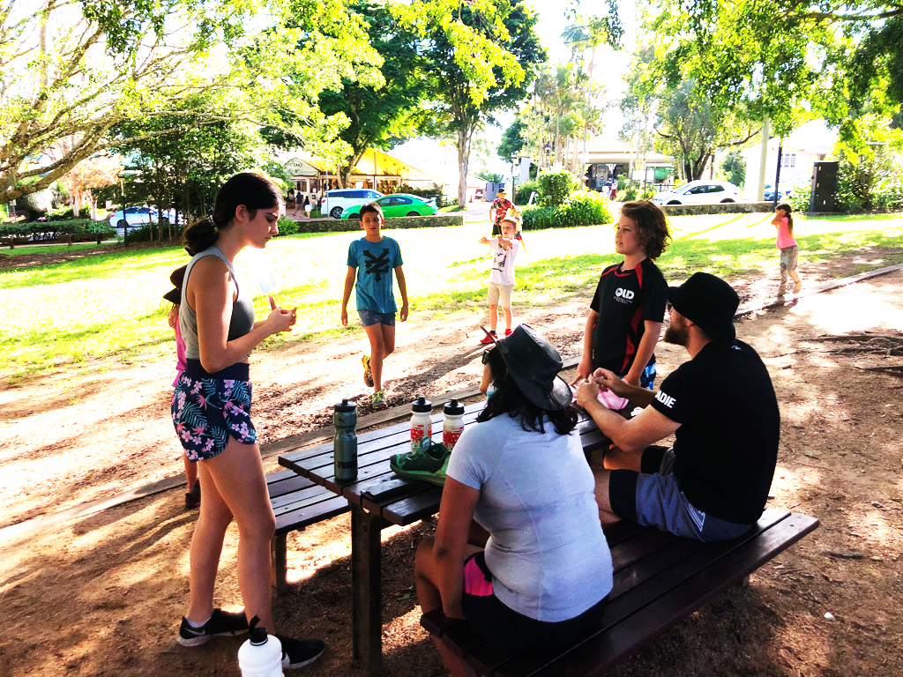
4. Social Media / Individual Communication
Source: private

Slide 27
C. Communication Phenomena on three levels
Inter- / transdisciplinary approach to SD
Communication
Communication
Cultural change
SD agenda
Social change
Problem
Solution
Problem
Solution
Problem
Discipline 1
Discipline 2
Discipline 3
Discipline x
Notes:
So when we go back to our understanding of Sustainable development … and communication as facilitator & processes of reproduction and representation of change … and the questions of
- who communicates about sustainability?
- And to whom?
And what are the communication channels?
And what common sense about sustainability is created?
Then …

Slide 28
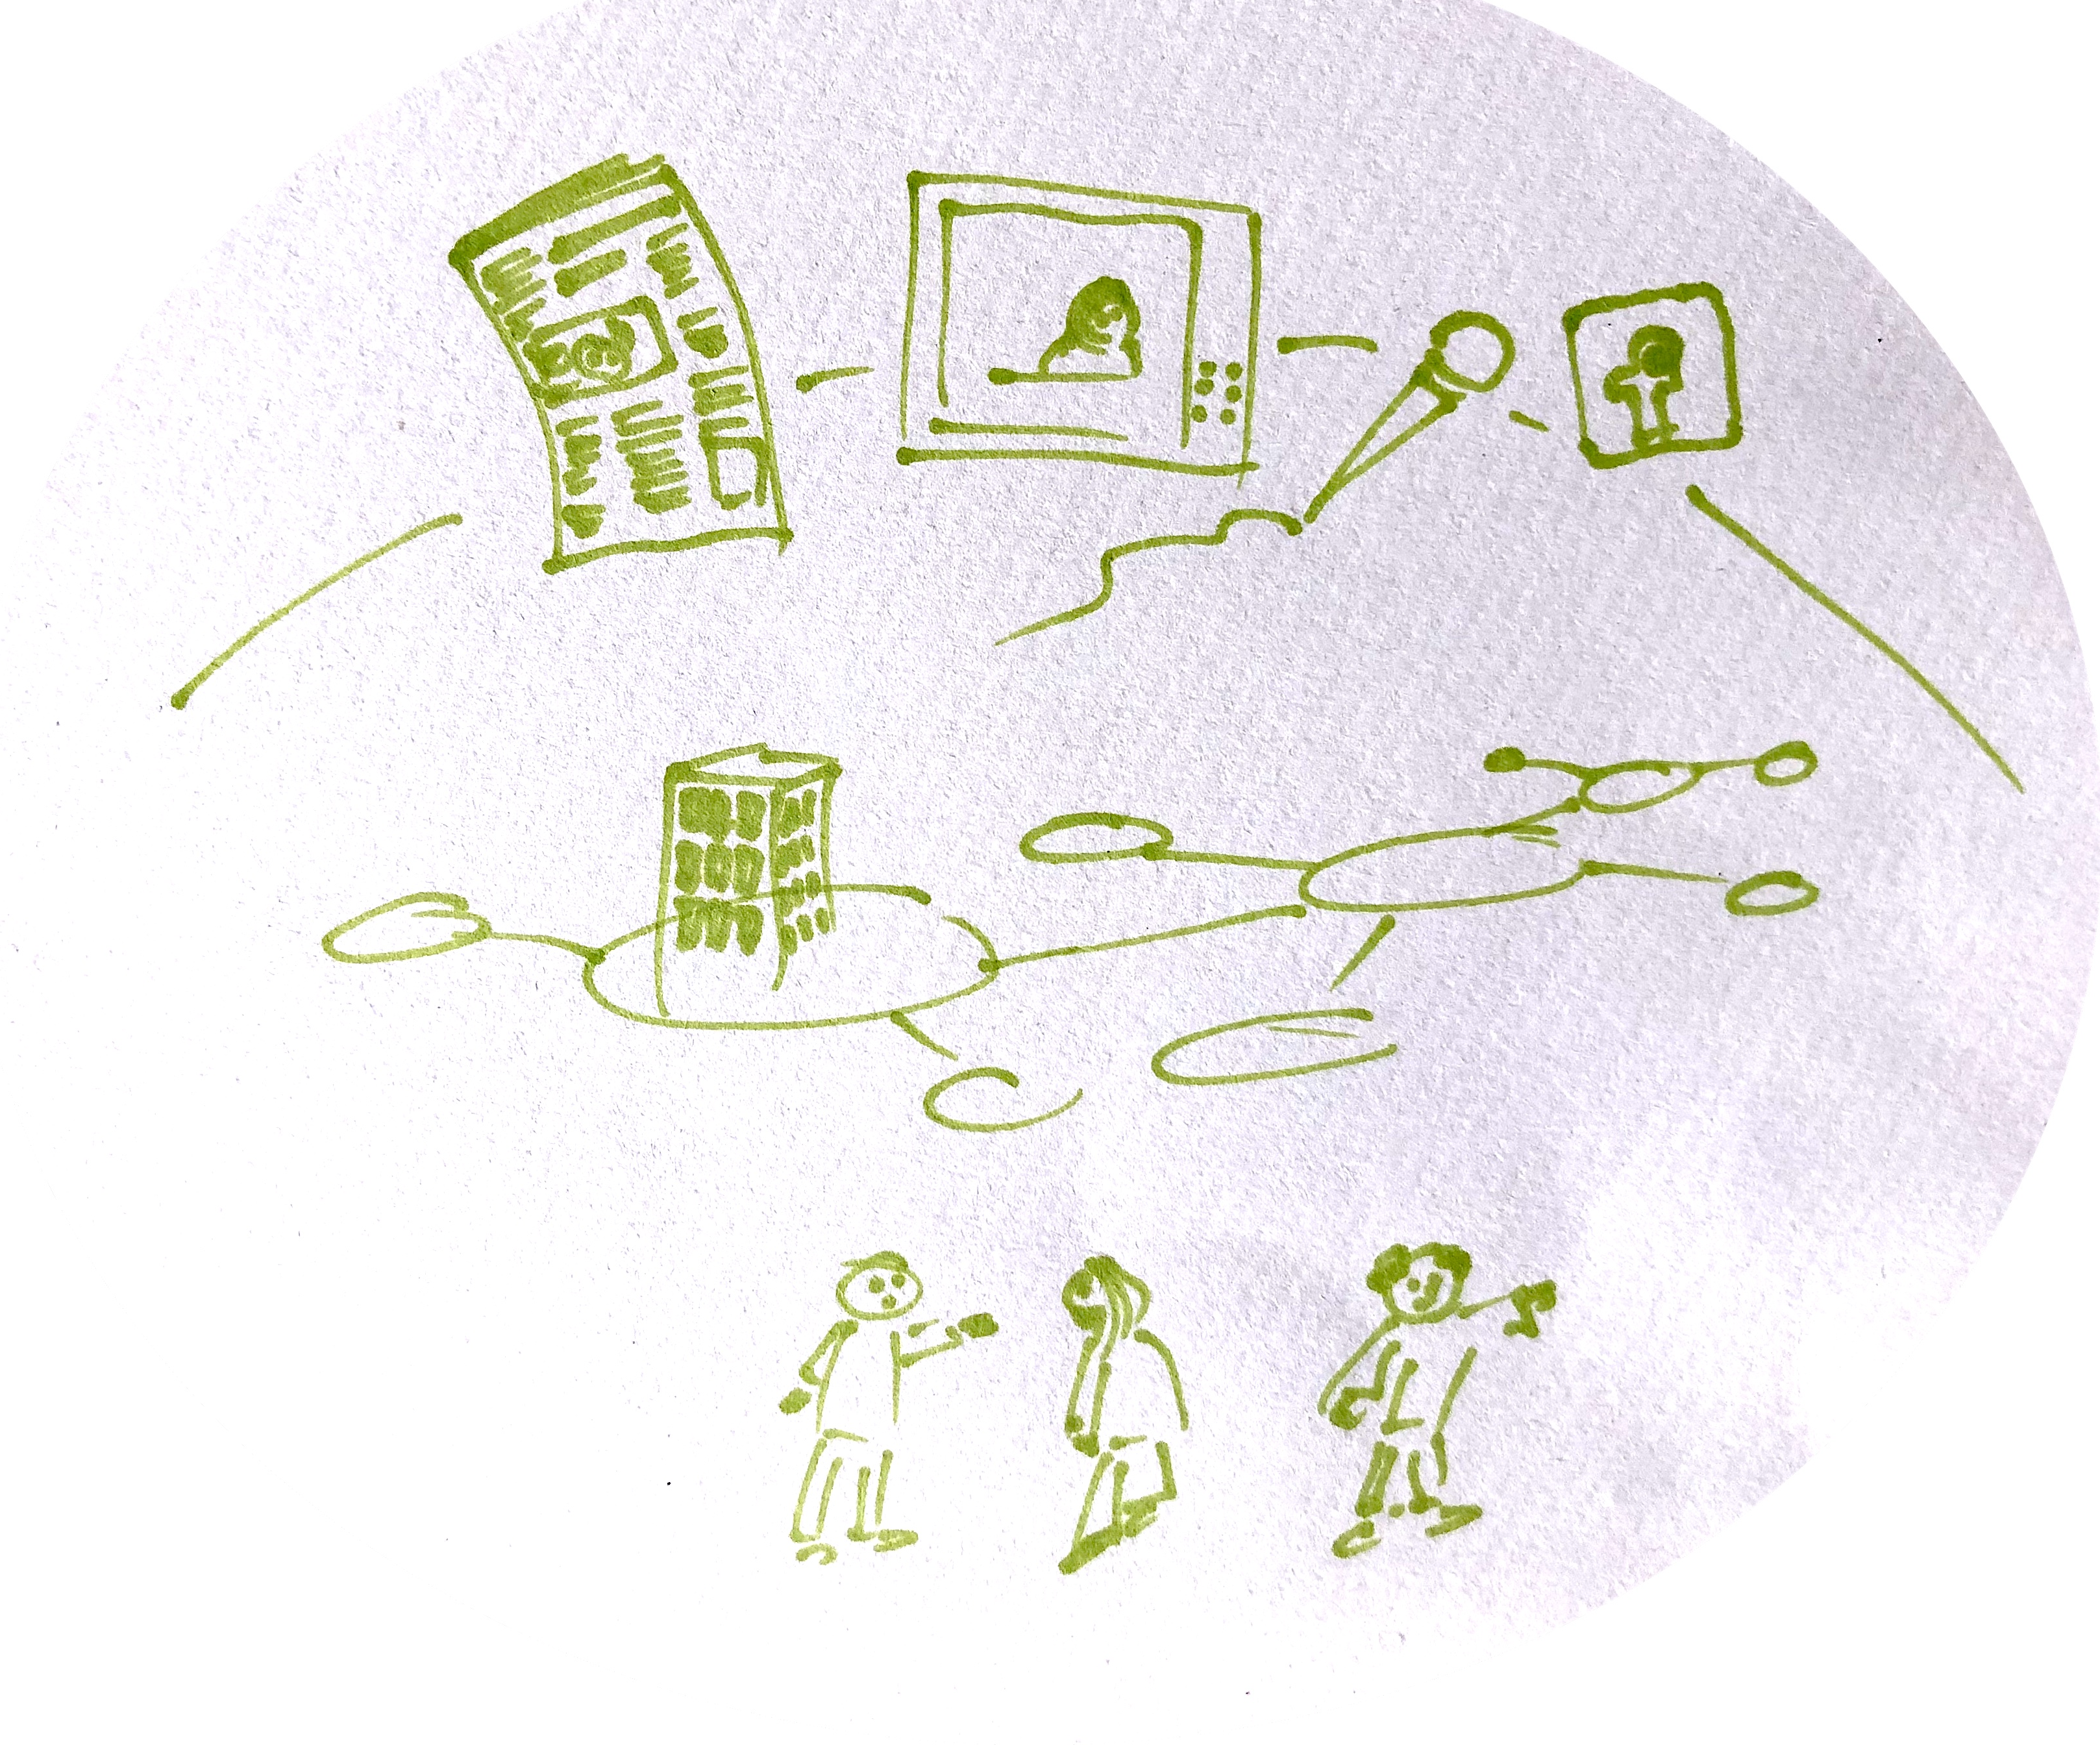
C. Communication Phenomena on three levels
_MACRO: social system, cultural context, public discourses/public sphere
Communication
_MESO: organizations, institutions, stakeholder/audiences
_MICRO: intra-/interpersonal communication
Notes:
We can differentiate between …

Slide 29
C. Communication Phenomena on three levels
Sorting Sustainability Communication
MACRO: Sustainability as WORLDVIEW, Sustainable development ; political/policy perspective (definitions, SDGs., national policies …)
MESO: Sustainability as PRINCIPLE/org. perspective, communication about & of sustainability (activities…), communication for sustainability (contribution)
MICRO: Sustainability as LIFESTYLE: morality!!! Sustainable = good, proudness, advertisement, media comm.; sustainability as vehicle for communication

Slide 30
OUTLOOK
Science & Risk Communication
Strategic / CSR Communication
Sustainability Communication
Environmental and Social Change Communication
Disciplines
Communication
Discipline 1
Discipline 2
Discipline 3
Discipline x
Notes:
And there are a few disciplines – who try to better understand communication processes related to change, sustainable development and new norms like sustainability on
A micro level
A meso level
And a macro level
These are predominantly …

Slide 31
OUTLOOK
Science & Risk Communication
Strategic / CSR Communication
Sustainability Communication
Environmental and Social Change Communication
Disciplines
Episode 2.02: Science Communication / Risk Communication
Episode 2.03: Sustainability studies & Environmental Communication
Episode 2.04: CSR / CSR Communication
Communication
Discipline 1
Discipline 2
Discipline 3
Discipline x
Notes:
… this is what we gonna look at in the next episodes of this lecture #2!

Slide 32
Reflection
Try to identify sustainability communication in your cultural, social, political and media context:
  Where is sustainability explicitly communicated?
  Where is sustainability used as „label“?
  Doe you talk about „sustainability“ with your family / friends? If so, related to which issues?
Make yourself familiar with the SDGS:
  Why isn‘t there a goal for communication?
  If you would be involved in creating SDG #18, what would it be about?
  How could communication be captured?
Evaluate the SDGs related to their potential to be used for/in communication.

